Slide 1
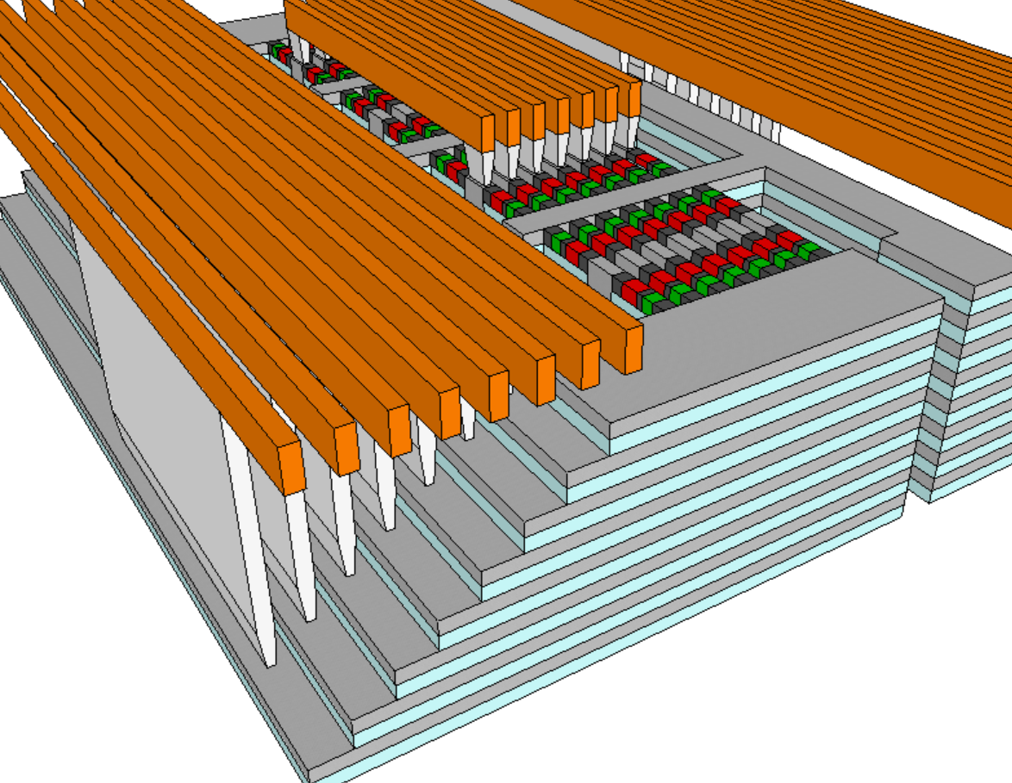
Cubic Architecture for Cross Point Memory Array
Prashant Majhi, Khaled Hasnat & DerChang Kau
3D NAND, 3DXP, 3D XPoint, 1S1R, Replacement Metal, Subtractive Process
Aug/14/2018
Context:
  Effective cell size of cross point memory cell = [Cell Pitch]² / [number of memory stacks]
Problem Statement:
  The best known or best technically feasible number of memory stacks is 6. Scaling path will be limited to memory pitch (lateral dimension) when maximum number of memory stack is reached.
This invention opens up the scaling path to increase number of stack without multiplying critical patterning process cost.
The access of memory cell in this new cubic array deploys 3-dimensional select with a unique set of wordline (WL), bitline (BL) and tier (TE) addresses while inhibit the rest of WLs, BLs and TEs, as illustrated in Fig.1 below. See also attached example in slide 2 for random access of cubic array.
The constructs of the cubic array are achieved either by subtractive or replacement processes. The embodiments of replacement process flow is illustrated in the slides 3 to 18. The constructed array is shown in Fig. 2.
Teardown or reverse engineering to detect infringement.
Fig. 1 Cubic Array Schematics
Current 3DXP increases bit density by pitch scaling and stacking layers. But these also increase wafer cost due to multiplying the numbers of critical litho steps when increase number of stack
Intel Optane™ technology delivers 4 decks of memory at pitch of 41nm. The effective cell size is (41nm)²/4=420nm².

Slide 2
Random Access of Cubic Cross Point Memory Array
4-Tier XOR 2WLX4BL mini Array
SET
RESET
READ
V_{BL,desel}
V_{BL,sel}
V_{BL,desel}
V_{T,Reset}
V_{Tier,sel}
V_{T,Set}
V_{WL,sel}
WL₁
V_{WL,sel}
V_{BL,sel}
WL₀
V_{Tier,sel}
For I_{RESET}
V_{WL,desel}
For I_{SET}
For I_{READ}
V_{Tier,desel}
V_{Tier,desel}
V_{Tier,desel}
BL₀
BL₁
BL₂
BL₃
Tier₀
Tier₁
Tier₂
Tier₃
V_{BL,desel}
V_{WL,desel,}
V_{Tier,desel}
V_{Tier,desel} can also use high impedance float by
Switching off the deselected Tier bias circuit
0V
Accessing bit with single
Tier, WL and BL selected
V_{WL,sel} illustrated is used as a current clamp for RESET/SET/READ operations.
It can be a simple on/off switch with additional current control circuity outside array

Slide 3
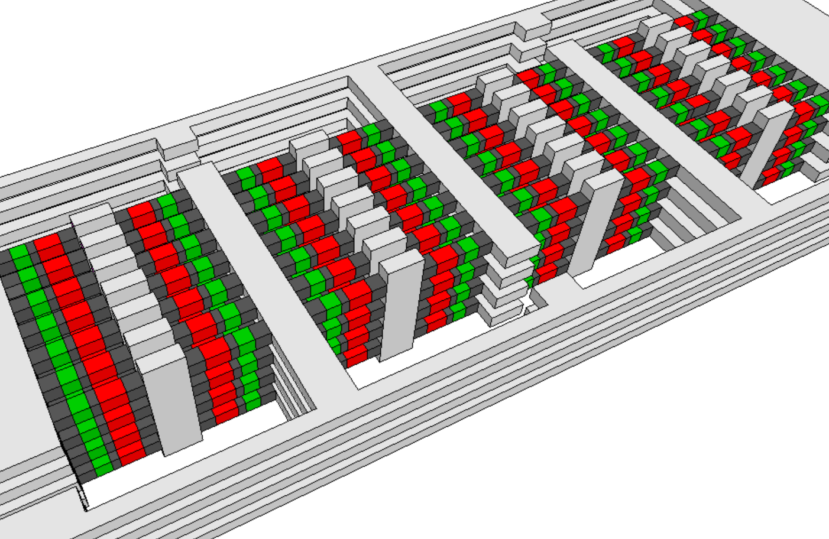
3D XPoint™ Cubic Array Architecture
3D XPoint
XOR array architecture –
Dielectric isolation removed for
Tier to Pillar 3D connectivity visual purpose

Slide 4
Replacement Tier/Pillar Process Flow

Slide 5
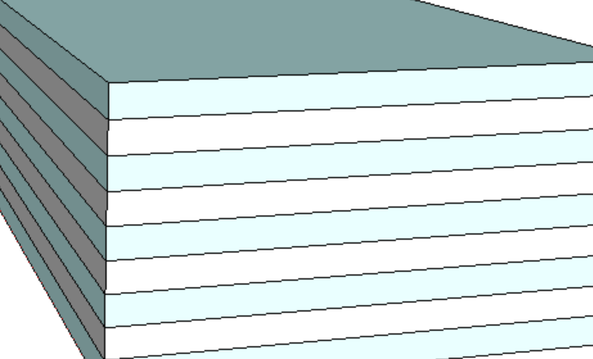
Memory Tier Stack – 4 Tiers in the exhibit
Dielectric, eg, oxide
Sacrificial material, eg. silicon
Cell 2nd Cut
Cell 1st Cut
Memory Tier
WL Poly
BL Poly
Silicon Pillar
Alternate stacking sacrificial layer and dielectric layer to build memory tiers.

Slide 6
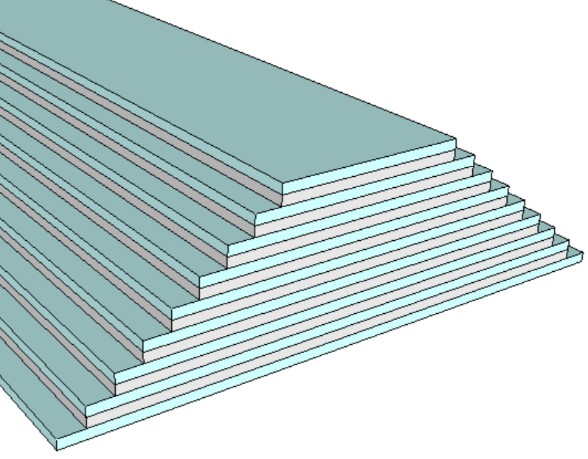
Tier Stair Formation – an 8-tier exhibit
Tier Stair Etch
Mask
Mask
Mask
Mask

Slide 7
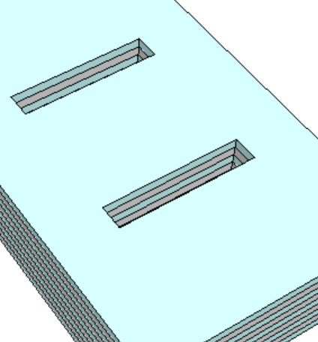
1st Cut: Opening for Cell Stack Materials
A
A’
A
Cell 2nd Cut
Cell 1st Cut
Memory Tier
A’
WL Poly
BL Poly
Silicon Pillar
Tier Stair not shown

Slide 8
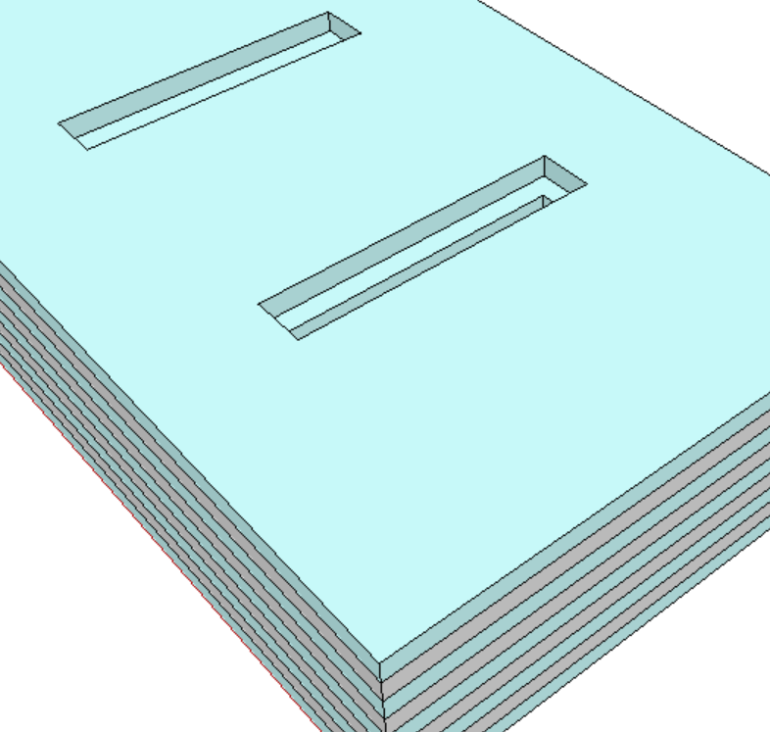
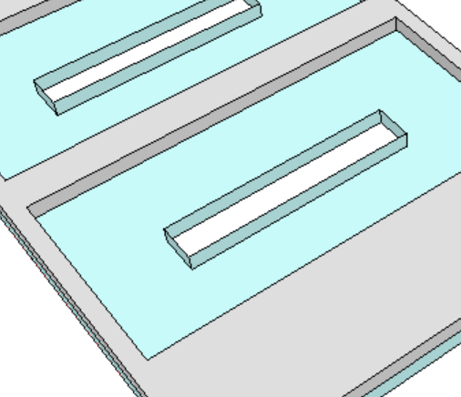
Tier Sacrificial Layer Recess Etch
A
A
A’
A’

Slide 9
1st Electrode
First Electrode Conformal Dep
First Electrode Recess Etch
A
A’
A
A’

Slide 10
SD
SD Conformal Dep
SD Recess Etch
A
A’
A
A’

Slide 11
2nd Electrode & PM
2nd Electrode dep/etch, PM Conformal Dep
PM Etch
PM Etch
A
A’
A
A’

Slide 12
3rd Electrode & Fill: Replacement for Pillar
2nd Electrode Dep/Etch
Sacrificial Pillar Nitride Dep Etch/CMP
A
A’
A
A’

Slide 13
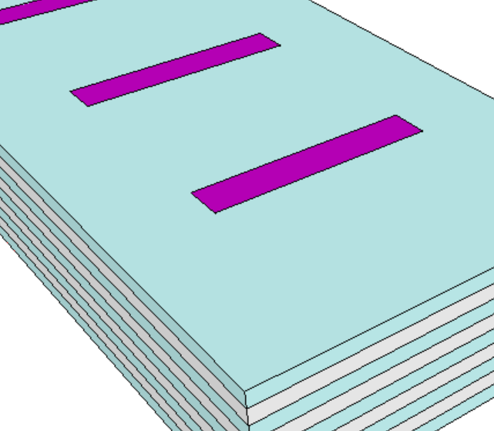
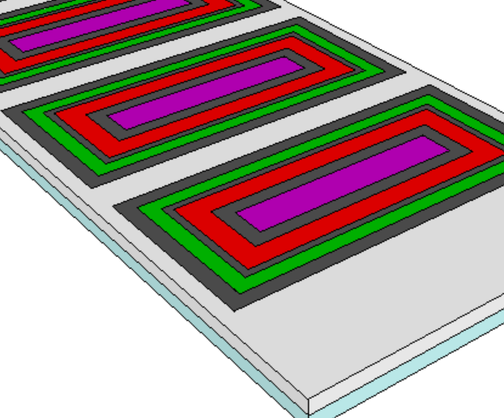
End of 1st Cut module
Tier Dielectric, eg. Oxide
Sacrificial material for Pillar metal (BitLine), eg. Nitride
A
A
A’
A’
Memory
1^{st,} 2nd, 3rd Electrode,
Selector
Sacrificial material for Tier metal (WordLine), eg. amorphous Silicon

Slide 14
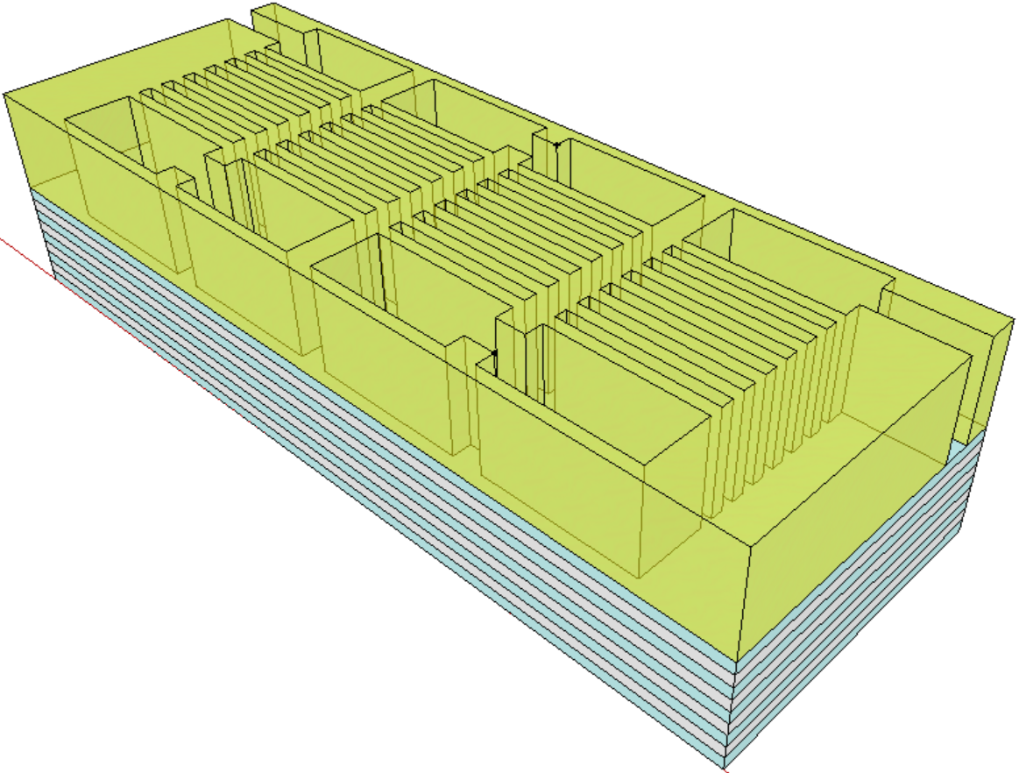
2nd Cut definition
Cell 2nd Cut
Cell 1st Cut
Memory Tier
WL Poly
BL Poly
Silicon Pillar

Slide 15
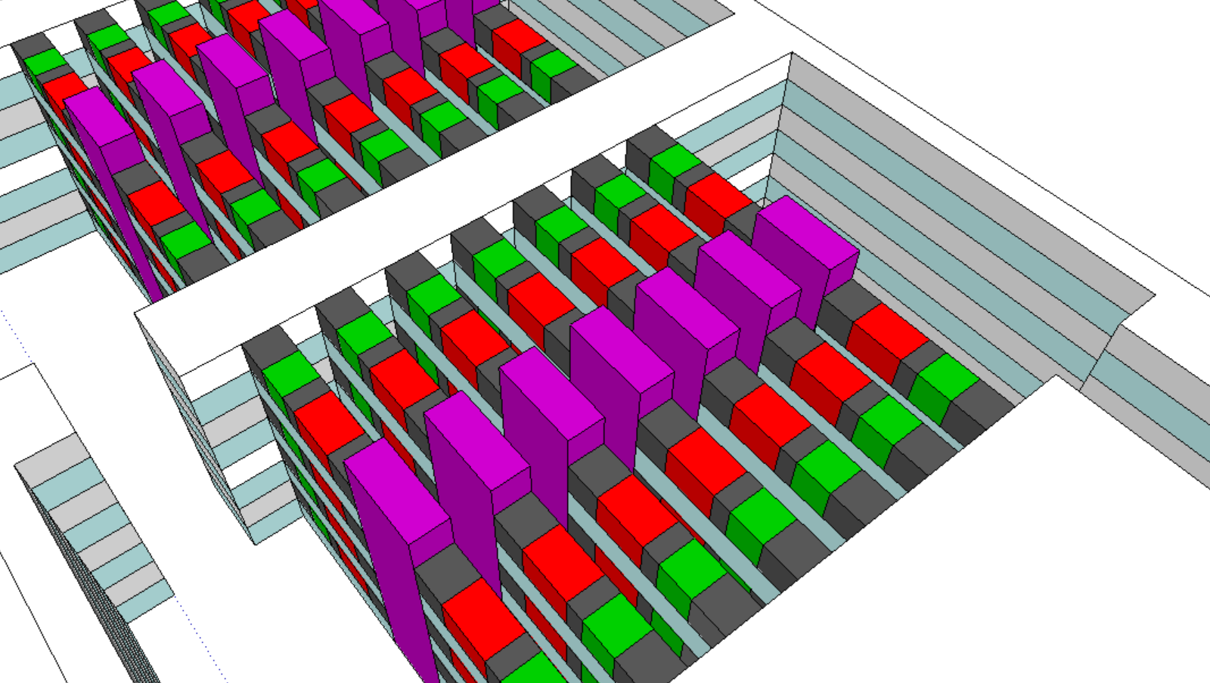
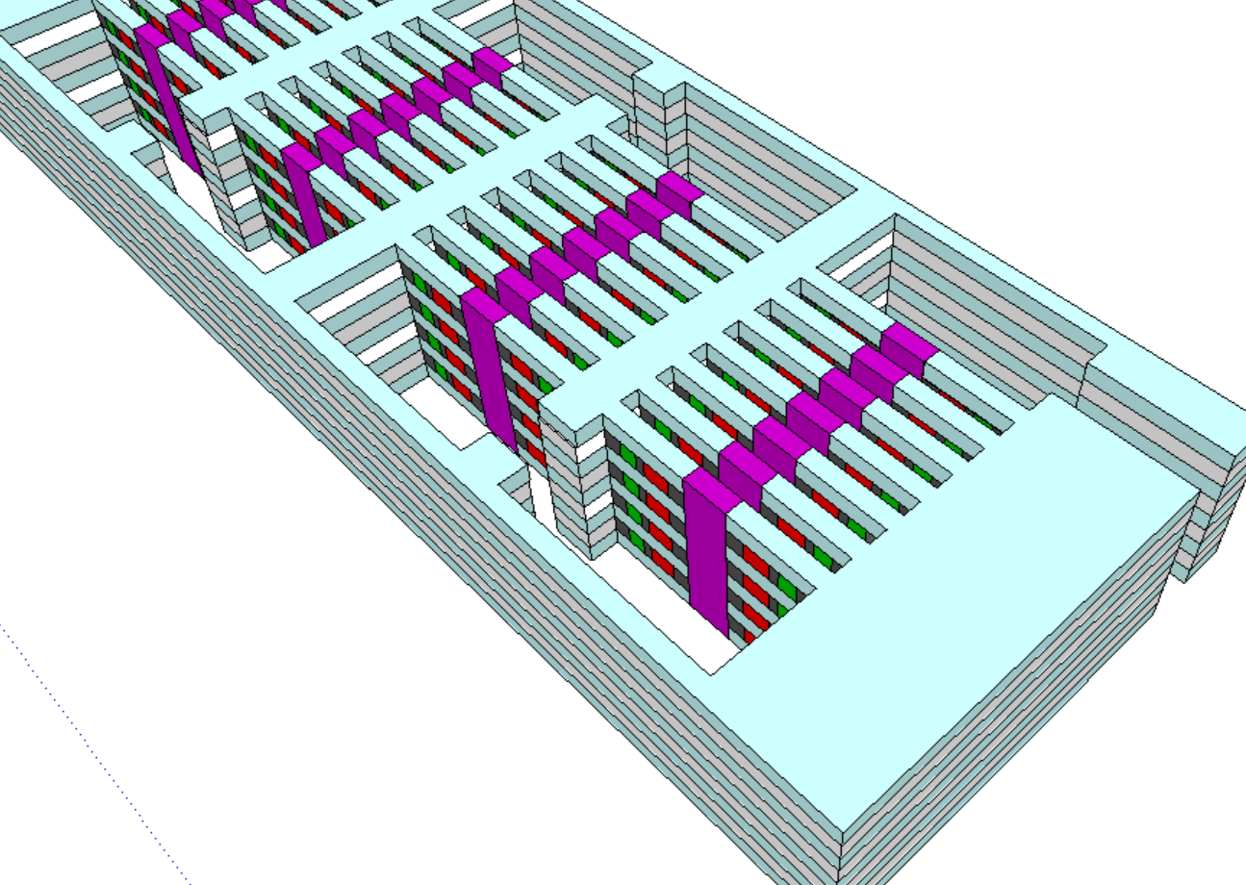
2nd Cut
Top Dielectric Removed

Slide 16
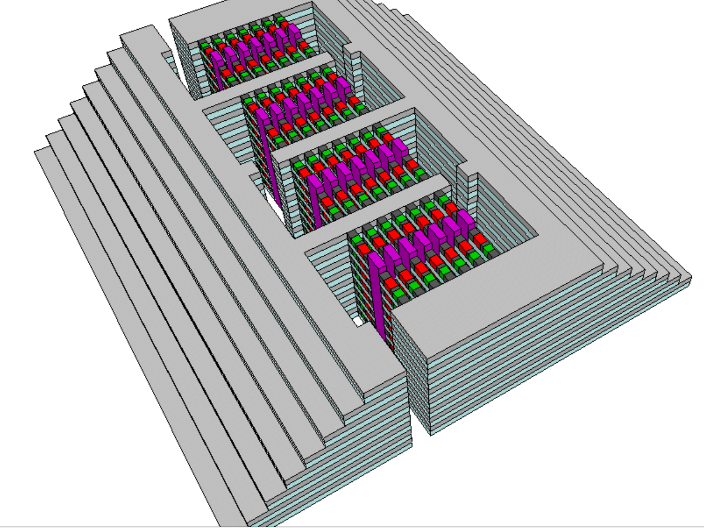
Tier Metal Replacement
Isotropic sacrificial tier material (eg. amorphous silicon) etch then conformal Metal dep
(eg. ALD W) fill the gap,
followed by anisotropic
metal etch removing
metal in the 2nd cut
opening region then gap
filled with oxide(not shown)
With
top dielectric
removed, Array with
Tier Stair (termination)

Slide 17
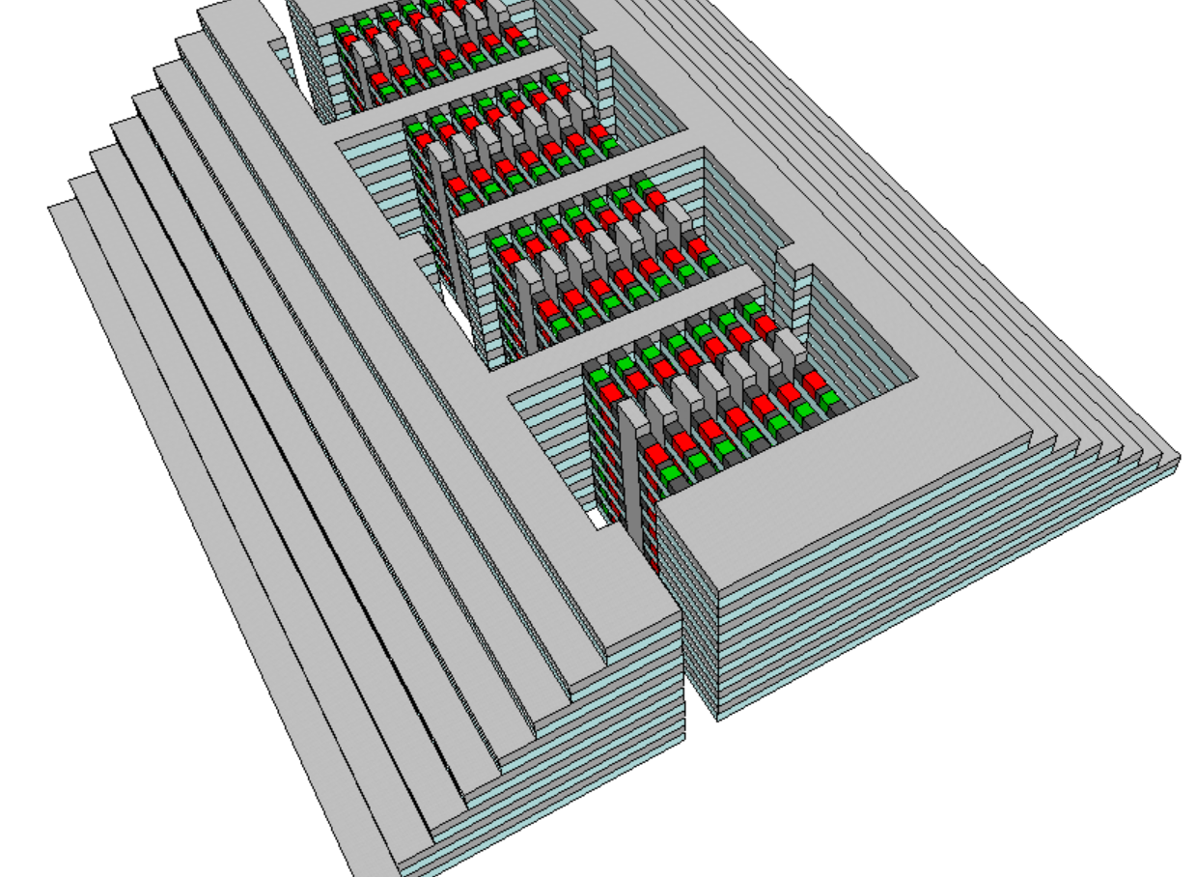
Pillar Metal Replacement
Isotropic sacrificial pillar material (eg. nitride) removed then
Metal (eg. W) fill the gap
gap filled oxide and top tier dielectric are not shown
(not shown)

Slide 18
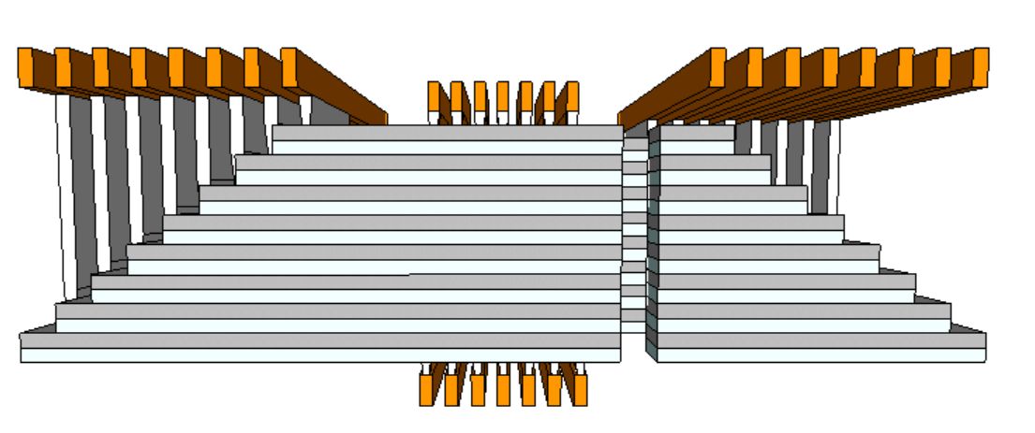

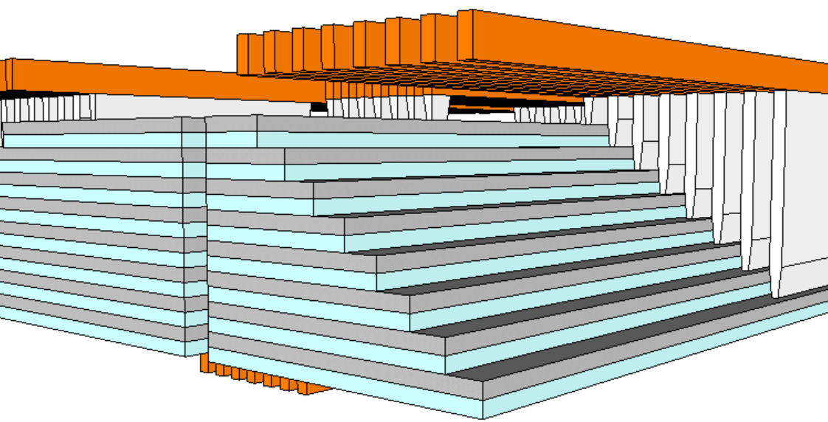
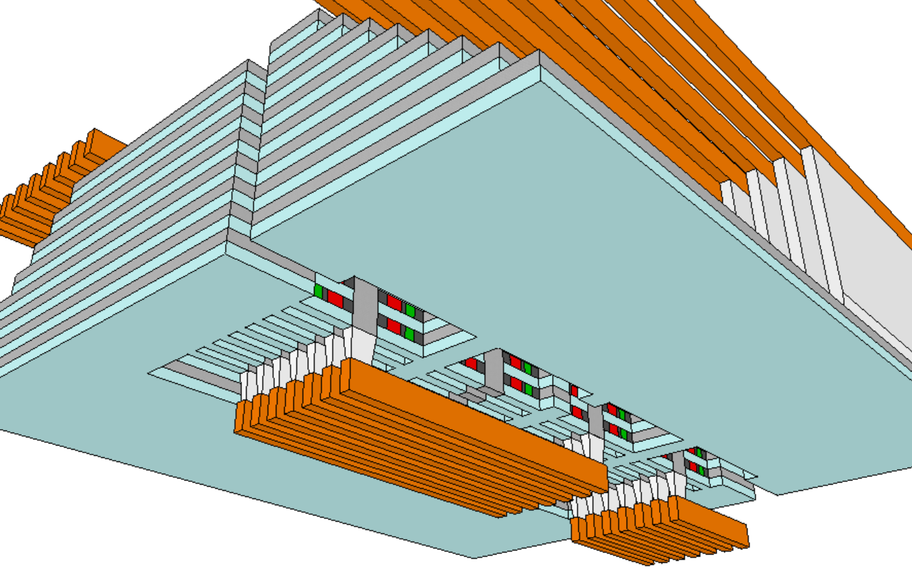
Array Interconnect connecting Tier and Pillar to Periphery Control Circuit

