Slide 1
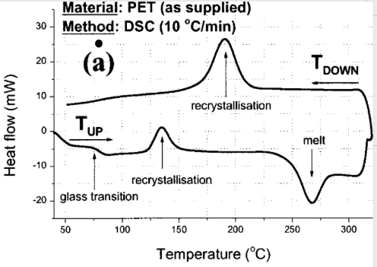
Read algorithm for MLC 3DXP cell
Hemant Rao, Saad Monasa, Raymond Zeng, Sanjay Rangan, DerChang Kau
MLC Read
5/12/2020
Problem Statement
Intermediate state for a 1.5bpc MLC 3DXP cell is achieved by keeping PM in an amorphous state while keeping SD in a low VT state. To be able to read the intermediate state we need to threshold switch this state and retain PM amorphization and SD in a low VT state post read to prevent disturb. Key challenge is to prevent PM crystallization which leads to BER increase with multiple reads when threshold switching amorphous PM
State of Art / Best Known Solution
Current approach uses a single short time and low current pulse to read the bit which works well for POR SET state and slow to nuc/grow bits but doesn’t work for fast to crystallize bits since temperature in the PM is closer to nucleation
Proposed solution here utilizes the materials understanding of recrystallization temperature regimes as seen in a typical DSC measurement for a phase change material system. Based on this understanding 4 different approaches to perform read are proposed,
Option1 (T_{read} < T_{re-crystallization1}) : Apply a fast quench (<2ns) post-threshold to drop the temperature below the lower end of the re-crystallization temperature
Option2 (T_{re-crystallization2} < T_{read} < T_{melt} ):
2a: High current pulse to ensure temperature in the cell stays above the 2nd re-crystallization temperature regime. This can be followed-up by dropping the current lower for a short amount of time (~10ns) to setback the SD or the high current time can be
increased to get a SD setback effect
2b: Utilize the transient current spike detect to quench at
higher currents (<5ns)
Option3 (T_{read} > T_{melt}) : Apply a POR reset pulse post low current to
re-amorphize the PM and then followed by a short low-current pulse
to setback the SD
1
2a
2a
2b
3
120µA
10ns
80ns
20ns
10ns
~2ns
~80-90uA
~80-90uA
~5ns
~10µA
20µA
~20ns
10µA
~15ns
Notes:
DSC
Two read options
Spike detect : Avoid the lower re-crytallization
High read current then with/without setback
Full Reset again (>Tmelt)
High spike transient detect (<ns)

Slide 3
Problem Statement
Please start with a clear objective to establish the context of problem solving.
Problem statement is a clear & concise statement on the specific observations of an undesired result.
State of Art / Best Known Solution
Concise articulation to reflect the known solutions
Current art may come from literatures or other media format in public domain, or Internal comparative analysis and benchmark.
Intel employees must not write about or discuss non-Intel patents or patent applications with anyone without first talking with Intel lawyers as explained in Intel’s policy for reading patents and applications of other companies included at Intellectual Property.
Please include the essential concept, elements in short bullet points
Please include at least one figure
Please describe how each of the bullet points above would be detected in a competitor’s product (e.g., teardown, reverse engineering, can be seen using ___ technique, likely in product literature…)
Please briefly describe why your solution is better than other solutions (if relevant)
Use one optional page for key message and invention abstract.
You can use additional pages to illustrate and annotate your embodiment.
Please see next slide for alternative “One Page Summary” format

Slide 4
Please start with a clear objective to establish the context of problem solving.
Problem statement is a clear & concise statement on the specific observations of an undesired result.
Concise articulation to reflect the known solutions
Current art may come from literatures or other media format in public domain, or Internal comparative analysis and benchmark.
Intel employees must not write about or discuss non-Intel patents or patent applications with anyone without first talking with Intel lawyers as explained in Intel’s policy for reading patents and applications of other companies included at Intellectual Property.
Please include the essential concept, elements in short bullet points
Please include at least one figure
Please describe how each of the bullet points above would be detected in a competitor’s product (e.g., teardown, reverse engineering, can be seen using XX technique, likely in product literature)
Please briefly describe why your solution is better than other solutions (if relevant)
Use one optional page for key message and invention abstract.
You can use additional pages to illustrate and annotate your embodiment.
Please see previous slide for alternative “One Page Summary” format

Slide 5
The supplementary page is the abstract of your invention.
Example shown below uses four attributes to characterize your invention.
Introduction –
this is the ‘hook’ to IP reviewers. The best hook is to illustrate the live problem you are solving.
The ideas –
Brief description of invention. Illustrate your originality in solving the problem.
What are the key elements? Use next page to annotate the exhibits of invention.
What’s new –
Are there known solutions? Contrast the differences to yours.
Detectability –
The best way to protect your invention is detectability.
How do you know your invention is used on a product.
Please use font size 18 or bigger. If you are to provide more information to fit in a page, chances are, another IP disclosure can serve the purpose.

