Slide 1
Implant Modifications to Liner/Seal Sidewall
E. Todd Ryan, Cyrus Fox, Seshu Sattiraju
Optane 3DxP, 124x, liner, seal
19 April 2020
Need more conformal liner/seal deposition to protect cell materials. POR is PECVD nitride process with marginal conformality for 1241 and beyond. Need to enable a more conformal liner/seal deposition process.
Thermal ALD (tALD), PEALD, or thermal CVD (tCVD) have the needed conformality but
  POR PECVD process non-conformality (breadloafing) limits sidewall nitride thickness due to pinch off; limits scaling and barrier property optimization.
  PEALD plasma interactions with the cell materials are a known challenge.
  Thermal ALD film quality is a challenge without an effective post deposition treatment.
  Thermal CVD of other materials, such as a-Si, need to be converted to SiNx to be an effective barrier.
DPHe and similar post deposition plasma treatments lose effectiveness deeper in high aspect ratio trenches.
Pulsed plasma PECVD is current POR for 1240 with ~40% LP seal step coverage in 1240.
tALD and PEALD have near 100% step coverage. tCVD can achieve >90% step coverage.
DPHe or DPN used as post deposition treatments to improve sidewall film properties. But depth of effective treatment limited.
Note: a separate IP disclosure will be submitted for tCVD a-Si converted to SiNx by DPN nitridation.
Use Implant to densify or chemically modify the liner/seal along the sidewall.
Densify the liner/seal by bombarding the sidewall surface with angled implant using He, N, Ar.
Modify liner/seal chemical composition by implanting Si, N, B, C, etc.
  Improve SiNx by increasing either Si or N as needed.
  Convert tCVD a-Si to SiNx by N implant.
  Convert tCVD a-Si to SiCx by C implant.
  Potential bi-layer (a-Si/SiNx or a-Si/SiCx) formation controlled by implant dose.
Minimize implant damage using implant angle, species radius, implant power, and implant dosage.
Use flash anneal for post implant anneal if necessary
  Flash anneal to minimize SD/PM thermal damage.

Slide 2
Introduction –
  Enable effective liner/seal scaling to 1241 and beyond by using post deposition implant to modify liner/seal materials.
The ideas –
  See previous page
What’s new –
  Known solutions use various plasma treatments to densify/modify the sidewall material. This is a new application of implant to enable sidewall modifications beyond plasma treatments.
  Implant may also better enable new approaches for highly conformal films in high AR trenches. For example, tCVD a-Si is low temperature (<250C) but would need to be converted to SiN, SiCN, or SiC to be an effective barrier.
    Implanting could allow for bilayer film formation on the sidewall by controlling implant depth.
Detectability –
  Direct Detection: For chemically modified films, i.e., B-doped SiNx, the detection of the dopant detects use, especially for dopants hard to include during deposition.
  Indirect Detection: For C-doped films that cannot be deposited conformally a conformal C-doped film suggest use.

Slide 3
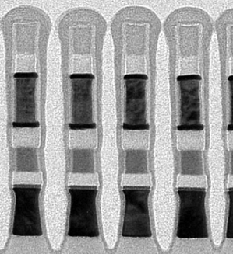
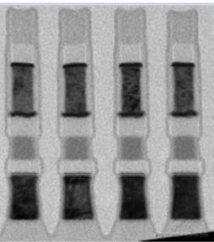
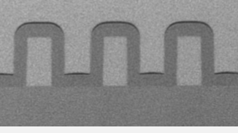
Step Coverage for Potential Deposition Methods
Limitation of DPHe or Other Plasma Treatments
POR PECVD TSN Seal
~40% step coverage
ALD Nitride Seal
>95% step coverage
Effect of DPHe
Effective treatment depth
tCVD a-Si
>90% step coverage
DPHe treatment depth limited by aspect ratio and top opening as measured by HF etching as proxy for seal quality.

