Slide 1
XOR Architecture for 3D XPointTM Technology
DerChang Kau, 6/26/2017
XOR Architecture and Circuit Schematics
Array Transistors – MOS vs. BJT
Random Access
Memory Array Layout in Tier
Array MOS Transistor Topology
XOR 3DXP toplogy
Process Flow and Cross Section (Memory Tier only)

Slide 2
Basic Architecture and Circuit Schematics
XOR – Wired OR with single active/select

Slide 3
Schematics
4-Tier XOR Cell
Tier₃
Tier₂
Tier₁
Tier₀
BL
WL

Slide 4
Two Types of Cells
MOS
BJT

Slide 5
Random Access
4-Tier XOR 2WLX4BL mini Array
SET
RESET
READ
V_{BL,desel}
V_{BL,sel}
V_{BL,desel}
V_{T,Reset}
V_{Tier,sel}
V_{T,Set}
V_{WL,sel}
WL₁
V_{WL,sel}
V_{BL,sel}
WL₀
V_{Tier,sel}
For I_{RESET}
V_{WL,desel}
For I_{SET}
For I_{READ}
V_{Tier,desel}
V_{Tier,desel}
V_{Tier,desel}
BL₀
BL₁
BL₂
BL₃
Tier₀
Tier₁
Tier₂
Tier₃
V_{BL,desel}
V_{WL,desel,}
V_{Tier,desel}
V_{Tier,desel} can also use high impedance float by
Switching off the deselected Tier bias circuit
0V
Accessing bit with single
Tier, WL and BL selected
V_{WL,sel} illustrated is used as a current clamp for RESET/SET/READ operations.
It can be a simple on/off switch with additional current control circuity outside array

Slide 6
Parallelism
Accessing bits with
one pair of BL and WL
and multiple tiers ,
4 in the exhibit,
selected

Slide 7
Array Layout (socket not included)

Slide 8
Array Layout
Cell 2nd Cut
Cell 1st Cut
Memory Tier
WL Poly
BL Poly
Silicon Pillar

Slide 9
Array Transistors
Poly is driven by pitch cell decoders
All Si Pillar grounded at base
Cell 2nd Cut
Cell 1st Cut
Memory Tier
WL Poly
BL Poly
Silicon Pillar

Slide 10
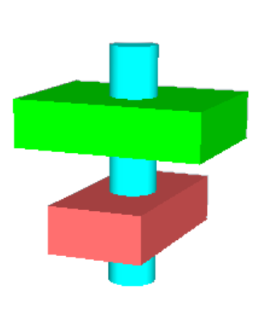
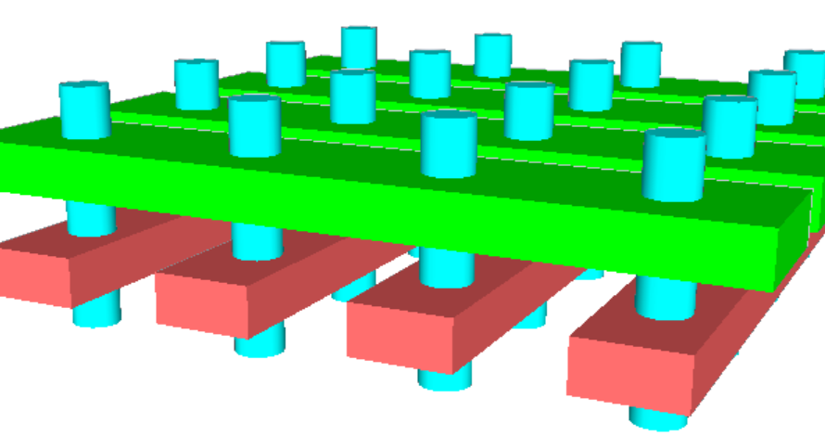
GAA MOS Array Transistor Implementation
GAA: Gate All Around
Array
Cell
WL
BL

Slide 11
Alternative Array Transistor : Planar MOS
Cell 2nd Cut
Cell 1st Cut
Memory Tier
Array Via
Metal-2
Via-1
Metal-1
Contact
Poly
N-Diffusiuon

Slide 12
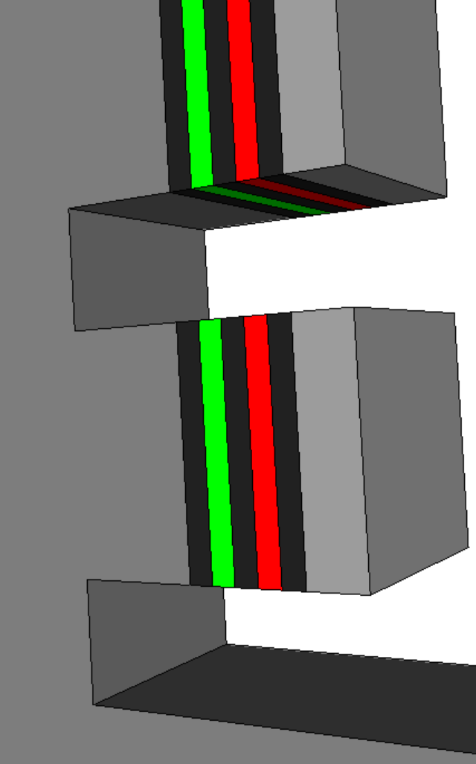
Memory Tier and Cell Definition
Electrodes
Cell 2nd Cut
Metal
Cell 1st Cut
Memory Tier
SD
PM

Slide 13
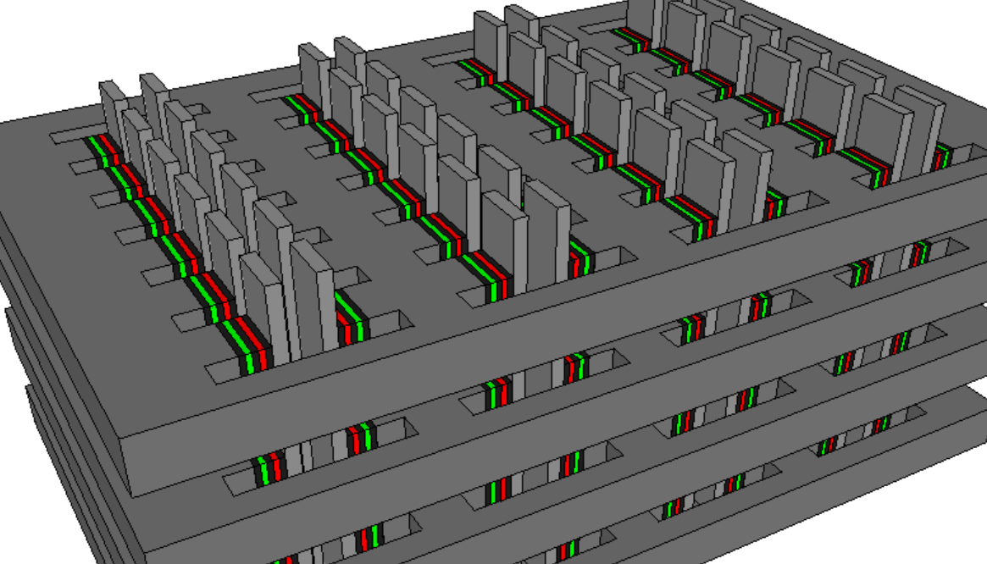
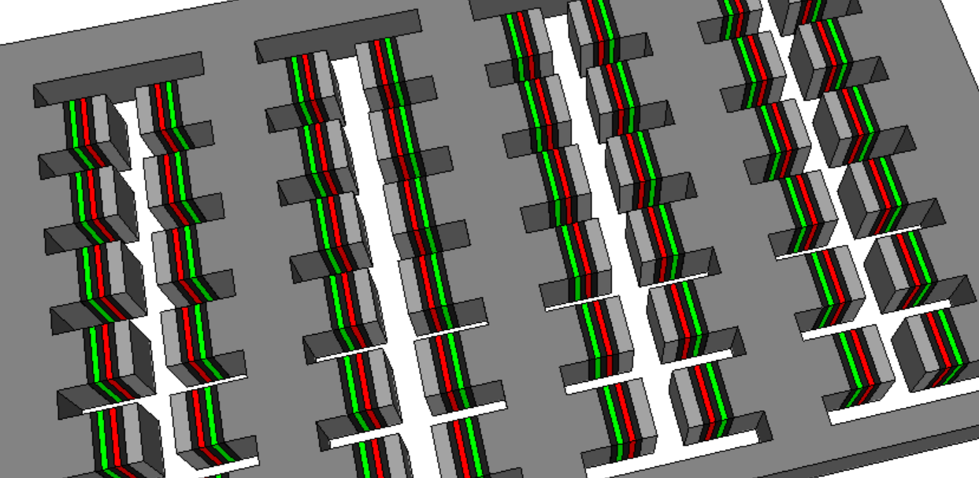
3D XPoint XOR Array
Single tier view
3D XOR XPoint in multi-tiers

Slide 14
Array Process Flow

Slide 15
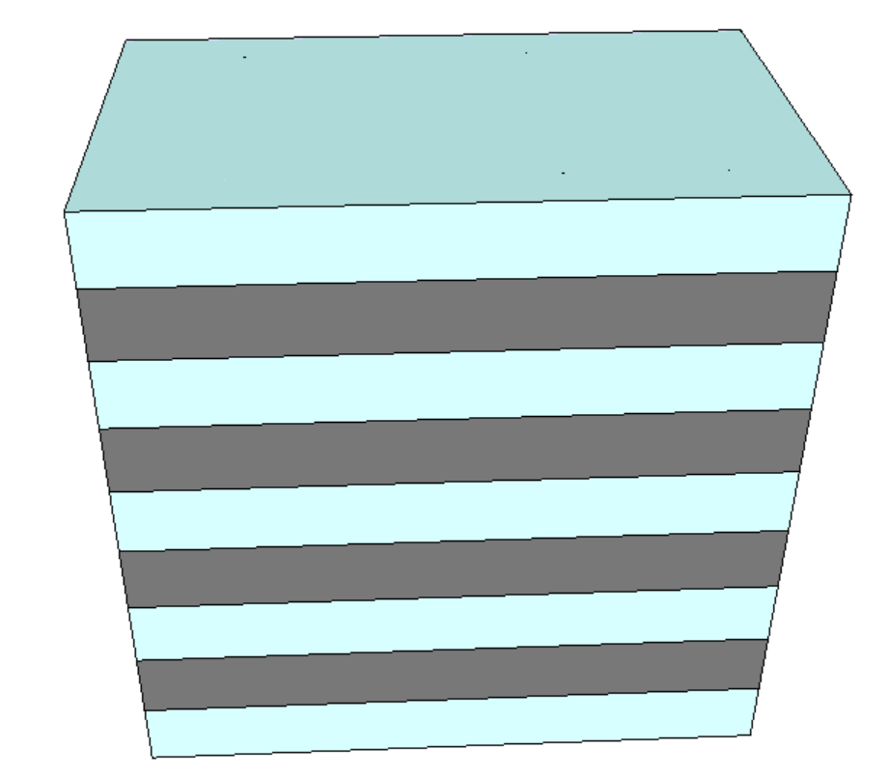
Memory Tier Stack – 4 Tier in exhibit
Dielectric
Tier-3 Metal
Tier-2 Metal
Cell 2nd Cut
Tier-1 Metal
Cell 1st Cut
Memory Tier
WL Poly
Tier-0 Metal
BL Poly
Silicon Pillar

Slide 16
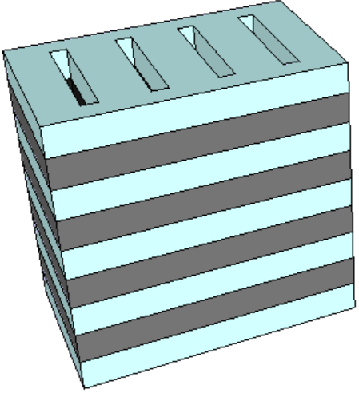
1st Cut for Cell Stack Materials Deposition
A
A’
A’
A
Cell 2nd Cut
Cell 1st Cut
Memory Tier
WL Poly
BL Poly
Silicon Pillar

Slide 17
Tier Metal Recess Etch
A
A’

Slide 18
1st Electrode
First Electrode Conformal Dep
First Electrode Recess Etch
A
A’
A
A’

Slide 19
SD
SD Conformal Dep
SD Recess Etch
A
A’
A
A’

Slide 20
2nd Electrode & PM
2nd Electrode dep/etch, PM Conformal Dep
PM Etch
PM Etch
A
A’
A
A’

Slide 21
3rd Electrode & Pillar Metal Conforming Dep
2nd Electrode Dep/Etch
Pillar Metal Dep/Etch
A
A’
A
A’

Slide 22
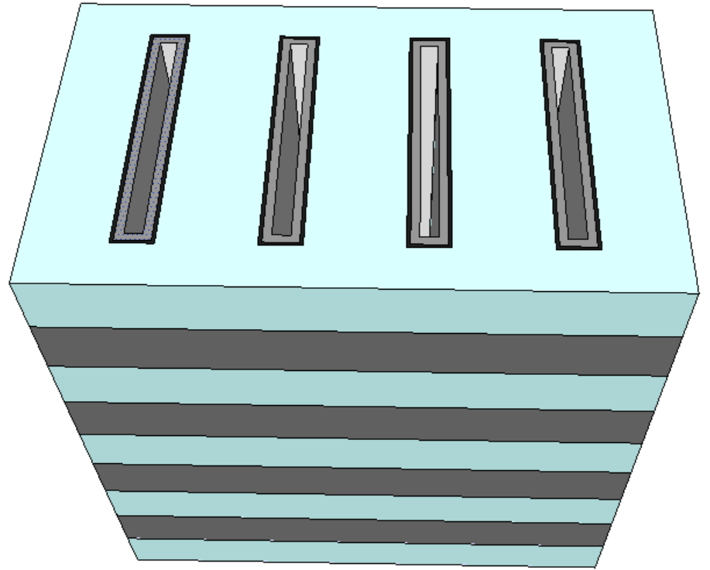
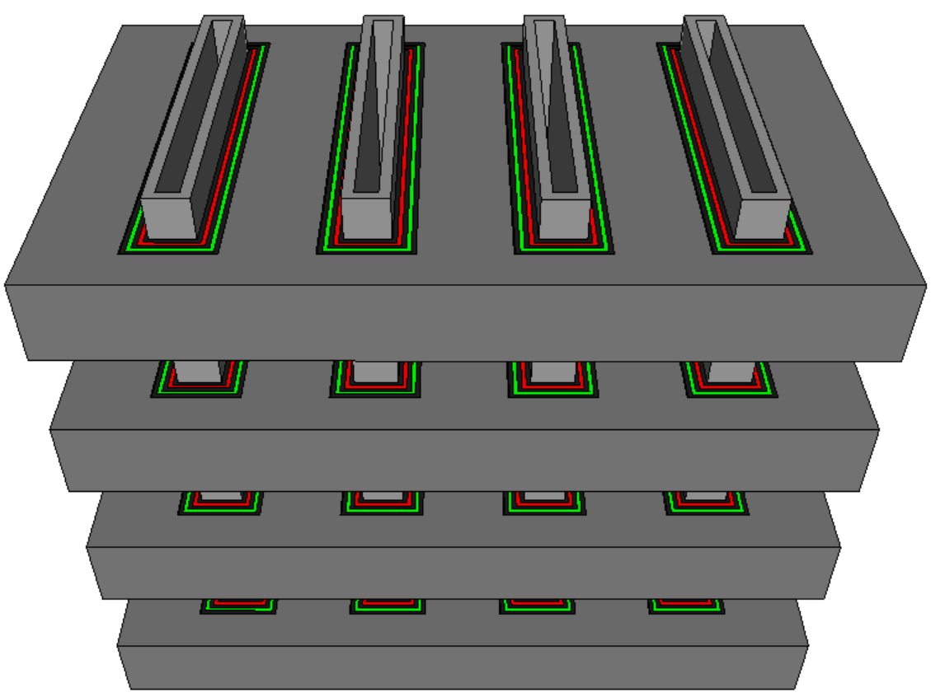
End of 1st Cut module
Before 1st Cut Fill
With Dielectric Removed

Slide 23
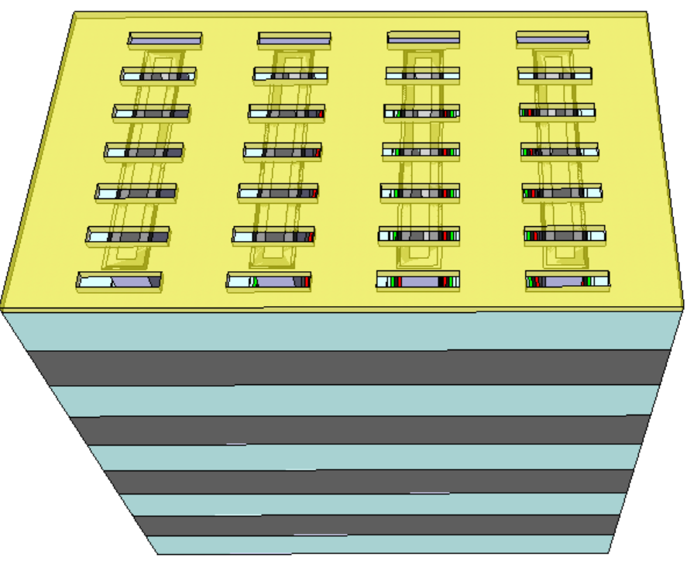
2nd Cut definition
Cell 2nd Cut
Cell 1st Cut
Memory Tier
WL Poly
BL Poly
Silicon Pillar

Slide 24
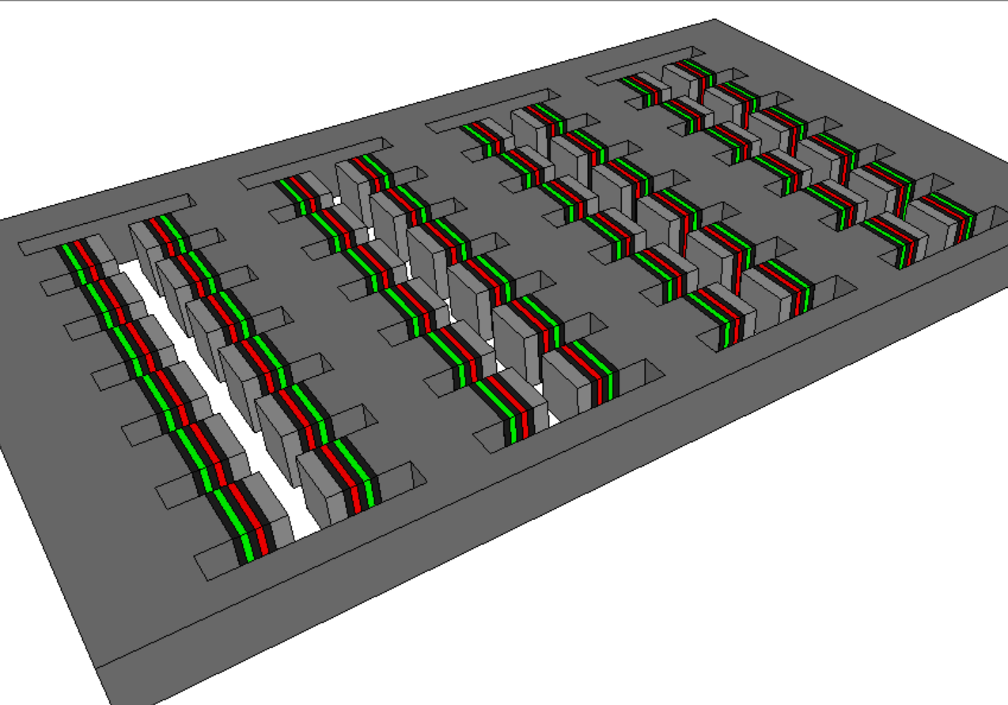
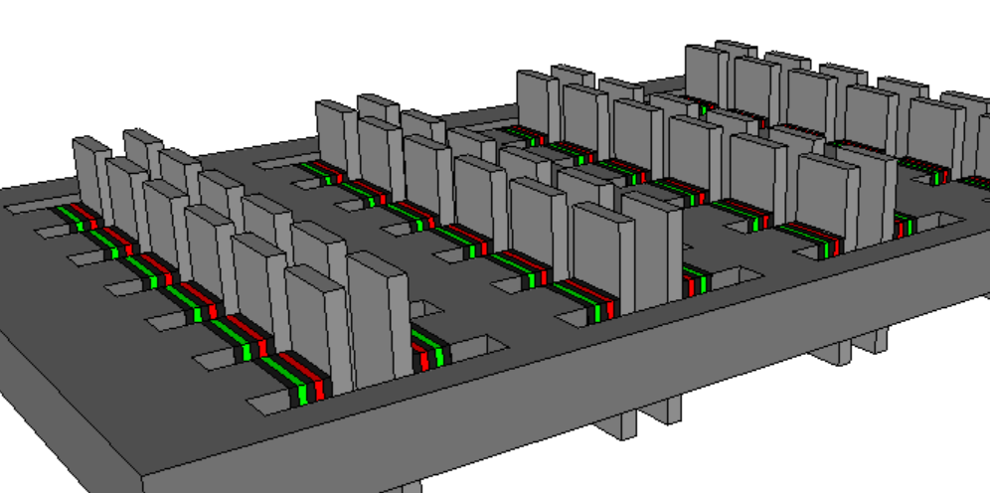
Final 3D XPoint XOR Array (dielectric no shown)
4 tiers
Single tier view
One tier
With Pillar metal

