Slide 1
3DXP Deck Select Architecture
DerChang, Prashant, Max, 1/25/2019
Deck Select Transistors integrated with Cross Point Array Technology
3 Deck Select TFT ideas – Ω, Fin, Saddle
Fin TFT embodiment
Saddle TFT embodiment

Slide 2
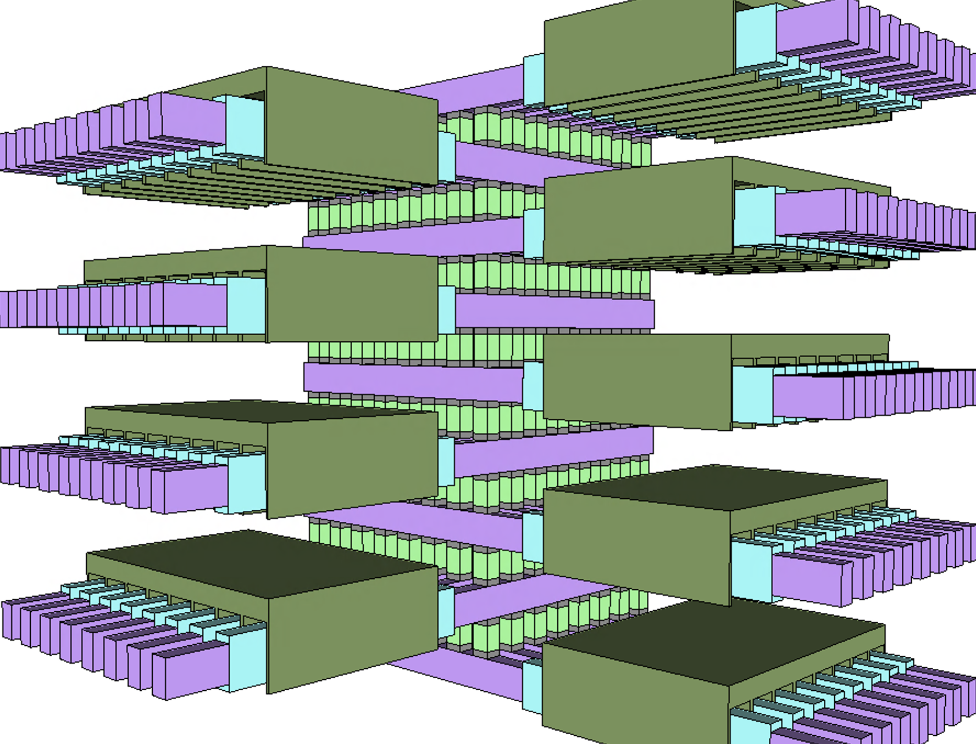
½ Kb Array: 8 decks of 8x8 cross point

Slide 3
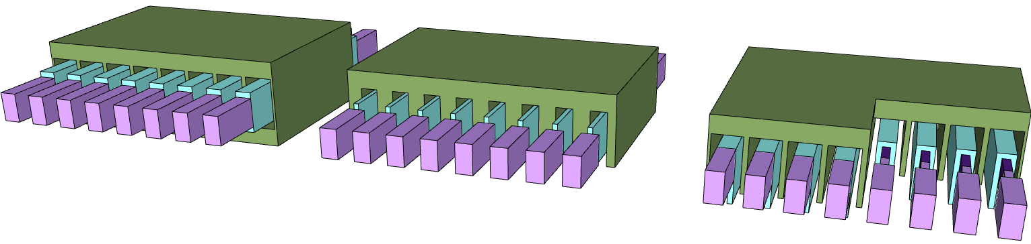
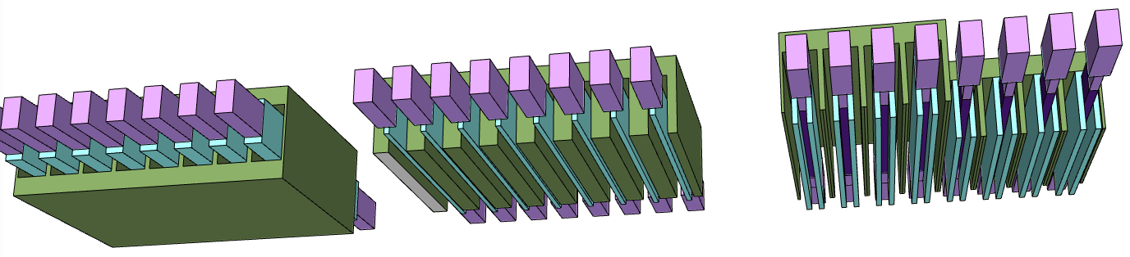
3 ideas
Ω-TFT
FIN-TFT
Saddle-TFT

Slide 4
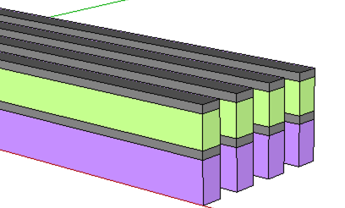
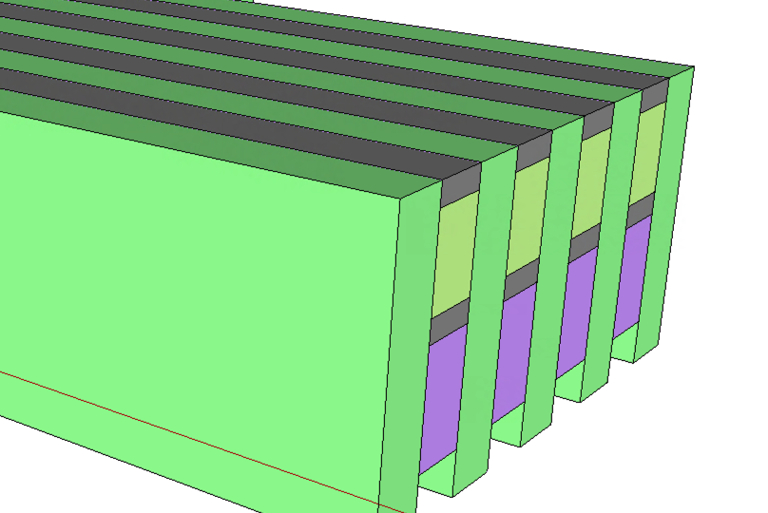
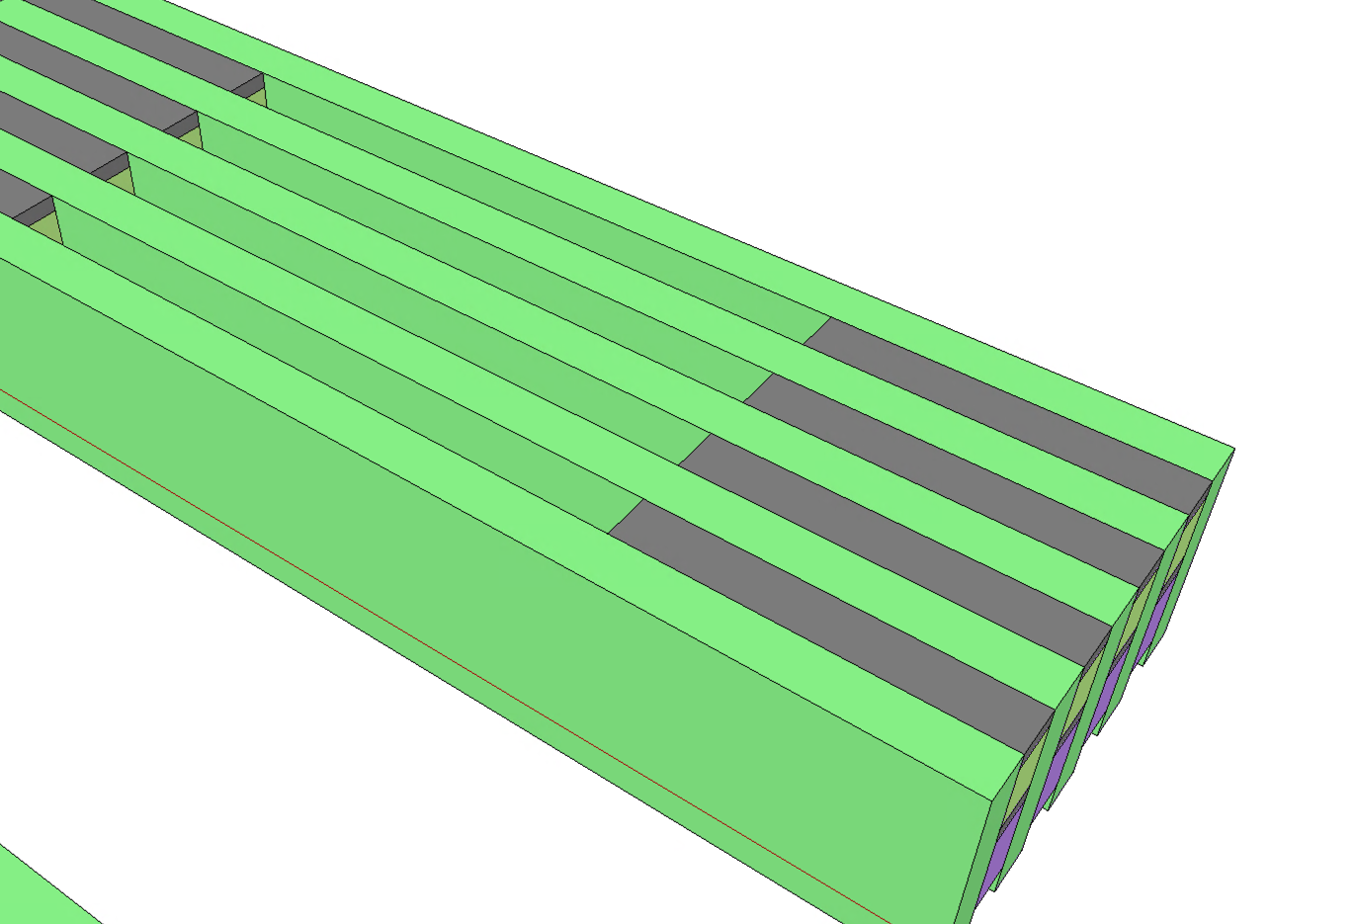
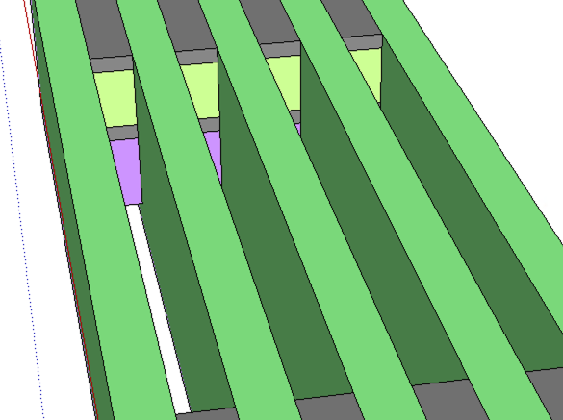
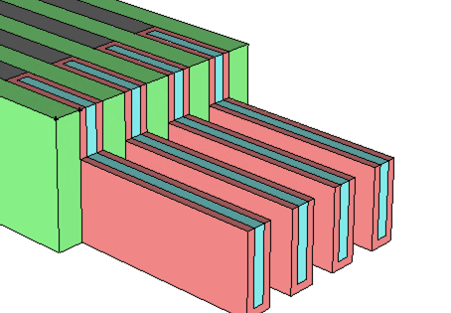
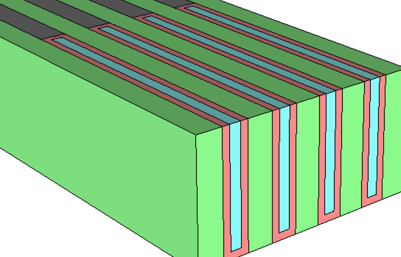
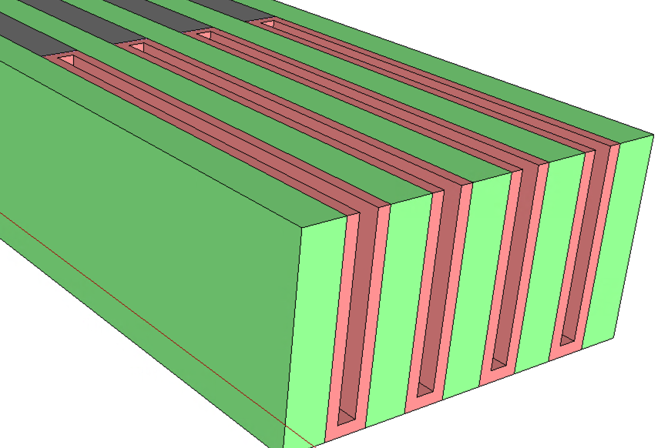
FinTFT Process Flow
Deck Select TFT Placeholder:
200~400nm stripe opening,
Selective stack material removal
Array First Cut
First Cut Gap Fill
TFT Fin Height definition
TFT Fin Channel Material Dep
Optional Spacer to define TFT FinFET width

Slide 5
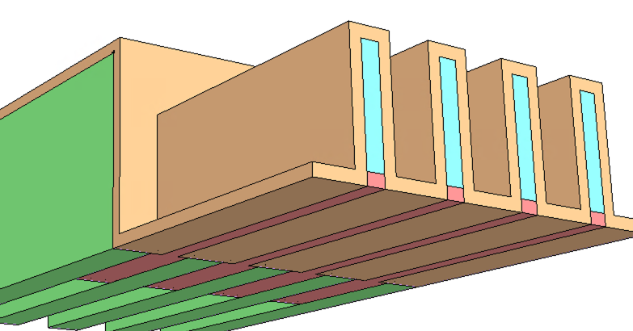
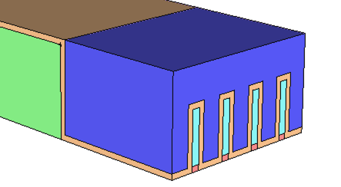
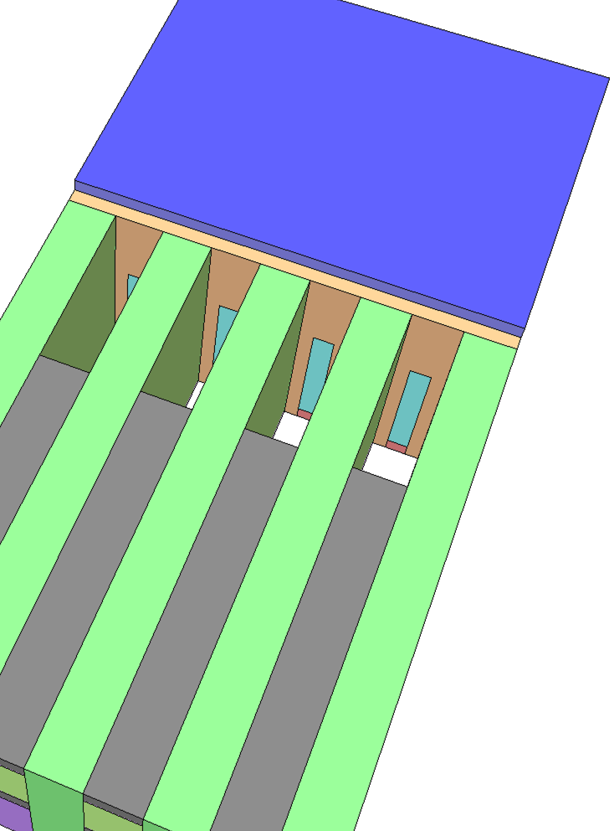
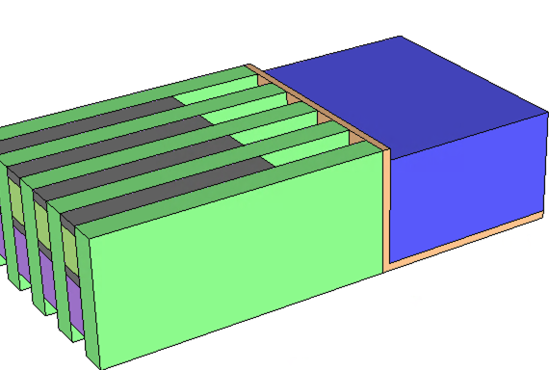
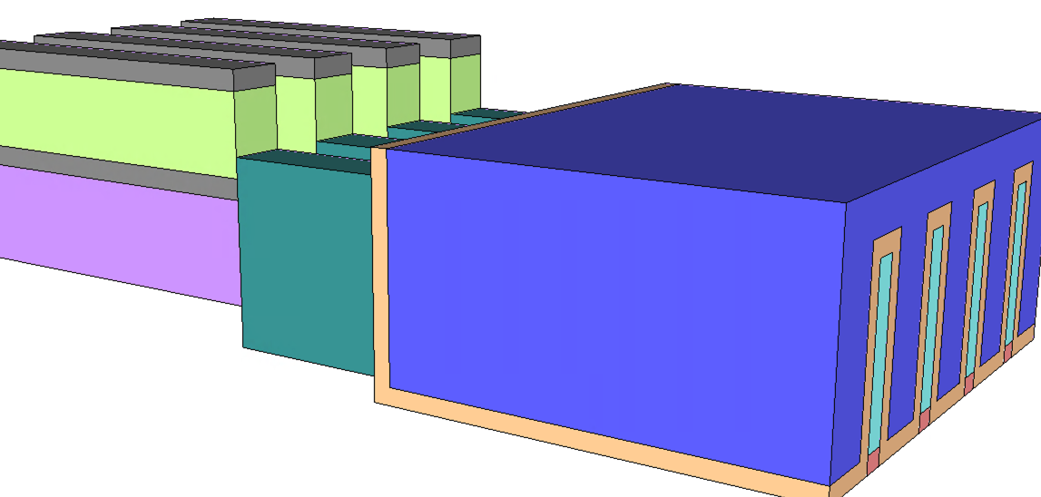
Fin TFT Process Flow (cont.)
TFT FinFET Oxide Dep
TFT FinFET Gate Dep
FinFET S/D Placeholder
TFT FinFET S/D Dep

Slide 6
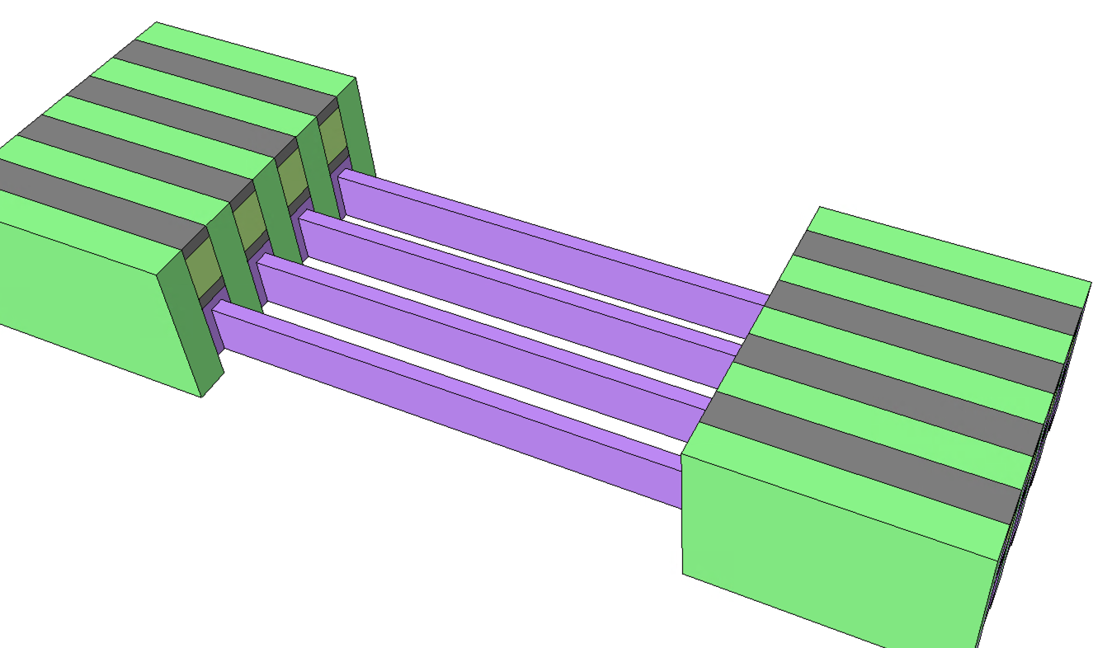
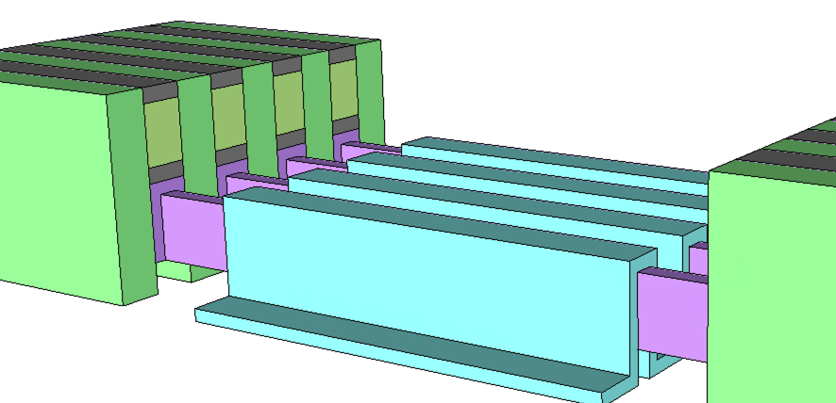
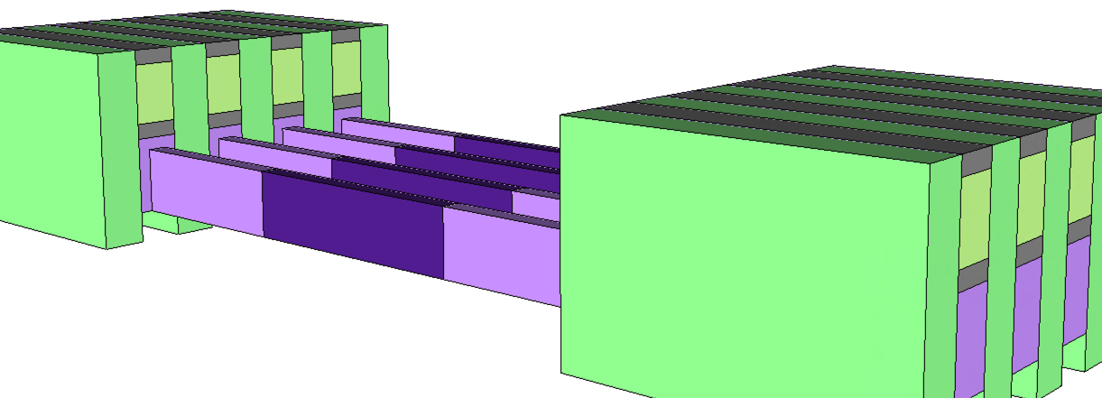
Saddle TFT Process Flow
Deck Select TFT Placeholder:
200~400nm stripe opening,
Selective etch, remaining W
Array First Cut
First Cut Gap Fill
Saddling up TFT Fin Channel Material
Channel Length Definition
Oxidize W

Slide 7
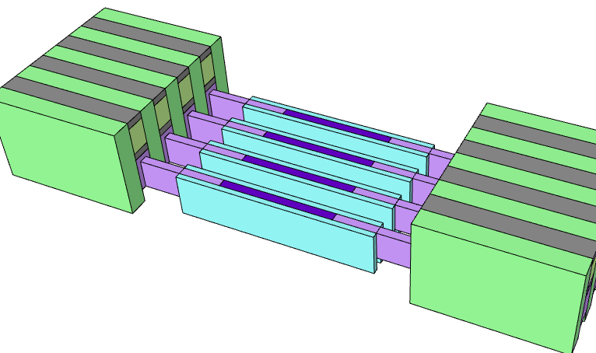
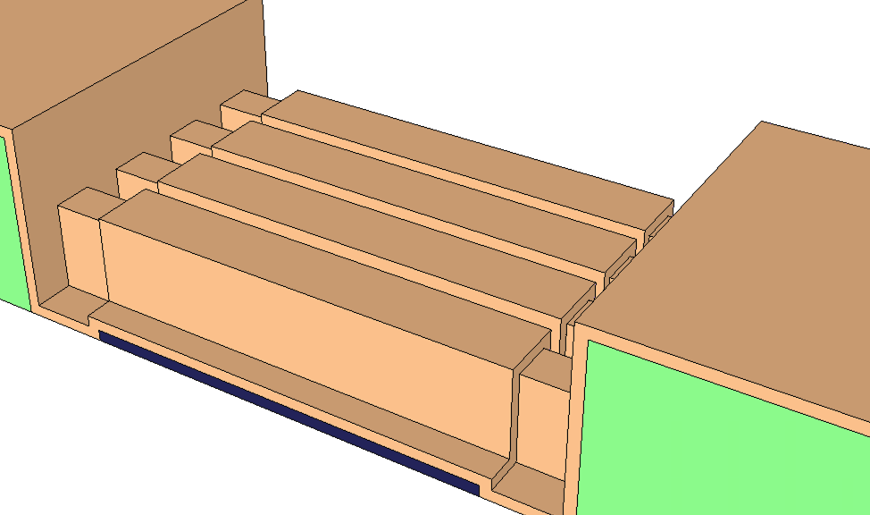
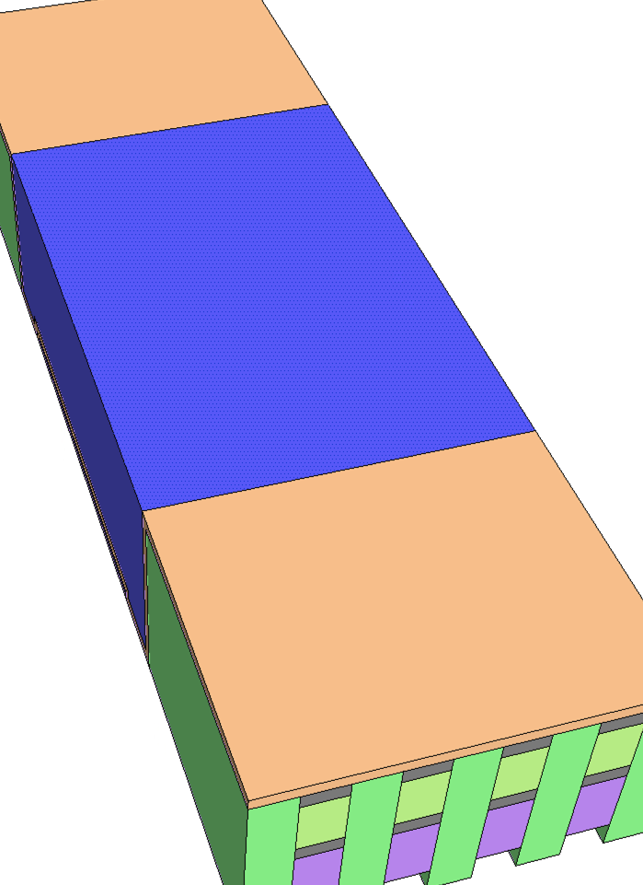
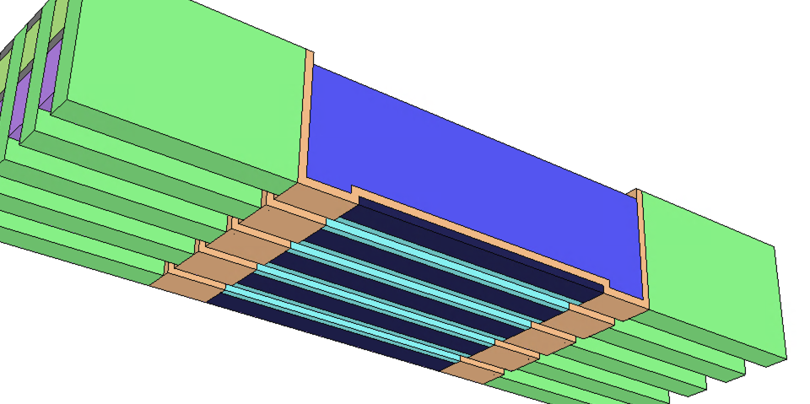
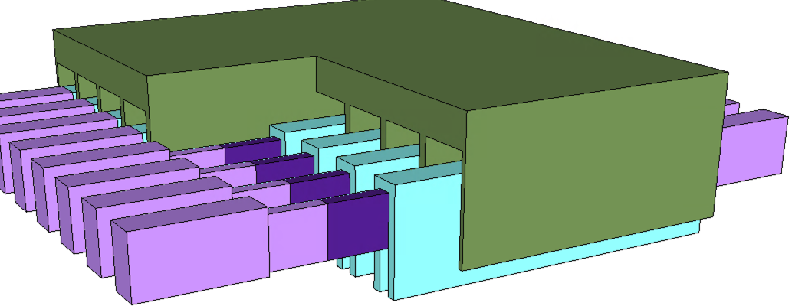
Saddle TFT Process Flow (cont.)
Saddle Isolation
Saddle TFT Oxide conforming Dep
Saddle TFT Gate Dep
Saddle TFT

