Slide 1
Memory Technologies
The long gestation from research to mainstream
Al Fazio
Intel Senior Fellow
Director, Memory Technology Development
November 2021

Slide 2
A Walk down memory lane
Intel has rich and ongoing history of creating significant new memory technology disruptions roughly every decade since 1970
Each time, the new technology required great efforts for each to take hold and “help customers overcome the short-term technical obstacles and see the long-term possibilities of the product”
Once established, each helped lead to global technology and business transformation in memory and computing technologies
Your efforts on Optane are continuing Intel’s legacy

Slide 3
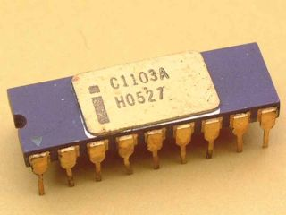
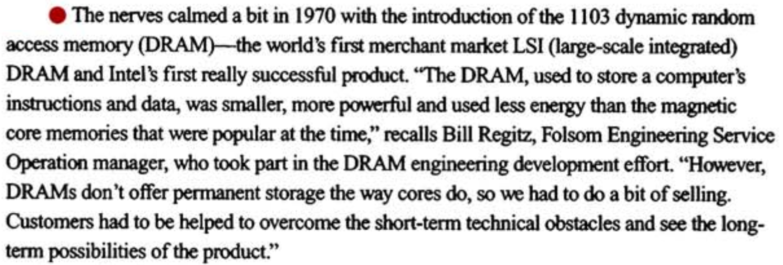
1970’s: Intel Delivers 1st commercial DRAM
1953: 1st Magnetic core memory computer ➔ 1970: IBM’s 1st Semiconductor memory computer
SRAM: Invented in 1963; thru 1960’s, semiconductor memory ~100x more expensive vs core
DRAM: October 2020 marked 50th anniversary of Intel 1103 – 1st commercial DRAM
Source: “Defining Intel: 25 years / 25 events”

Slide 4

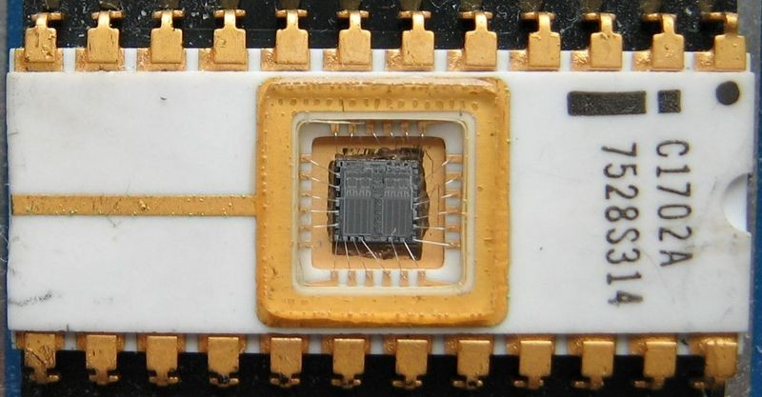
1970’s: Intel EPROM establishes the field of semiconductor NVM
The EPROM ushered in a revolution in how computer systems were prototyped, dramatically reducing the time it took designers and software developers to perfect their systems, which accelerated the growth of microcomputers in an era before the PC existed
“ …had to go to customers and convince them that the charge will stay there for a long time.”
Dov Frohman, Computer History Museum 2018 Fellow Award speech
Dov Frohman, Inventor of the EPROM and established Intel-Israel

Slide 5
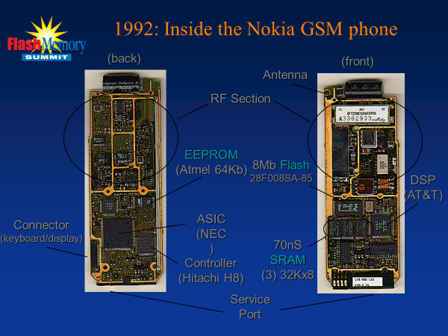
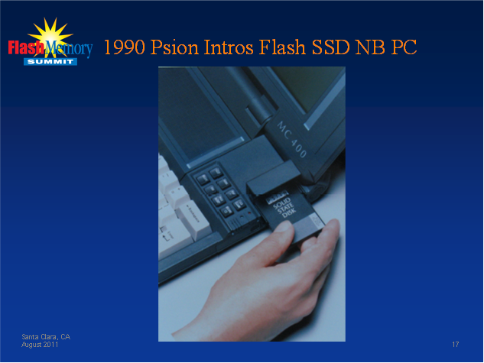
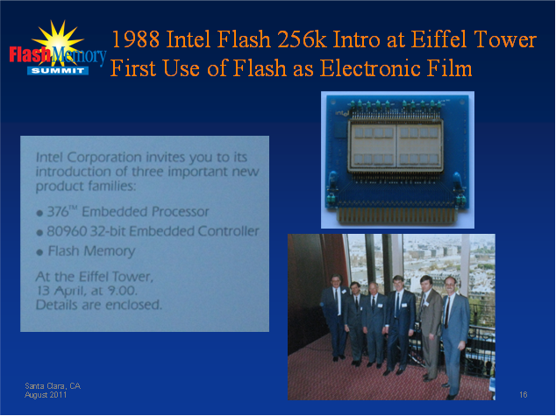
1980’s: Intel Delivers 1st commercial Flash memory
Source: “History of Flash Memory” Dick Pashley, Flash Memory Summit 2011
1980’s Flash vision: replace HDD…correct vision, but >20 years before viable
Flash becomes key enabler of consumer mobility (digital phones & cameras)

Slide 6
EPROM ➔ Flash Transition Was not instantaneous
~5 Years for 50% of Biz

Slide 7
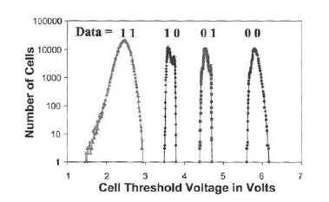
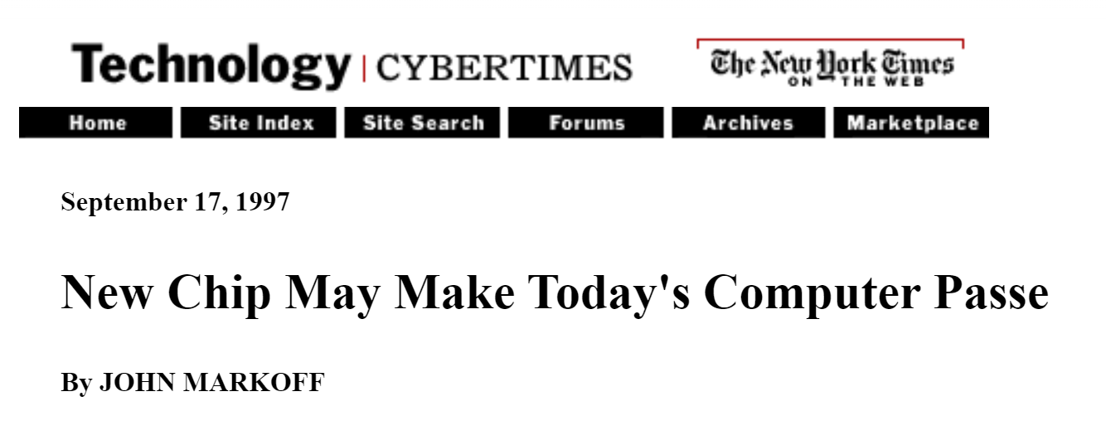
1990’s: Intel Delivers 1st commercial multi-level-cell
MLC greatly accelerated Moore’s Law for memory technologies and established flash as leadership tech node position ahead of DRAM
Resulting cost reductions and capacity increases accelerated new usages across a wide spectrum of applications from e-readers to music players, while phones and cameras were able to merge into a single device
"A Giant Advance for Intel"
Front page of The San Jose Mercury News
Sep 17, 1997
Front page of The New York Times Sep 17, 1997

Slide 8
Single level cell ➔ Multi level cell took longer
~7 Years for 50% of Biz

Slide 9
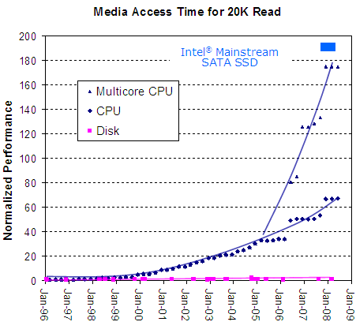

2000’s: Intel 1st performant SSD capable of mainstream computing
Performant SSD’s accelerated data center transformation for virtualization and made thin and light PCs possible
>$25B industry today, but in 2008 naysayers were vocal…
  “Flash memory can be considered as an early version of SCM, and it is slowly being adopted for certain enterprise niche uses. However, its cost, write performance, and write endurance (number of times a flash bit can be written) will limit the extent to which it will replace disks on a large scale.”
  IBM J. RES. & DEV. VOL. 52 NO. 4/5 JULY/SEPTEMBER 2008

Slide 10
2010’s: Intel Delivers 1st Commercial Persistent Memory
We are now on the journey with Optane, putting in the great effort working to “help customers overcome the short-term technical obstacles and see the long-term possibilities of the product”
Once again, we will transform technology and businesses—this time, with persistent memory in the coming years that will make an impact in ways that we are only beginning to imagine today

Slide 11
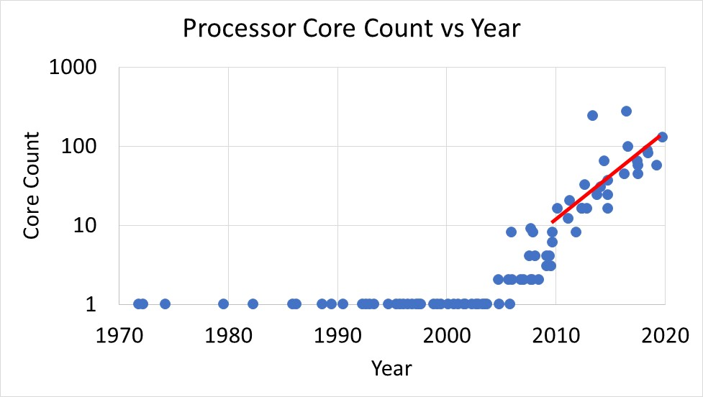
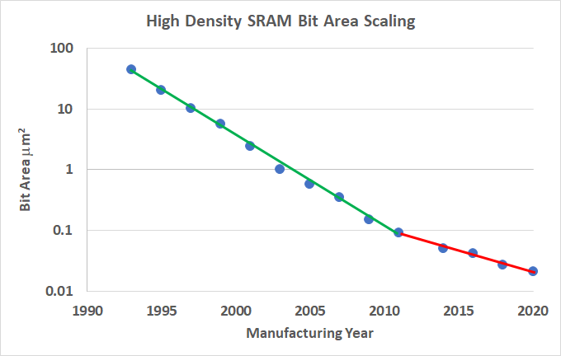
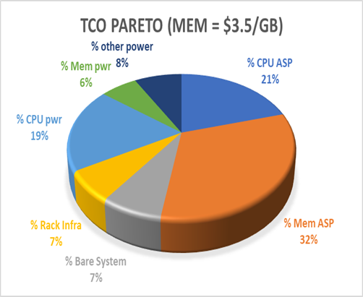
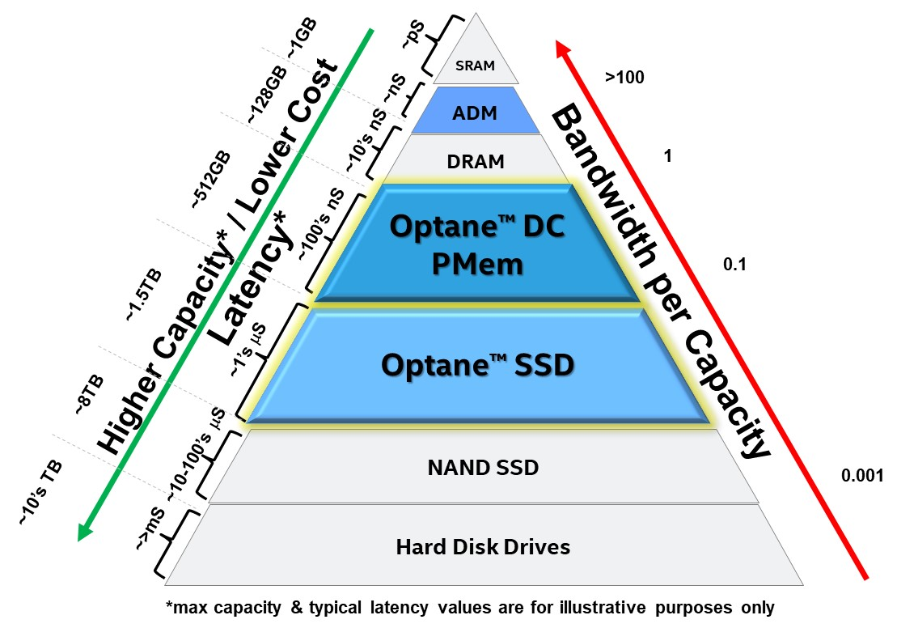
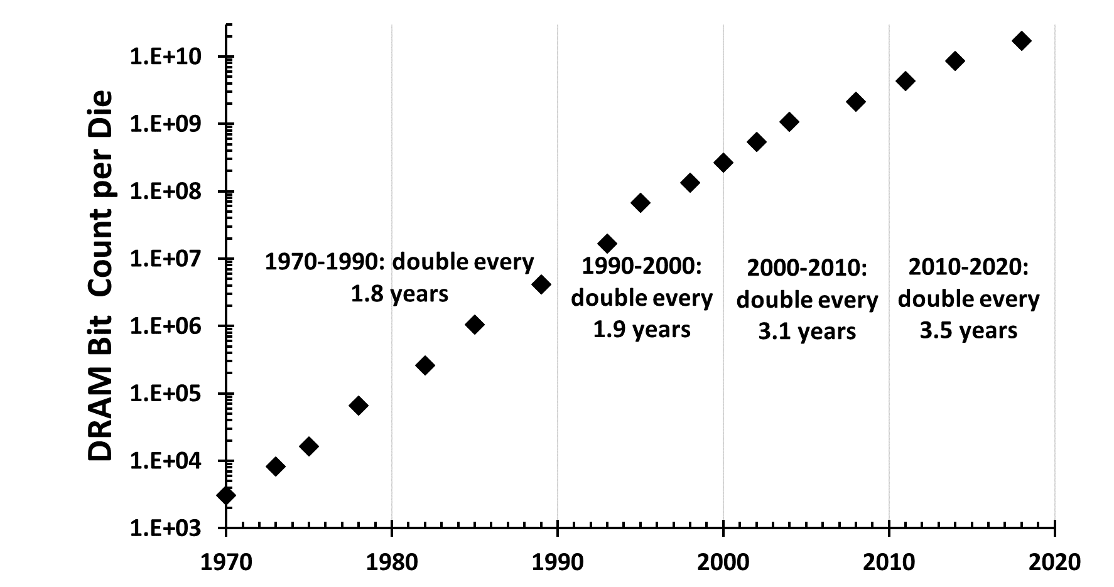
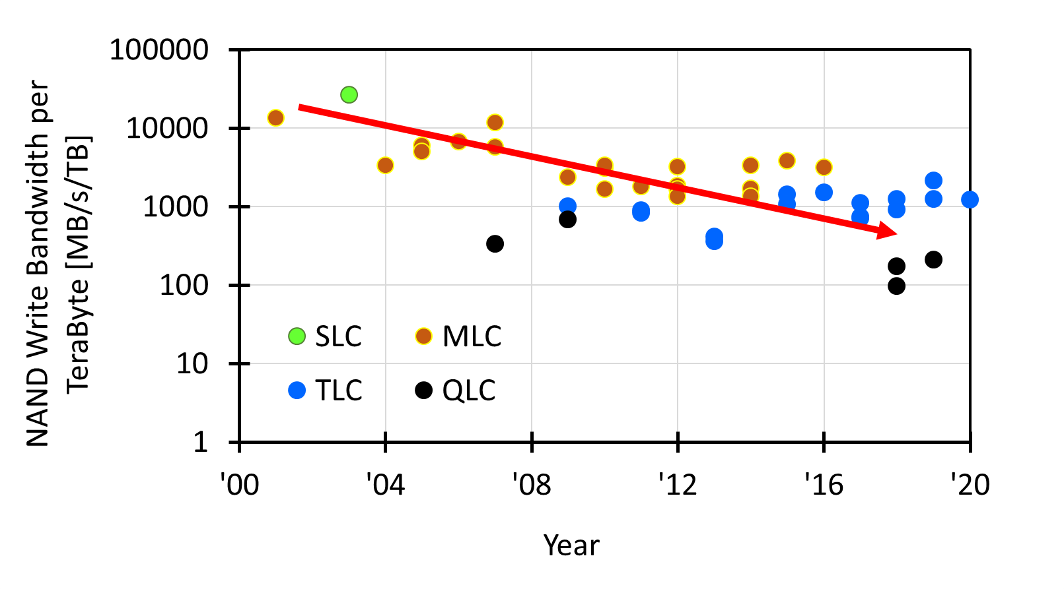
Why pursue 3D Xpoint?: Technology trends last decade ➔ TCO Issue
Memory TCO Issue:
96 core GNR-AP-12Ch @ 400W TDP with 8GB/core of memory
1. Large core growth ➔ Memory demand grows
2. SRAM scaling slows ➔ Cost pressures
½ Area every 2 Years
~1.25x/year; ~10x in 10 years
½ Area every 5 Years
Source: Intel & TSMC Public info
Original data up to the year 2010 collected and plotted by M. Horowitz, F. Labonte, O. Shacham, K. Olukotun, L. Hammond, and C. Batten. New plot and data collected for 2010-2019 by K. Rupp https://github.com/karlrupp/microprocessor-trend-data/commit/47382e2e3c653d71ebae66d8e8aecc088866543d
Source: Intel & TSMC Public info
Optane Strategy to displace DRAM:
Fill Memory Cap. - Storage Perf. Gap
4. NAND BW/Capacity drops ➔ NAND can’t fill memory gap, storage performance gap emerges
3. DRAM scaling slows ➔ Memory capacity gap
Source: Various ISSCC, IEDM, VLSI Publications, and Public Info
Source: Various ISSCC, IEDM, VLSI, IMW Publications
Source: Various ISSCC, IEDM, VLSI, IMW Publications

Slide 12
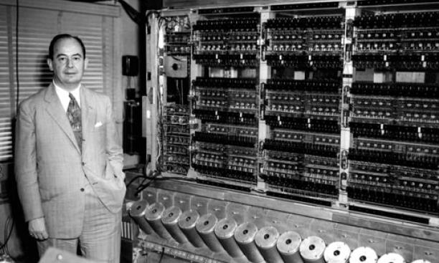
Unified memory…Or…Hierarchy?
Memory technologist silo’d approach: Invent universal memory…compatible w/logic, low latency, high BW, low cost, NVM, w/ multi bit/cell….Probably spend a lot of money and not solve anything
Perhaps a better approach…and one Intel uniquely capable…leverage our computer architect friends
“ Ideally one would desire an indefinitely large memory capacity such that any particular … word would be immediately available. … It does not seem possible physically to achieve such a capacity.
We are therefore forced to recognize the possibility of constructing a hierarchy of memories, each of which has greater capacity than the preceding but which is less quickly accessible.”
From, “Preliminary Discussion of the Logical Design of an Electronic Computing Instrument”
Arthur Burks, Herman Goldstine and John von Neumann
1946

Slide 13
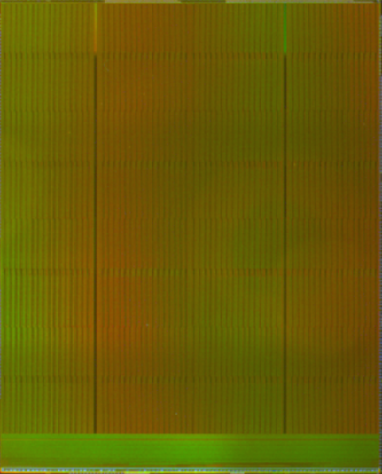
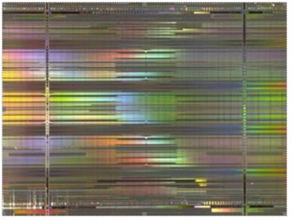
3D Xpoint Capacity/performance hierarchy tier ➔ merges DRAM /NAND attributes
Selected Wordline
All 32kB BLs active
Bank15
1kB-2kB/WL
Data Cache
16kB Page
Periphery
Bank1
Bank0
For Illustration Purposes
Periphery
 | NAND | 3D XPoint (2nd Gen) | DRAM
Access | 32kB cells w/in 1 page (dual plane) | 16Bytes: 1 cell in each of 16B tiles | 0.5kB -2kB cells across 1 bank
Banks | None (1 read or 1 write) | 32 independent banks | 16 independent banks (DDR4)
Endurance | ~1Ks Write Cycles | ~2-4Ms Write Cycles | Unlimited Write Cycles
Retention | ~Years | ~Years | ~ms
Read/Write BW | 1250MT/s (IO Limited) / 80MB/s | 1600MT/s (IO Limited) / 800 MB/s | 1600 - 3200MT/s DDR4 (IO Limited)
Read/Write Latency | 50μs / 800μs | 100ns / 500ns | 30ns / 30ns
Memory Density | ~4.5 Gb/mm² (96-layer TLC) | ~1.3 Gb/mm² | ~0.3 Gb/mm² (18 nm)
Values have been estimated based on internal Intel analysis and are provided for informational purposes only. Any difference in system hardware or software design may affect actual performance. Results may vary

Slide 14
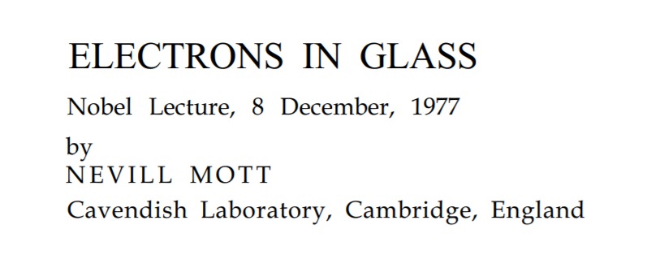
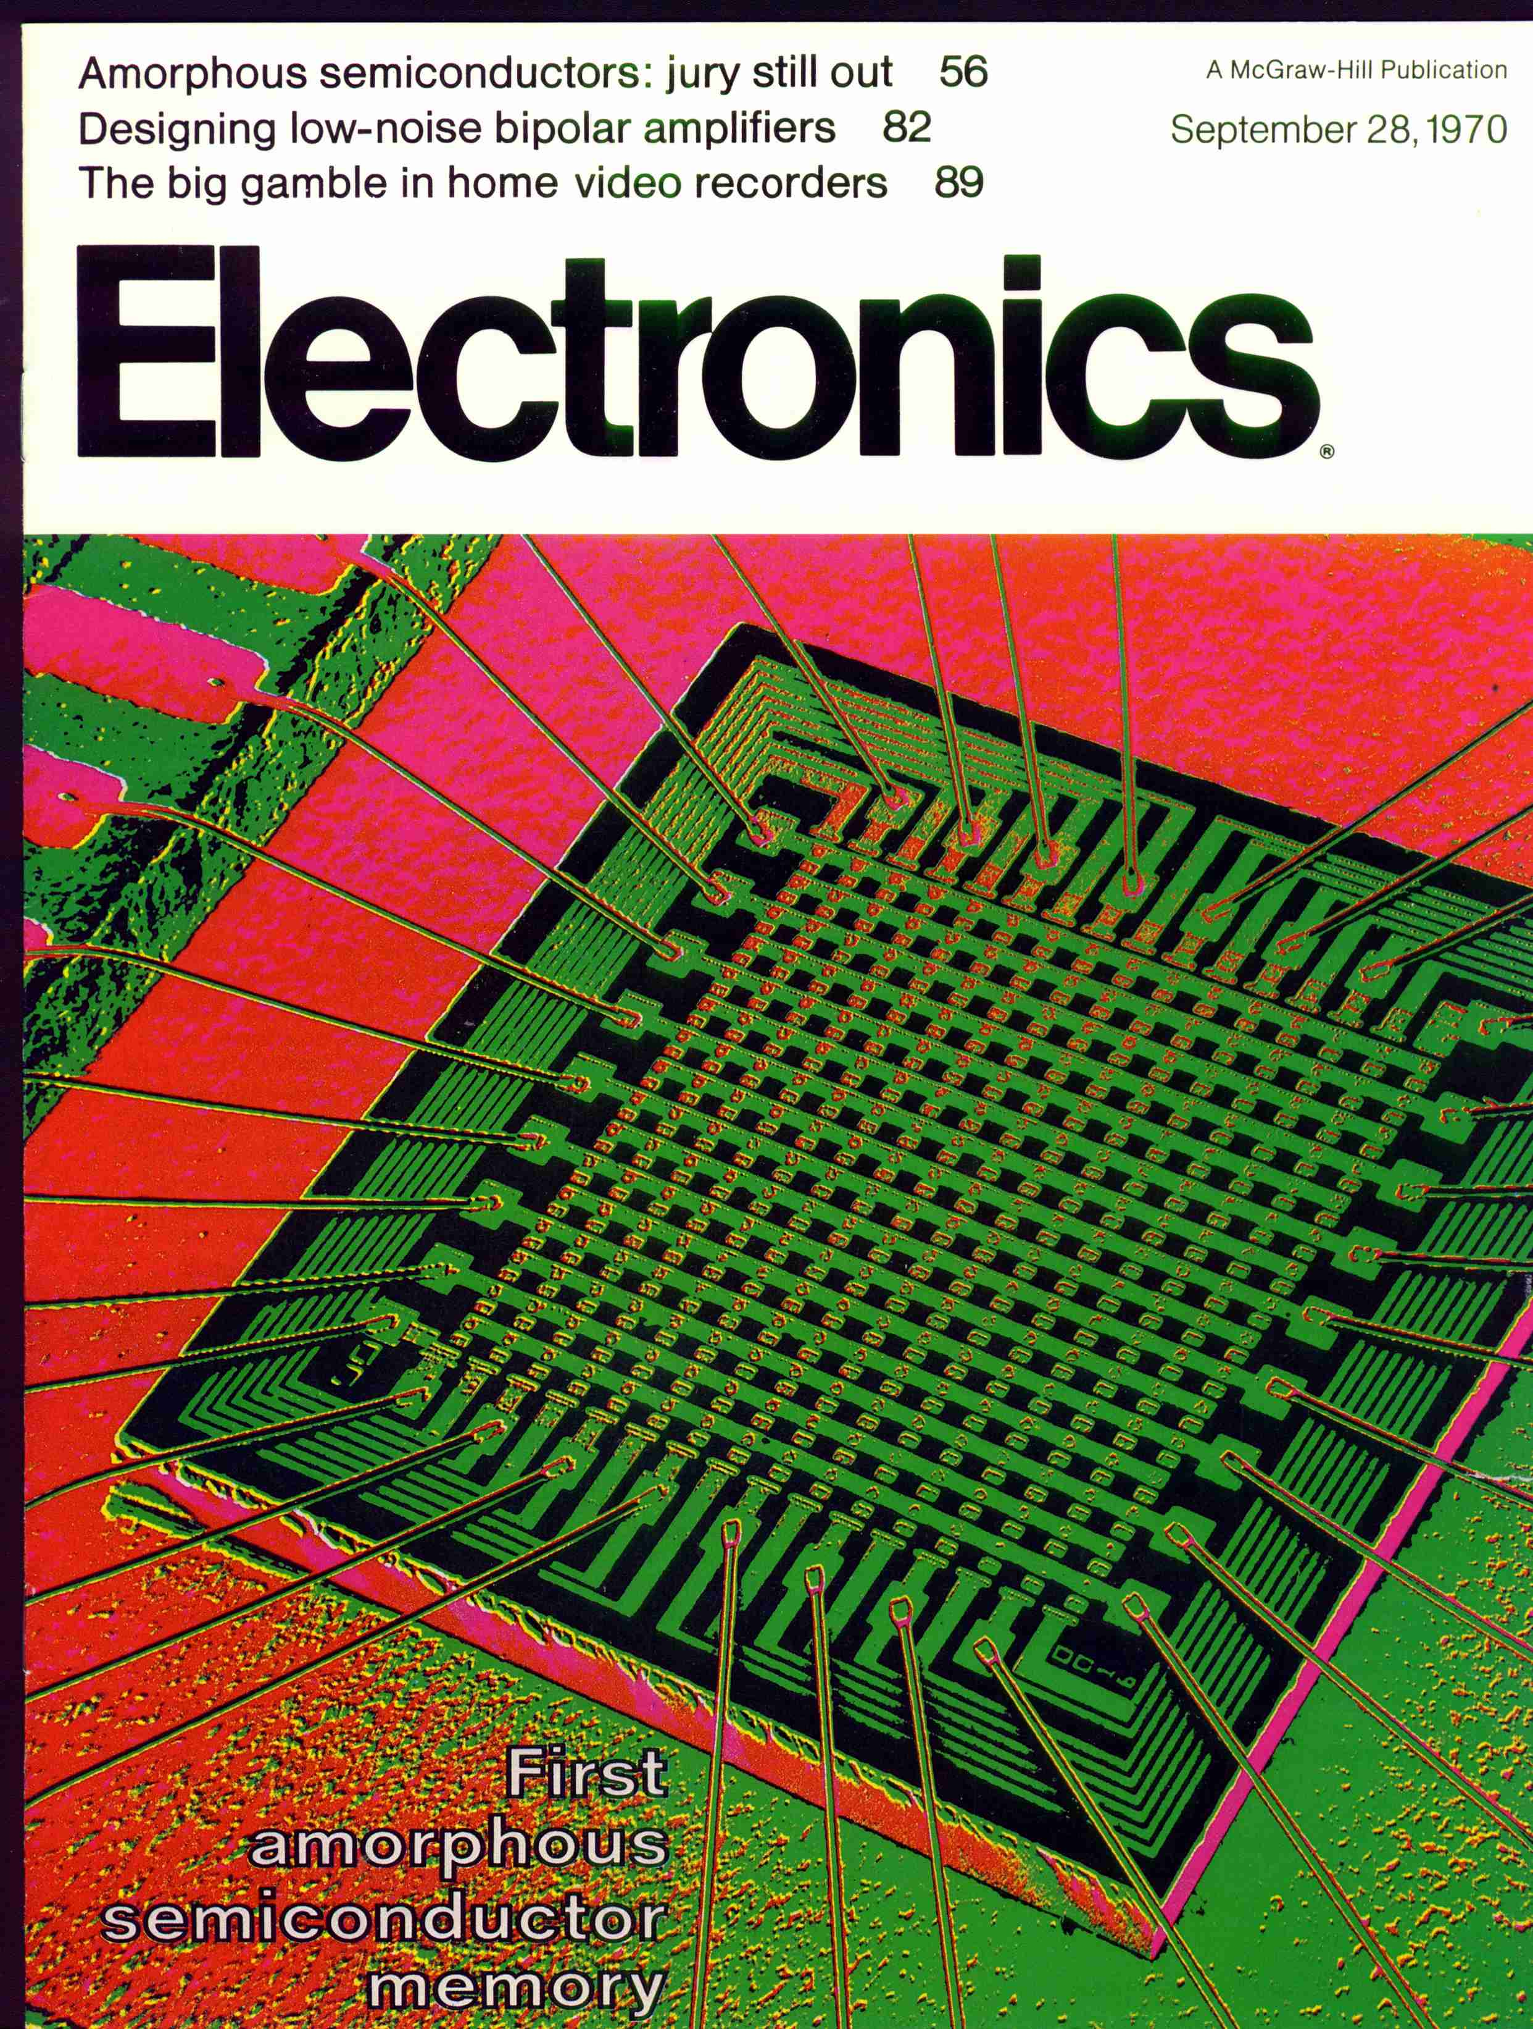
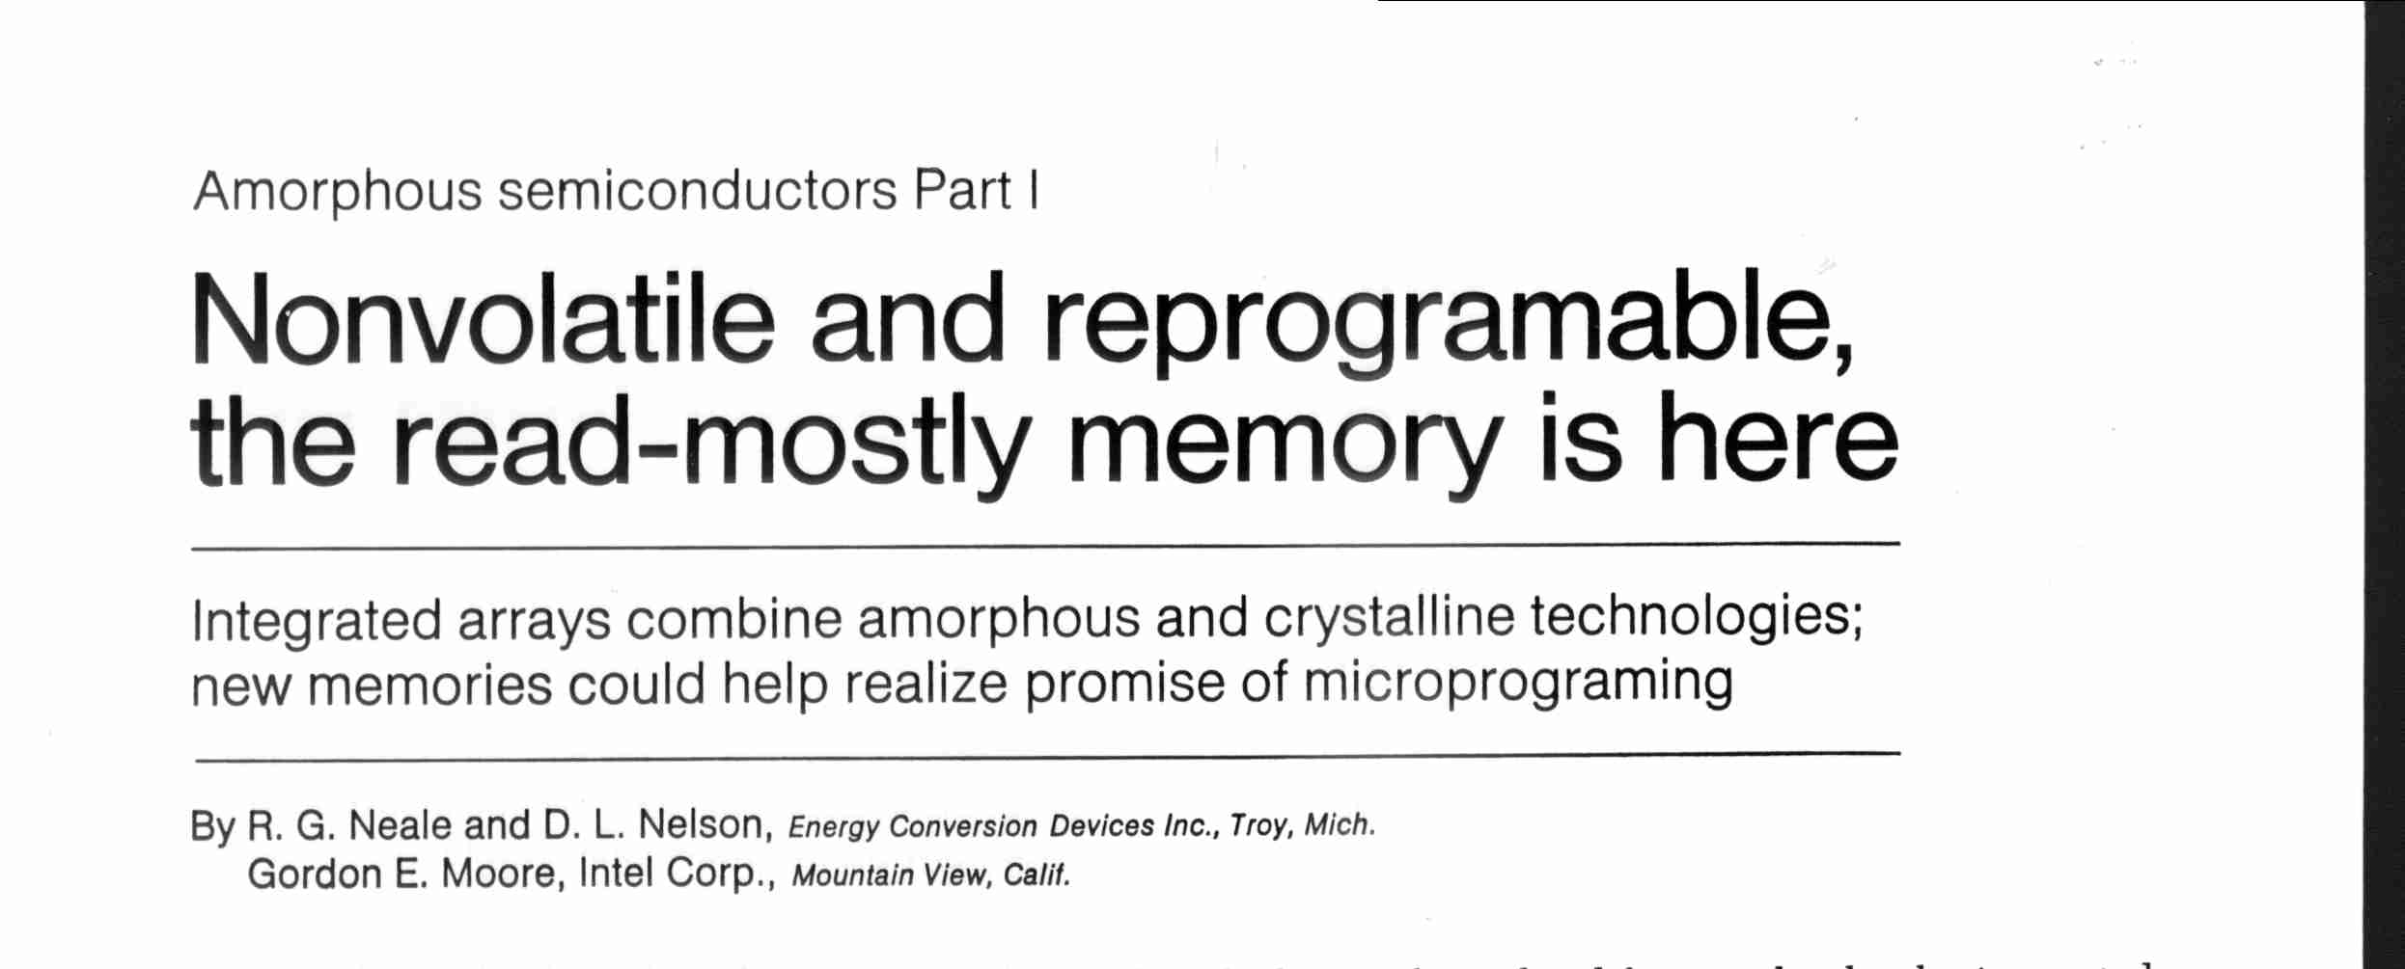
3D Xpoint based on decades of Amorphous Semiconductor research

Slide 15
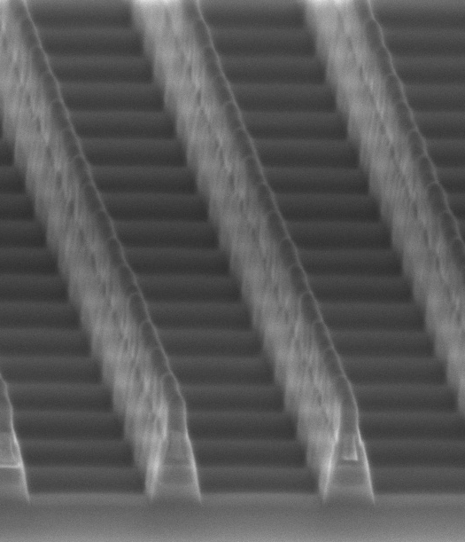
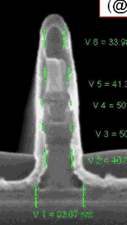
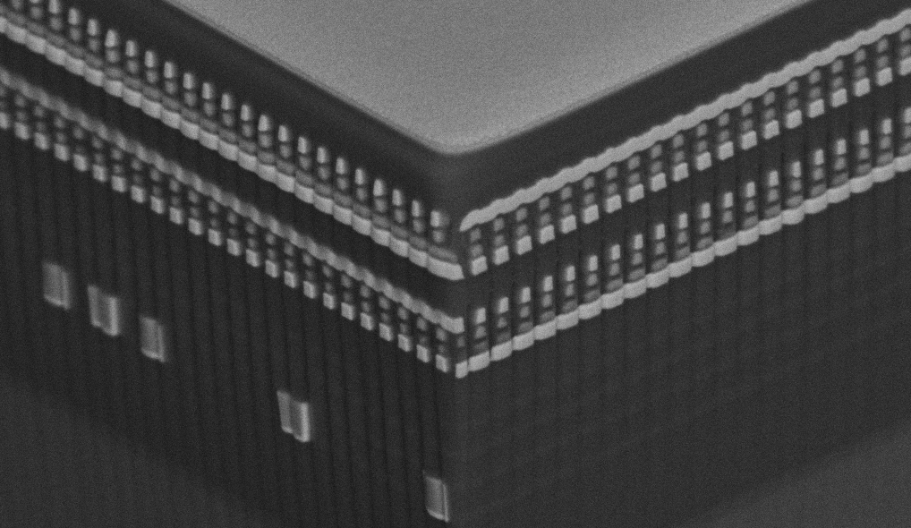
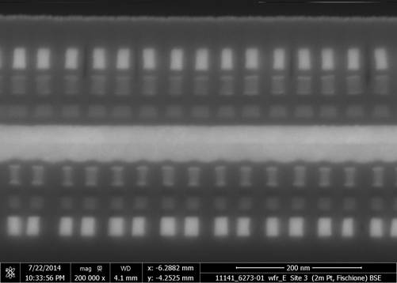
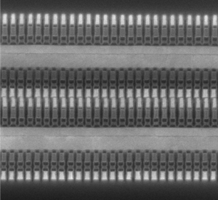
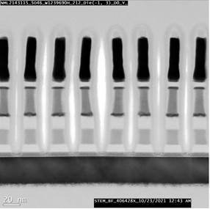
1999 marked Start of Intel’s 3D XPoint Development Efforts
4Kb 200nm feature, 4-mask Sublitho Heater
Damascene PM Subtractive SD
2003~2006 Santa Clara, CA
64Mb 180nm ½ Pitch 6-Mask Sublitho Heater Damascene PM, Subtractive SD
2007~2009 Santa Clara, CA
64Mb 100nm feature, 2-Mask
Self-Aligned, Subtractive Cell
2010~2011 Agrate, Italy
64Mb 50nm ½ Pitch, 2-Mask
Dual Deck, Self Aligned Subtractive Cell
2012~2013 Agrate, Italy
X-section along ROW
TiAlN
SD
C
W
PM
TiAlN
Selector
C
C
Selector
TiSiN
Memory
Mid Electrodes
TiSiN
Memory
cell
128Gb 41nm Pitch
Dual Deck Self Aligned Subtractive Cell
2013-2017 Boise, ID
256Gb 41nm Pitch
Quad Deck Self Aligned Subtractive Cell
2015-2020 Lehi, UT & Rio Rancho, NM
Scaled Line/Space
2019-Present Rio Rancho, NM
1st Production Generation
2nd Production Generation
3rd Production Generation
3rd Generation Development

Slide 16
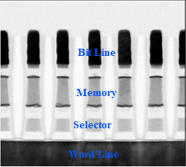
3D XPoint Cell Formation
  Decks: formed by two standard double patterning steps, subtractive etching
  Wordlines / Bitlines: formed in low resistivity conductors, enabling low RC for low latency
  Selector: based on ovonic threshold switch
  Carbon electrodes: provide diffusion barriers between active layers and ease process integration
  Memory element: shares chalcogenide-based genealogy with phase change memory, but does NOT rely on any sub-lithographic interfacial heating / switching structures
Single Deck cross-section of array
Source: A. Fazio “Advanced Technology and Systems of Cross Point Memory”, IEDM 2020

Slide 17
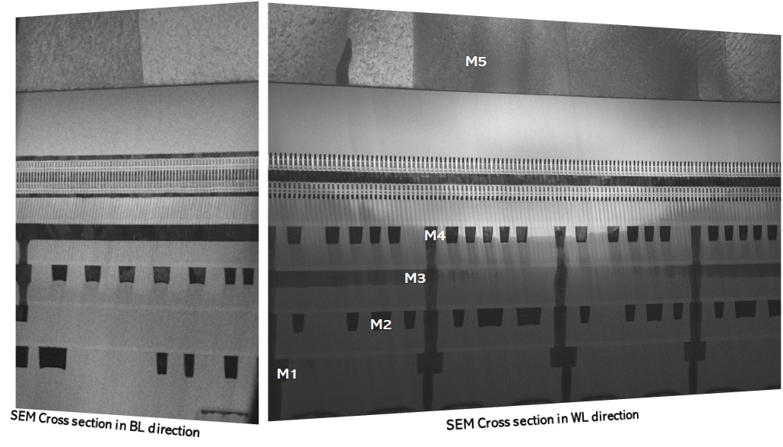
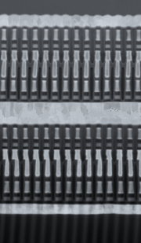
3D XPoint: Memory Addressable High-Capacity Persistence
+
20nm 2 Deck 128Gbit
3D XPoint Memory
Memory Addressable
High-Capacity Persistence
Cache Line Access
Crosspoint Structure: Selectors allow dense packing and individual access to bits (Crosspoint required), based on ovonic threshold switch
Product: 16Byte Access, Multi Banks; Direct write (no flash-like erase blocks)
Non-Volatile Persistence
Material Advances: Atomistic storage (not charge based)
Shared chalcogenide-based genealogy with phase change memory, but does NOT rely on any of PCM’s non-scalable sub-lithographic interfacial heating / switching structures
+
+
Low Latency
High performance cell-array architecture switches states 1000x faster than NAND
Wordlines / Bitlines: low resistivity conductors, enabling low RC = low latency
High Capacity
Low Cost: cell=4λ²/ #decks
Scalable memory layers with CMOS under array. Each Decks = two standard double/quad patterning steps, subtractive etching
2nd Generation: 4 decks
Source: A. Fazio “Advanced Technology and Systems of Cross Point Memory”, IEDM 2020

Slide 18


System innovations – Not possible w/Previously existing technologies
HIGH END SERVERS
HPC
TOP 3
WORLD RECORDS
2.5x
10x
IOPS
LOWER LATENCY
Were set with
DAOS, and the 10-node cluster challenge on the IO500 Challenge
Oracle Exadata X8
Oracle Exadata X8M
Oracle Exadata X8
Oracle Exadata X8M
Oracle Exadata X8M: Storage file system bypassed w/remote direct memory access to storage server PMem
Distributed Asynchronous Object Store (DAOS) metadata storage pool held in PMem, while bulk data object store is held in NVMe SSDs.
Source: J. Shi, “Exadata with Persistent Memory: An Epic Journey”, SNIA Persistent Memory Summit, Jan 2020
Virtual Institute for I/O, https://www.vi4io.org/io500/start

Slide 19
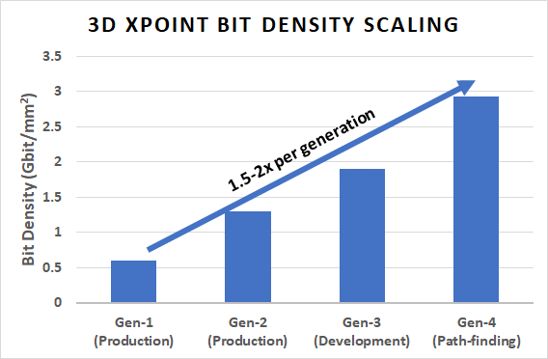
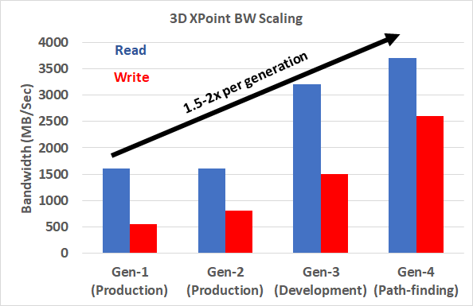
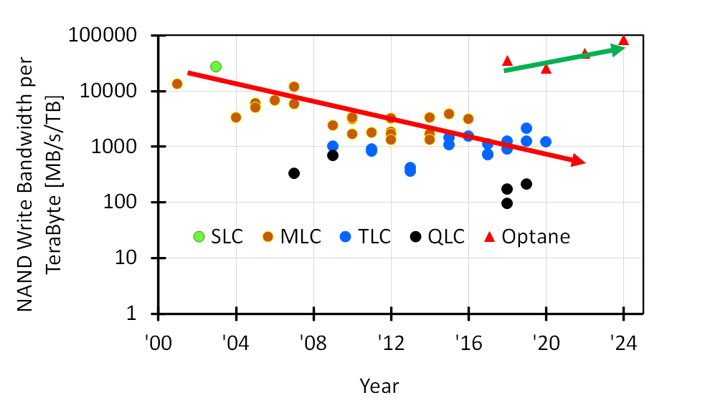
3D XPoint Die-Level Performance & Capacity Scaling trends
1
2
3
High-capacity die: 32GB vs 1GB DRAM (typ.) vs 64GB NAND TLC
BW improves, but lags DRAM ➔ Write BW Achilles heal for DRAM replacement
Focus on BW improvement & capping capacity for couple of gens (shrink die) ➔ improves BW/Capacity cf. NAND
NAND
Optane

Slide 20
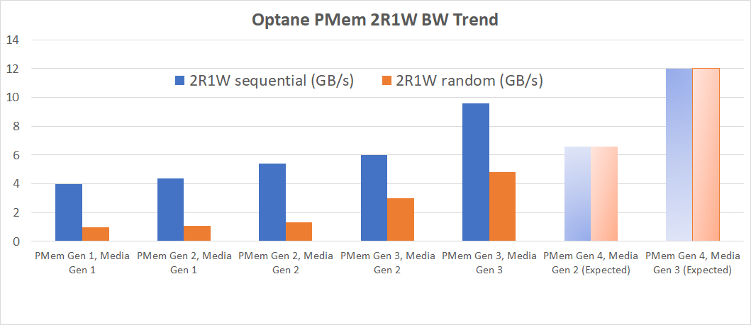
Performance Trend: overcoming short term technical obstacles
CXL Gen5 limit
100% gain Gen3 vs. Gen2 Media on
Gen4 PMem
50% gain Gen3 vs. Gen2 Media on Gen3 PMem
Values have been estimated based on internal Intel analysis and are provided for informational purposes only. Any difference in system hardware or software design may affect actual performance. Results may vary
50% performance gain demo’d w/Gen3 media (Atlantic Falls, under development) vs. Gen2 (S26) With PMem Gen4 (Donahue Pass) and Gen3 media, expect 2X gain relative to Gen2 media
➔ >10x gain in performance vs Apache Pass

Slide 21
Thank You!!! for helping customers overcome the short-term technical obstacles and see the long-term possibilities of the product

