Slide 1
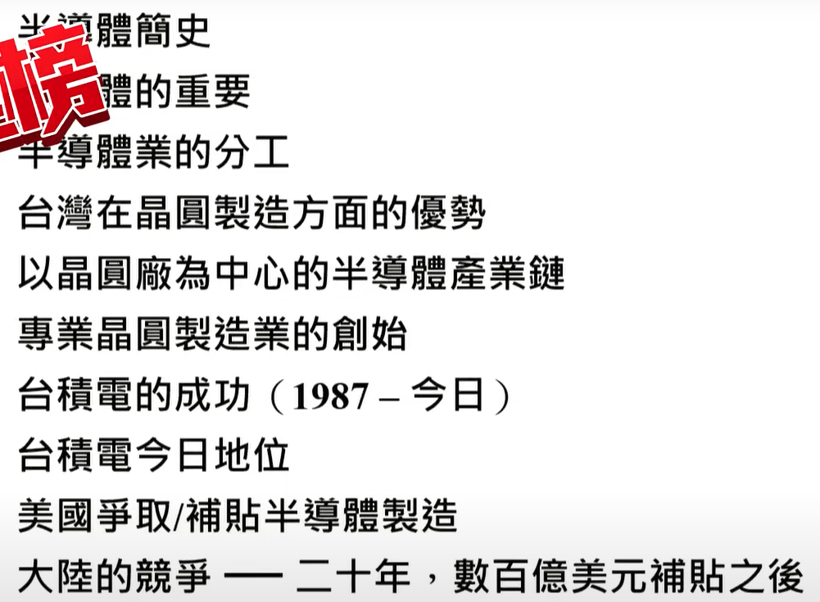

Slide 2
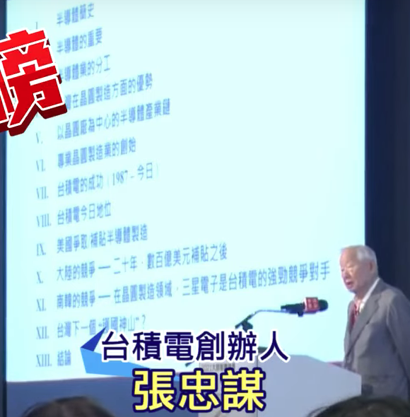
About Intel – Jump to 42-minute mark . The context is about semiconductor foundry business model. Morris argues the customer who also makes chip disturbing TSMC’s operation creating internal politics.
About Arizona – Throughout the last 15~20 minutes of his speech, he talks about the advantage of
TSMC close proximity with supply chain in Taiwan. He argues the vulnerability building fab outside the ecosystem, He also touches upon the inferiority and the challenges on the skill set, the workmanship and management. Specifically, he questions Arizona decision at 48m17s mark.

Slide 3
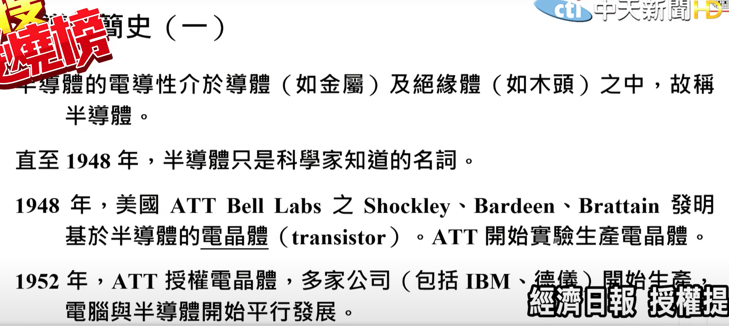
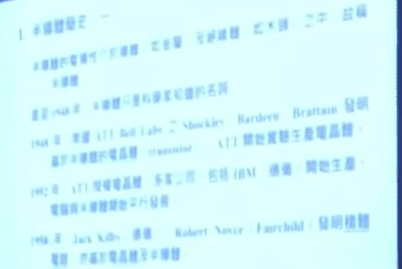

Slide 4
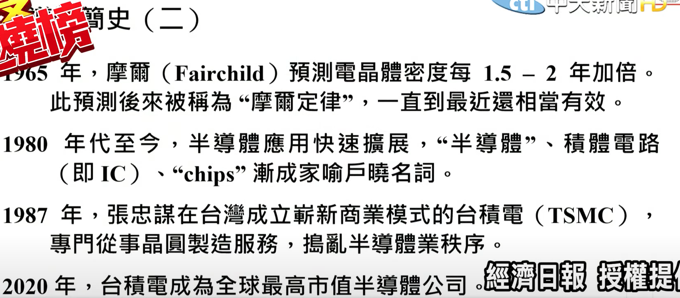
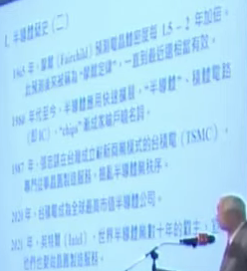

Slide 5
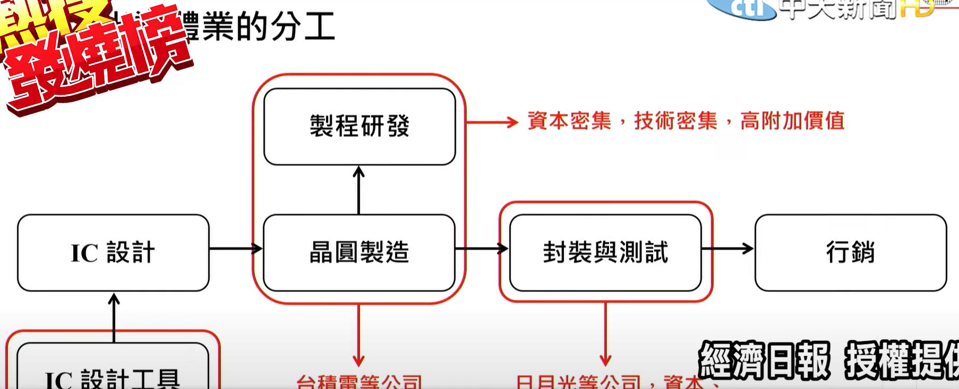

Slide 6
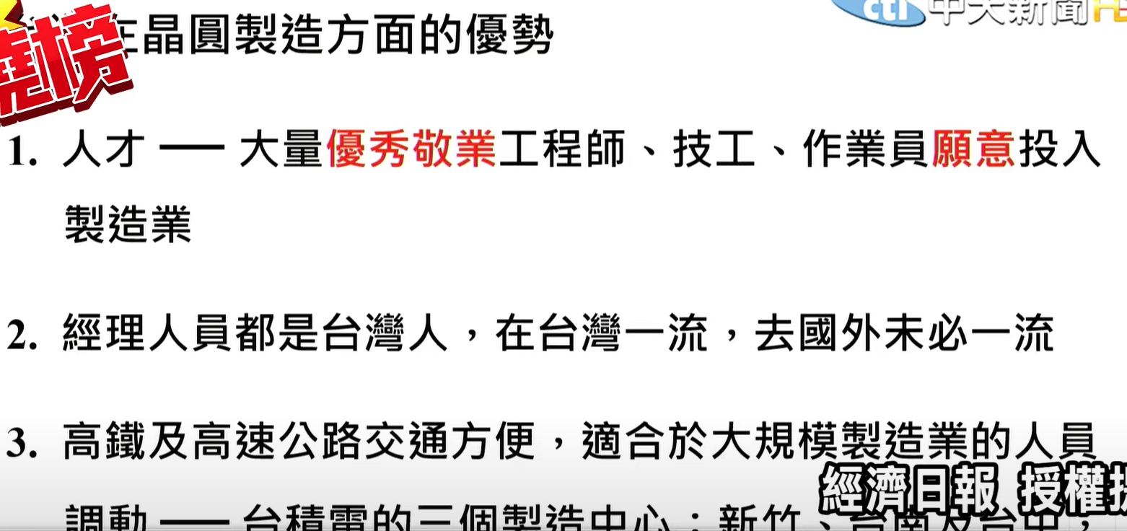

Slide 7
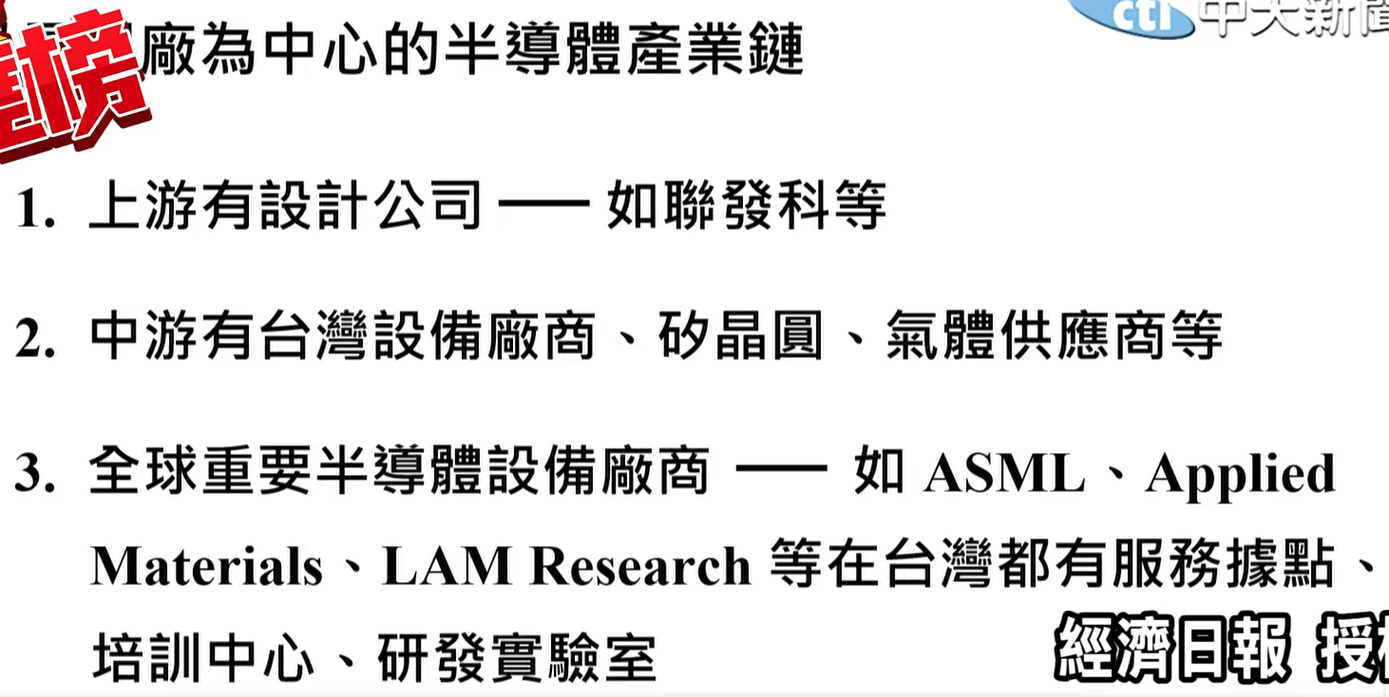

Slide 8
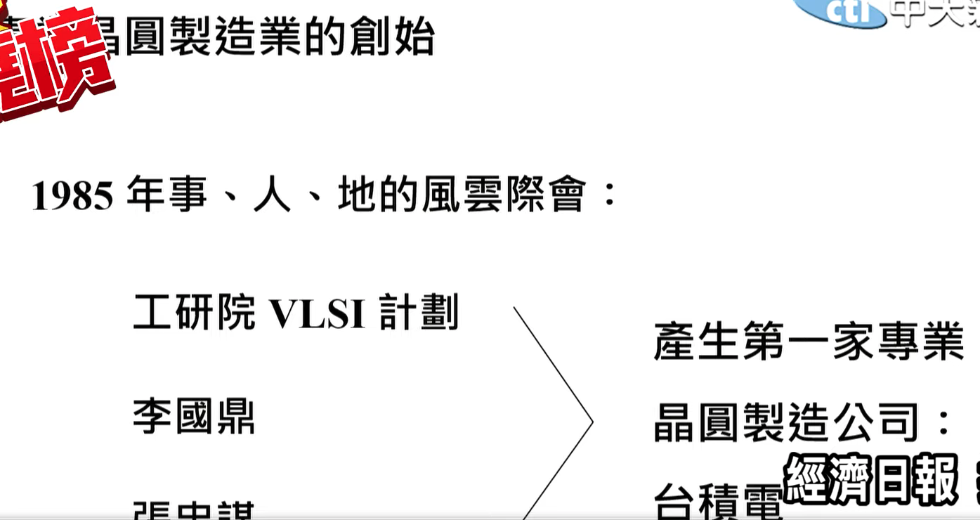

Slide 9
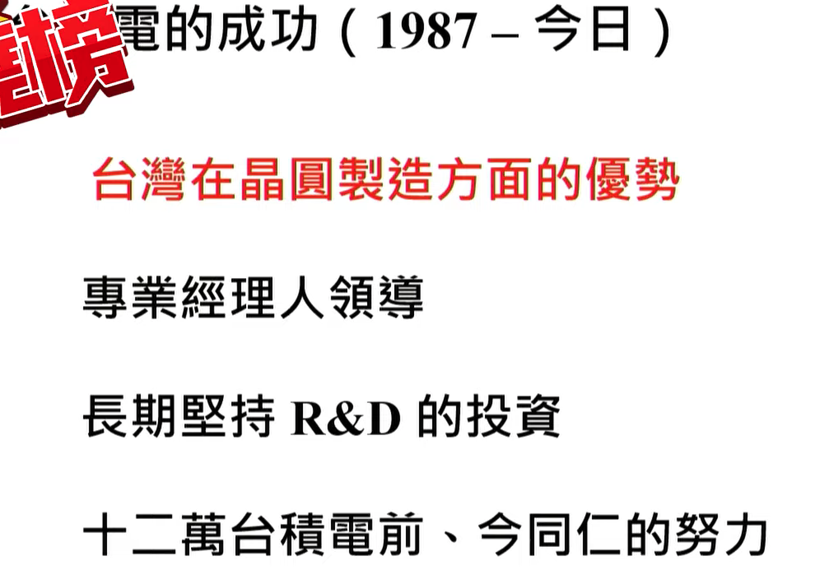

Slide 10
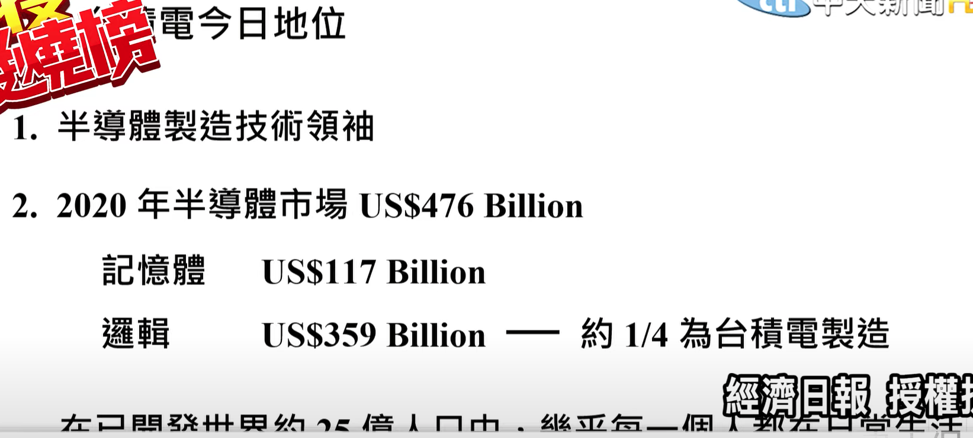

Slide 11
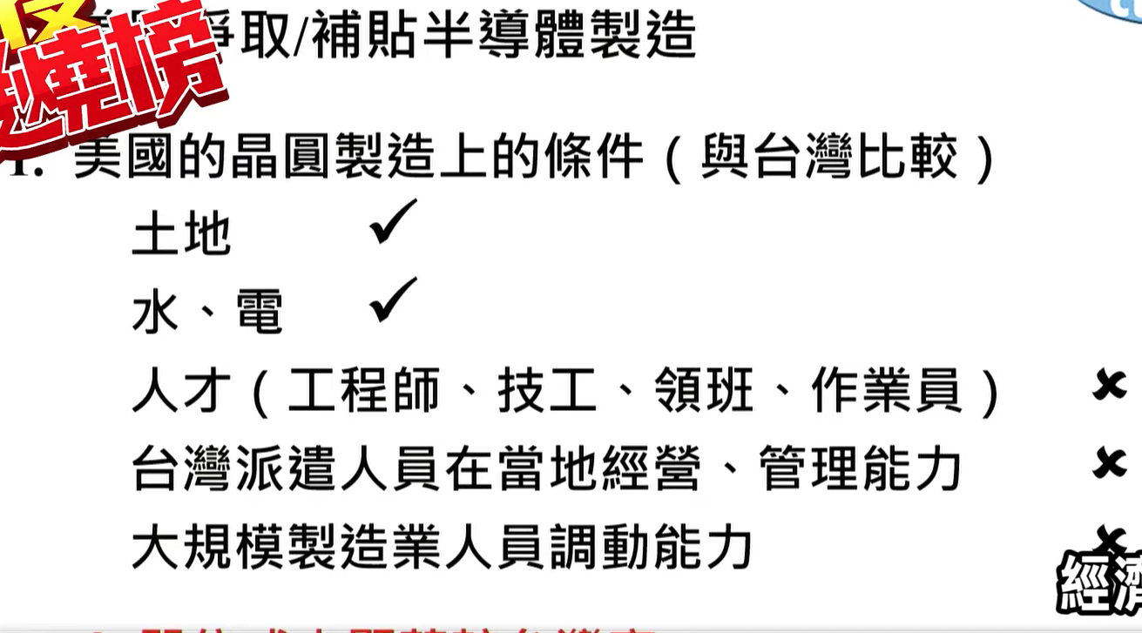

Slide 12
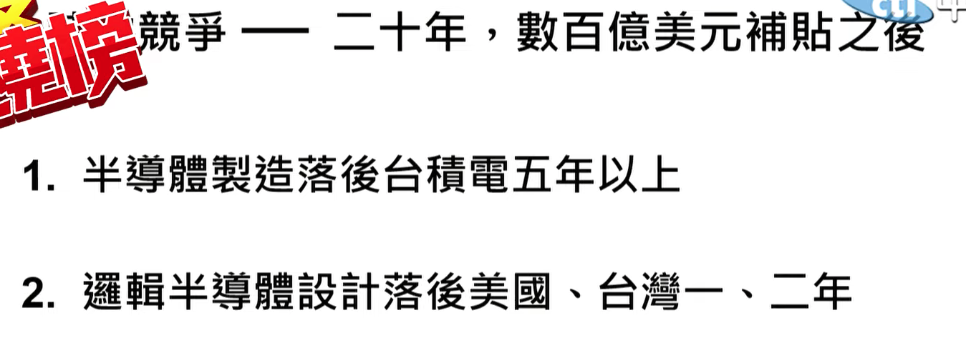


Slide 13
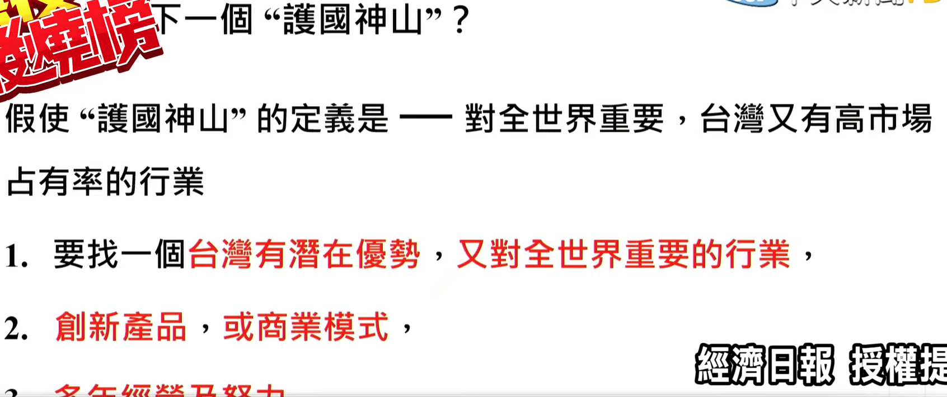

Slide 14
