Slide 1
Key Summary of ECTC 2023 – 2.3 D FO Technology
Li Chen

Slide 2
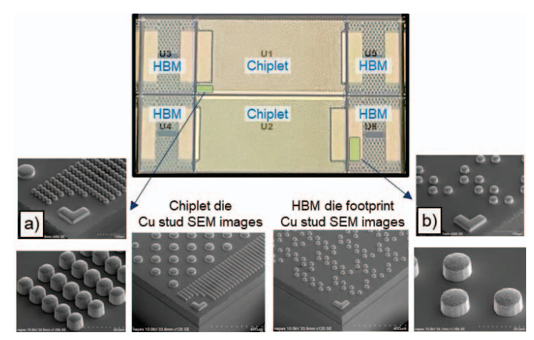
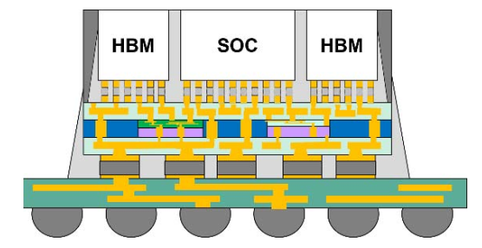
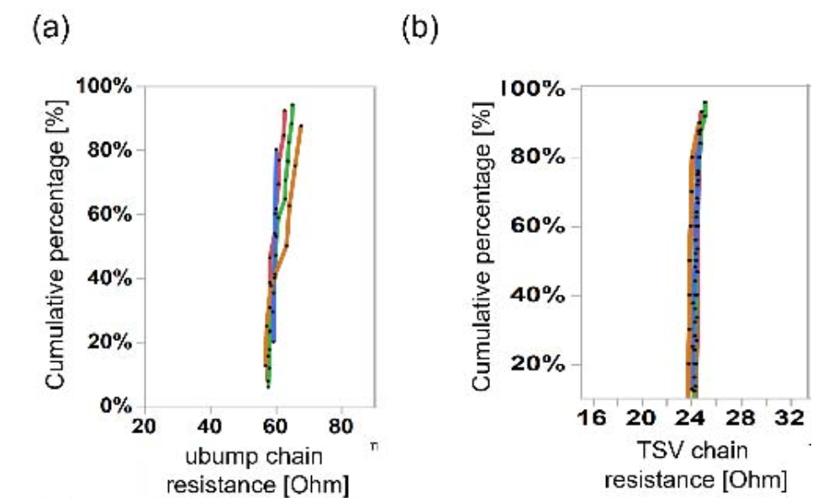
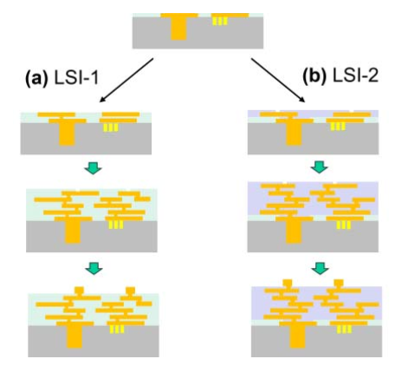
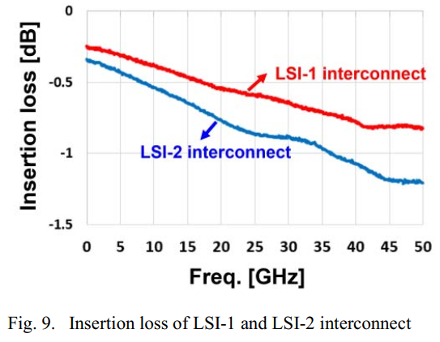
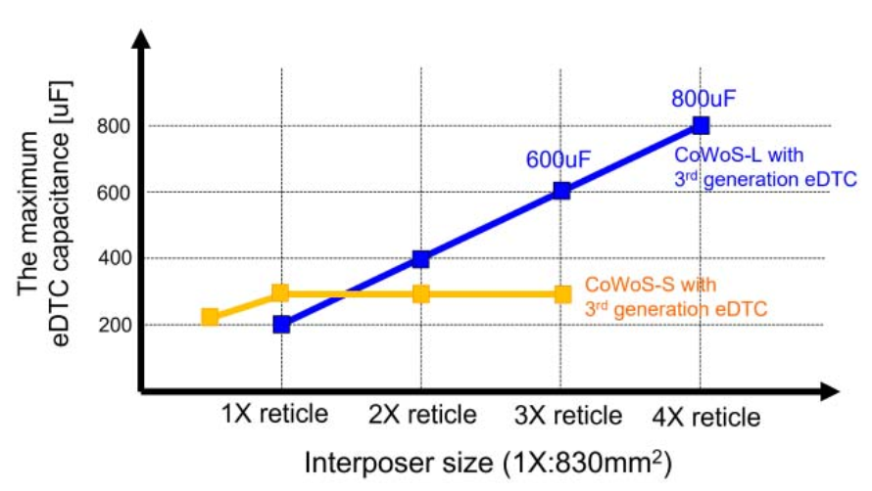
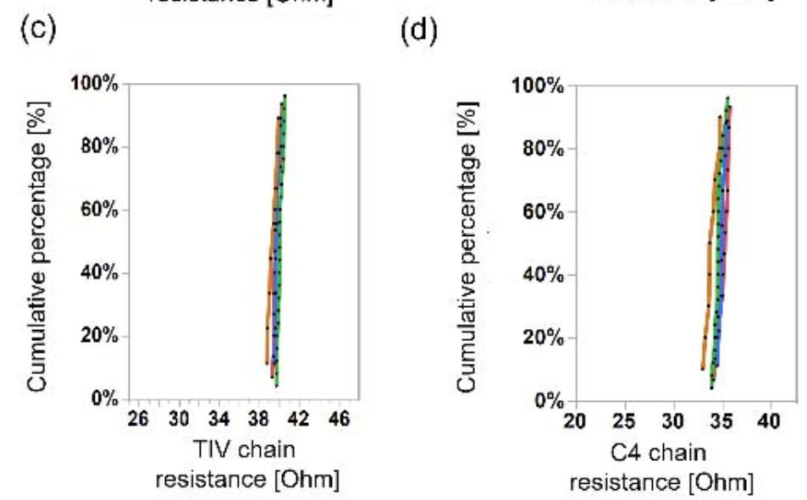
Key Summary of ECTC 2023 – 2.3 D FO Technology
Packaging Technologies Session 7: Large Formfactor Dense System Integration by Fan-Out
Integrating Chiplets using Chips First Ultra-High-Density Fan-out with Maskless Laser Direct Imaging and Adaptive Patterning for High Performance Computing Benedict SJ, etc. – Deca Tech & nepes hayyim
  Die shift issue mitigated by AP and LDI. Reconstituted on wafer or package size : 600x600mm².
  M-Series Gen2, CF, FO, 2+4HBM, bump 20µmP, via open 6um, RDL L/S 2/2μm. 2,518 IO/mm².
  Die location meas. input to adaptive patterning (AP) with unique real time design to create GDS file.
  Mask-less laser direct imaging (LDI) to form via opening and RDL according to optimized GDS file.
CoWoS Architecture Evolution for Next Generation HPC on 2.5D System in Package Yu-Chen Hu, etc. – TSMC
  CoWoS-L Package size 70x76mm², FO size 43x58mm² (2.9x) , μbump 30~60umP.
  Process flow : TIV→ LSI1/2 attach → MD → CMP → 1 TRDL → TD bond → UF → MD → BRDL → C4 → oS.
  LSI-1 : Dual damascene Cu, USG, L/S 0.8/0.8um, thk 2um, lower insertion loss. LSI-2: Cu RDL,PI, L/S 2/2um, thk 2.3um.
  eDTC capacitance: CoWoS-L, multiple LSI, max. 800uF, CoWoS-R, single silicon chip, max. 300uF.
  Reliability: ubump/TSV/TIV/C4 chain passed JEDEC MSL4, TCG 1500x, HTS 1500x, uHAST 264h.
349800a271.pdf
Packaging Technologies Session 25: Next Generation High-Performance Computing Architectures
349800b022.pdf

Slide 3
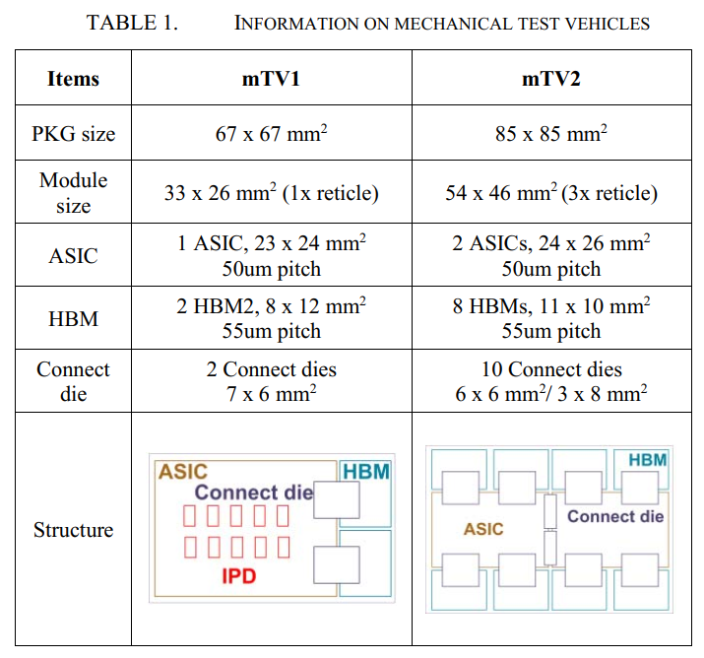
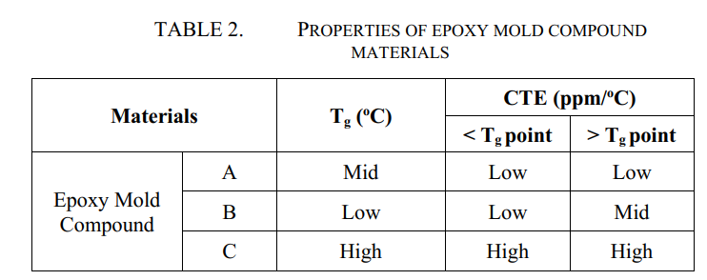
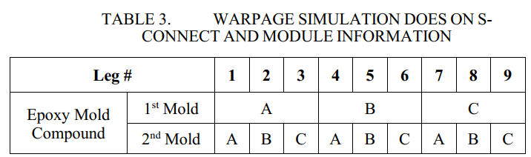
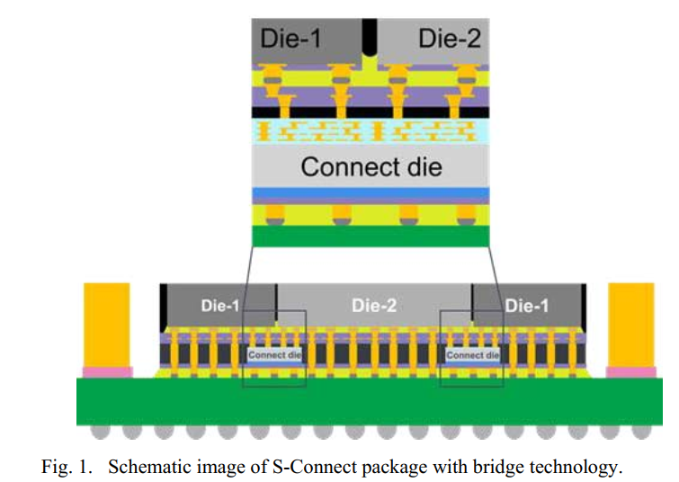
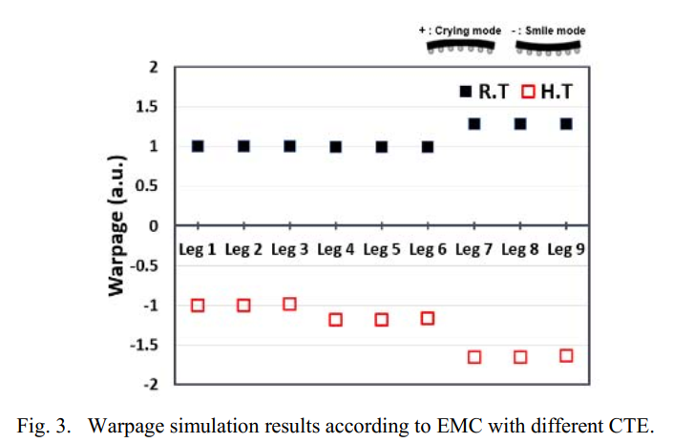
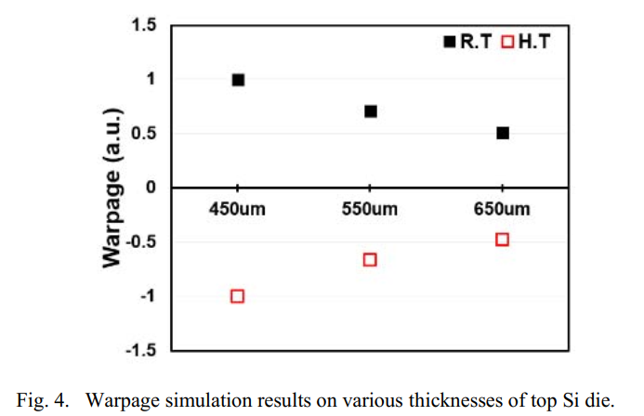
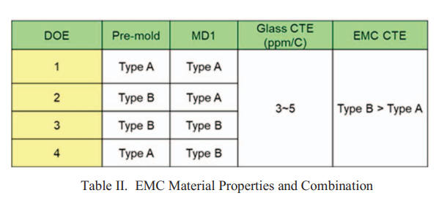
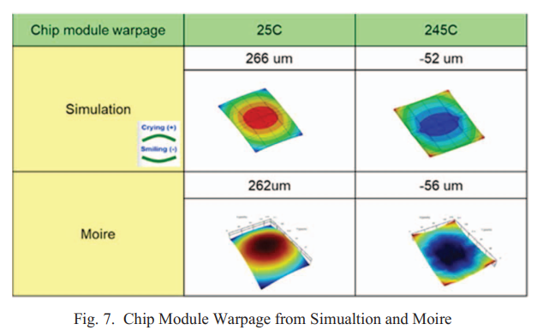
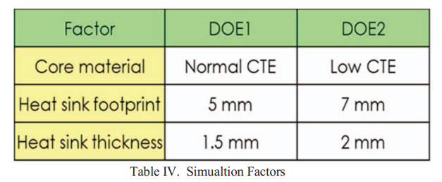
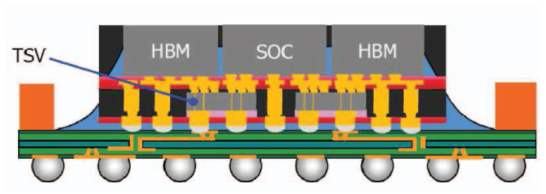
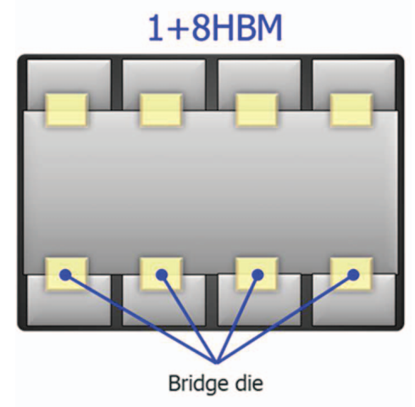
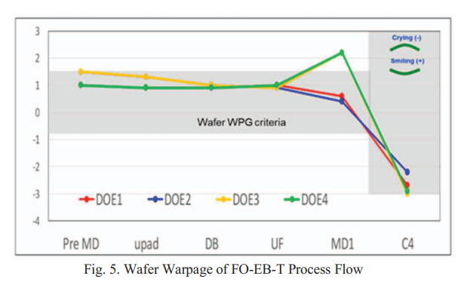
Key Summary of ECTC 2023 – 2.3 D FO Technology
Reliability Performance of S-Connect Module (Bridge Technology) for Heterogeneous Integration Packaging Heejun Jang, etc. – Amkor
  S-Connect chip-last process, μbump: 50μmP (1) mTV1 (1x): ASIC+2HBM+2BD+10IPD, (2) mTV2 (3x): 2ASIC+8HBM+10BD (max: A/R 2.7).
  Module warpage control (1) Low EMC CTE to minimize module warp (2) Thicker Si die 650μm ~50% lower warp than 450 μm.
  Reliability: mTV2 passed JEDEC standards component level reliability tests as MRTL4, uHAST 96hrs , TCB 1000x /HTS 1000hrs.
Fan-out Embedded Bridge with TSV (FO-EB-T) Package Characterization and Evaluation Vito Lin, etc. – SPIL
  FO-EB-T, 1+8HBM+4BD, FO ~3000mm² (2.5x), Low MD CTE with better process warp control & CM warp RT/262um, HT/-56um.
  Low CTE core and high HS thk with smaller package warpage: (DOE1) RT/408um,HT/-259um > (DOE2) RT/327um,HT/-200um.
  Low CTE core (DOE2) reduced CM corner crack risk and stress is lower than normal CTE core (DOE1) as 5% for lower CTE mismatch.
349800b027.pdf
RT:-30% warp
RT: -51% warp
EMC CTE low to high
Si THK
TMV 260μmP
135μmH
ICD
70μmH
HT: - 48% warp
HT: -60% warp
Thermal/Mechanical Simulation & Characterization Session 32: Thermo-Mechanical Modelling and Characterization
349800b344.pdf
High MD CTE
Low MD CTE

Slide 4
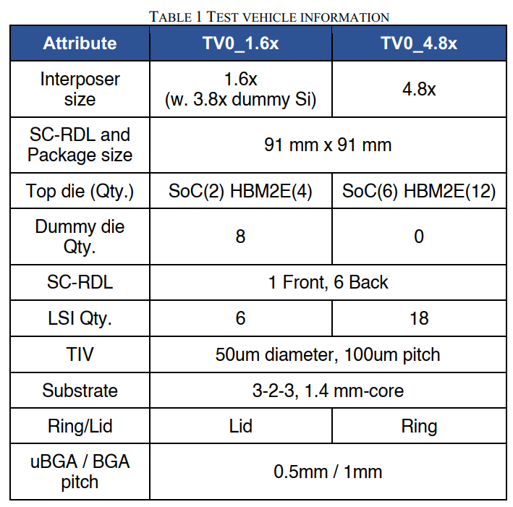
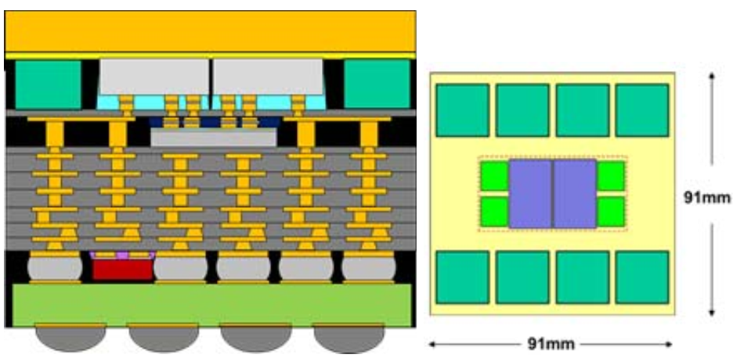
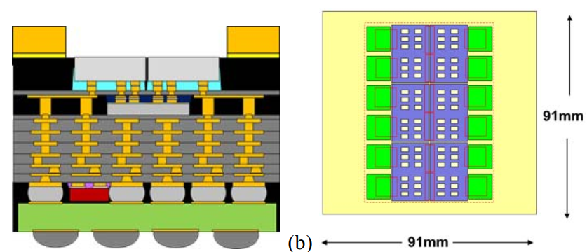
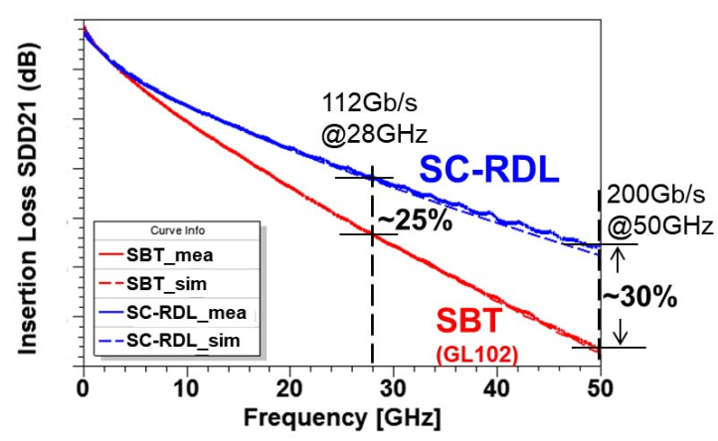
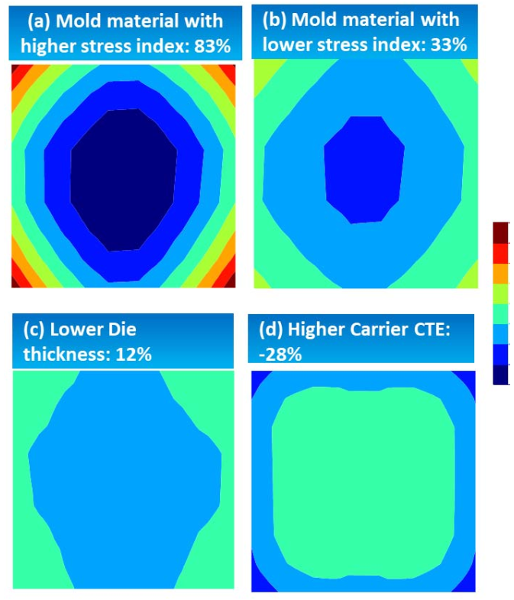
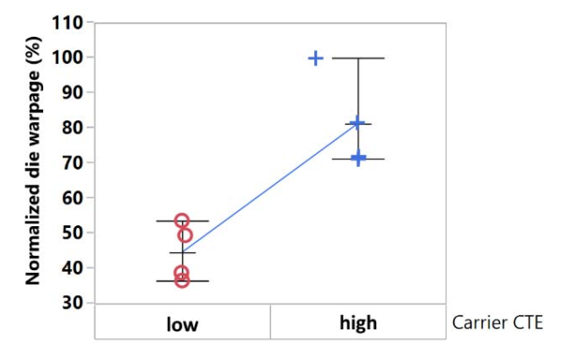
Key Summary of ECTC 2023 – 2.3 D FO Technology
Packaging Technologies Session 13: Wafer/Panel-Level and Advanced Substrate Technologies
349800a510.pdf
Supercarrier Redistribution Layers to Realize Ultra Large 2.5D Wafer Scale Packaging by CoWoS SY. Hou, etc. – TSMC
  New CoWoS with 6L SC-RDL (super carrier-RDL) L/S 11/11um under LSI interposer of CoWoS-L, 1L FRDL, 3-2-3 SBT,Pkg:91x91mm.
  mTV_1.6x : FO ~4500mm (5.4x) mimic by added 8 DMYs, 6 LSIs, with lid warpage RT 65um/ HT ~150um.
  mTV_4.8x FO ~4000mm (4.8x) 18 LSIs, with stiffener ring no TIM1 required warpage RT 200um/ HT 120um.
  SC-RDL : (1) Mitigate CTE mismatch (2) reduced SBT layer and low insertion loss (3) enable uBGA at 400-500umP to ensure oS yield.
  REL: mTV_1.6x passed MR6x, uHAST 396h,TCC 500x, TCG 850x, HTS 1000h, mTV_4.8x passed MR6x.
Warpage Modulation Study on Panel-level Compression Molding Technology for Heterogenous Integration Applications Liang He, etc. – Intel
  Warpage study for large form factor panel level 510x515mm (~2600cm²) : Mold/Carrier CTE, Die THK.
  50% panel warpage reduced by lower stress index mold material, thinner top die THK achieved 12%.
  Higher carrier CTE warpage turn to convex (-) for carrier shrinks more after cooling down to room temp.
  By reducing the carrier and Si CTE mismatch, the die warpage was reduced by half.
TV_1.6x
TV_4.8x
349800a526.pdf
Panel warpage
Die warpage

