Slide 1
High-Bandwidth, Energy-efficient DRAM Architectures for GPU systems
Mike O’Connor – November 2, 2015

Slide 2
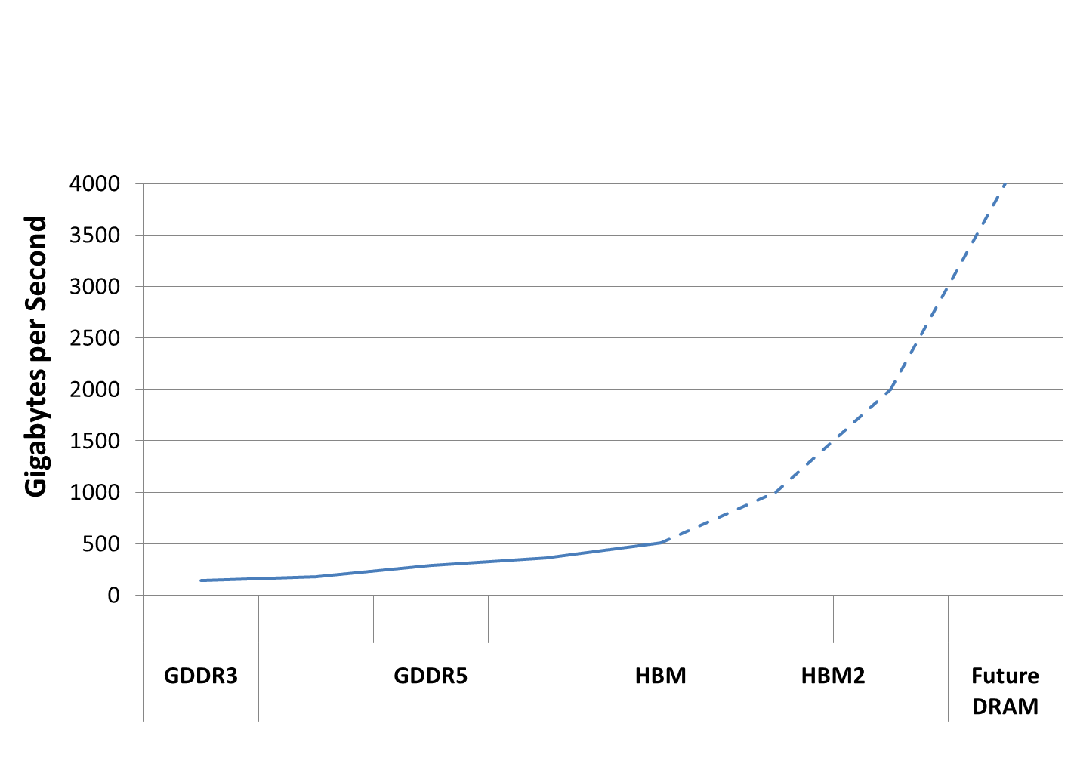
GPUs Demand High DRAM Bandwidth

Slide 3
GPUs Demand High DRAM Bandwidth
2008: NVIDIA Tesla GT200
512-bits @ 2.2 Gbps

Slide 4
GPUs Demand High DRAM Bandwidth
2010: NVIDIA Fermi
GF100
384-bits @ 3.7 Gbps

Slide 5
GPUs Demand High DRAM Bandwidth
2013: NVIDIA Kepler
GK110
384-bits @ 6 Gbps

Slide 6
GPUs Demand High DRAM Bandwidth
2013: NVIDIA Maxwell
GM200
384-bits @ 7 Gbps

Slide 7
GPUs Demand High DRAM Bandwidth
2013: AMD Fury X
“Fiji”
4096-bits @ 1 Gbps

Slide 8
GPUs Demand High DRAM Bandwidth
Future GPU with
4-stack HBM2
4096-bits @ 2 Gbps

Slide 9
GPUs Demand High DRAM Bandwidth
4 TB/sec Exascale Node Target

Slide 10
GPUs Demand High DRAM Bandwidth
CPUs, Not so Much
Typical PC CPU
2 Channel DDR3-1600
51.2 GB/sec

Slide 11
GPUs Demand High DRAM Bandwidth
CPUs, Not so Much
Newer High-End CPU
2 Channel DDR4-3200
102.4 GB/sec

Slide 12
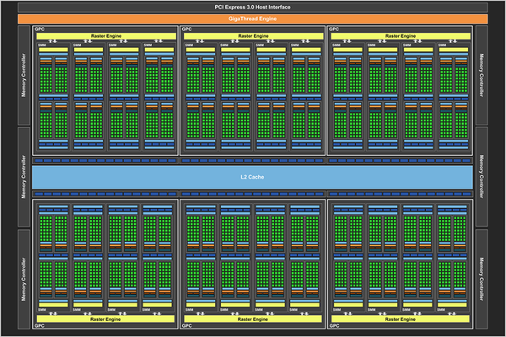
Why Do GPUs Demand so Much Bandwidth?
Lots of compute
24 Streaming Multiprocessors
each w/ 128 execution units
Lots of threads
64 warps of 32 threads
per SM
→ 49,152 threads executing
simultaneously on 3072 execution units
NVIDIA Maxwell GM200

Slide 13
Why do GPUs Demand so Much Bandwidth?
Different Memory Hierarchies
6 MB Register File
6 MB Register File
(Holds state for many threads)
25.25K Register File
(PRF)
128K L1
2.3 MB L1/Scratchpad
512K L2
~2 MB L1 and Scratchpad
8 MB L3
3 MB L2
Intel Core i7-4790
NVIDIA Maxwell GM200

Slide 14
Why do GPUs Demand so Much Bandwidth?
Radically Different Memory Hierarchies per Thread
3.28K Register File
(PRF)
16K L1
64K L2
128B Register File
6 MB Register File
(Holds state for many threads)
~2 MB L1 and Scratchpad
48B L1/Scratchpad
64B L2
1 MB L3
NVIDIA Maxwell GM200
49,152 Threads
Intel Core i7-4790
8 Threads

Slide 15
Why do GPUs Demand so Much Bandwidth?
Radically Different Memory Hierarchies per Thread
On-Chip Storage:
240 bytes per thread
vs.
1,133,856 bytes per thread
3.28K Register File
(PRF)
16K L1
64K L2
128B Register File
6 MB Register File
(Holds state for many threads)
~2 MB L1 and Scratchpad
48B L1/Scratchpad
64B L2
1 MB L3
NVIDIA Maxwell GM200
49,152 Threads
Intel Core i7-4790
8 Threads

Slide 16

Whole Different Ballgame
vs. typical CPU
25x More Bandwidth
Less sensitive to latency
LESS regular access patterns
More sensitive to tRRD/tFAW

Slide 17

I thought GPUs had regular/streaming accesses?
GPU warp = 32 Threads executed in SIMD manner
http://www.shopbuy.org/static/category/original/rope/14174435-seamless-heamp-rope-texture-pattern.jpg
http://www.shopbuy.org/static/category/original/rope/14174435-seamless-heamp-rope-texture-pattern.jpg
LD r1, [r2+tid.x]
Nice, Coalesced load of 32 x 4B = 128B

Slide 18
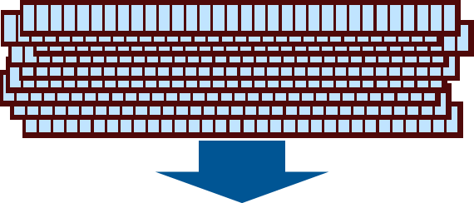
I thought GPUs had regular/streaming accesses?
But a lot is happening in parallel…

Slide 19

I thought GPUs had regular/streaming accesses?
24 SM’s…
64 warps each…
Highly interleaved execution!
HA HA HA! I will bring Chaos to your puny DRAM system!
But a lot is happening in parallel…

Slide 20

CPU
Fewer threads, lower chance of bank conflicts
2 ranks/channel
8 banks per rank
Typical CPU : 8 Threads
http://www.shopbuy.org/static/category/original/rope/14174435-seamless-heamp-rope-texture-pattern.jpg
http://www.shopbuy.org/static/category/original/rope/14174435-seamless-heamp-rope-texture-pattern.jpg
→ 4 banks per thread

Slide 21

GPU
6 channels
16 banks per channel
Many different threads competing
NVIDIA Titan X: 1536 Warps
→ 0.06 banks per warp

Slide 22
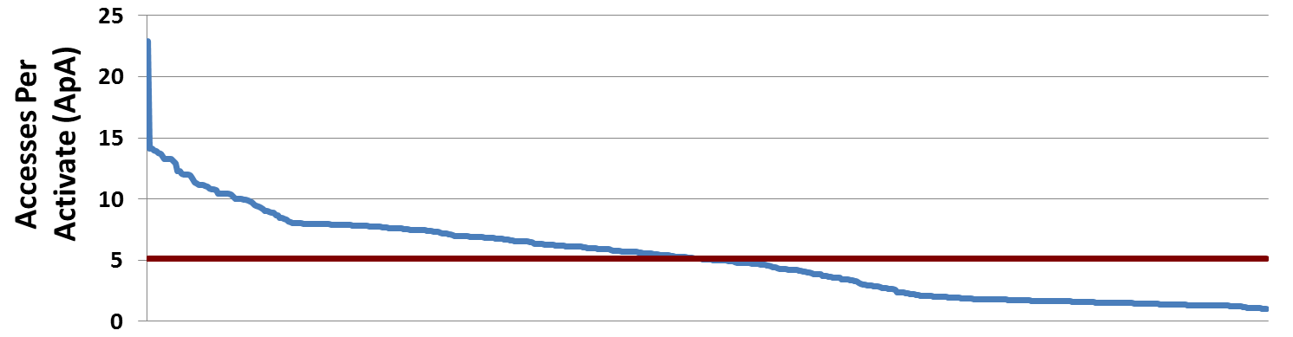
What does this mean for Energy?
Low Accesses per Activate
→ Average ~160 Bytes accessed per activate
(5 x 32B)

Slide 23

What does this mean for Energy?
Low Accesses per Activate
Compositing Images
→ High Accesses per Activate workloads are
typically simpler functions like large data copies

Slide 24

What does this mean for Energy?
Graph Analytics
Low Accesses per Activate
→ Many of the 1 Access/Activate workloads are
are doing graph traversals of large graphs

Slide 25

What does this mean for Energy?
Want to reduce row overfetch
DRAM device typically has 1-2KB row
- we only need 160B on average
Wastes ~84-92% of the energy on activate/precharge of a DRAM bank
Multiple devices in parallel (like a DIMM) make this even worse

Slide 26

What does this mean for Performance?
Activate rate is a key
High-bandwidth I/O is nice, but…
Key aspect of performance is rate of activates
- low tRRD and tFAW
- high number of channels
Typical 2-channel, 2-rank DDR4 w/ tRRD_{eff}=5.25ns: 762 M ACT/sec
HBM2 4-stack, 64-channel (w/ pseudochannels) w/ tRRD_{eff}=4ns:
16 G ACT/sec

Slide 27

Small DRAM Atoms
DRAM “atom” is smallest indivisible access
Basically a function of bus-width and burst-length
GPUs extensively use compression of graphics surfaces
Efficiency of compression a function of minimum access size
Efficient partial coverage

Slide 28
What to GPUs need from DRAM?
High Bandwidth (w/ low access / activate)
Energy-efficient (largely because of high bandwidth)
Small minimum burst sizes (e.g. 16-32B)
Not necessarily concerned with:
Low-latency
Extremely large capacities
Lowest possible cost

Slide 29
One Approach: High-Speed Signaling
Start with a commodity DRAM core
Since GPUs don’t need huge capacities, drop multi-rank support
Without multi-drop busses and sockets, push I/O data rates
Beef-up the DRAM core to keep up (reduce tRRD/tFAW if possible)
Basic approach behind GDDR DRAMs

Slide 30
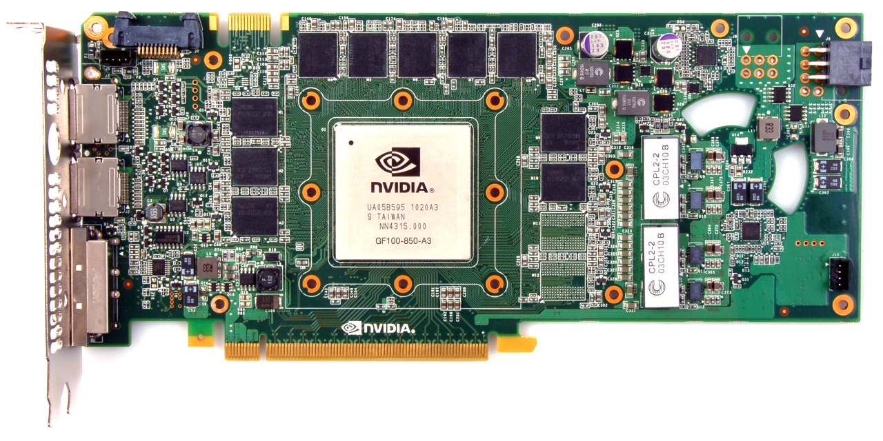
GDDR5
GDDR5 signals at up to 8 Gbps
GDDR5X soon going to 10-12 Gbps
Lots of board challenges
I/O energy efficiency not so great

Slide 31
Challenges with High-speed Signaling
Limits on data rates with inexpensive board & package
High-data rates place demands on the DRAM core
- Cycle the DRAM core arrays faster
And/Or
- Sub-partition pieces of the DRAM array
And/Or
- Fetch more data from the array each time

Slide 32
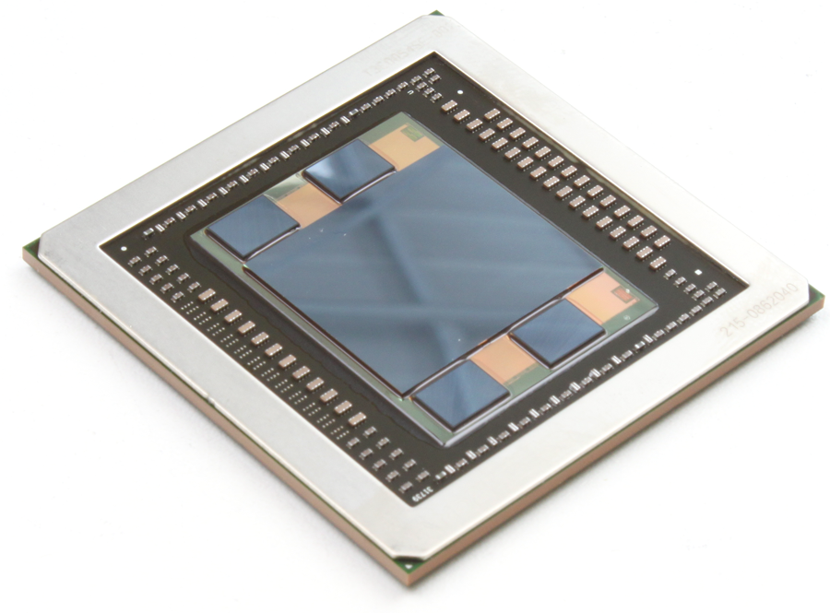
Another Approach: In-package Integration
3D Stacking technologies enable many more I/Os
What if instead of faster, we go wider…

Slide 33
What is High-Bandwidth Memory (HBM)?
Memory standard designed for needs of future GPU and HPC systems:
  Exploit very large number of signals available with die-stacking technologies for very high memory bandwidth
  Reduce I/O energy costs
  Enable higher fraction of peak bandwidth to be exploited by sophisticated memory controllers
  Enable ECC/Resilience Features
JEDEC standard JESD235, adopted Oct 2013.
  Initial work started in 2010

Slide 34
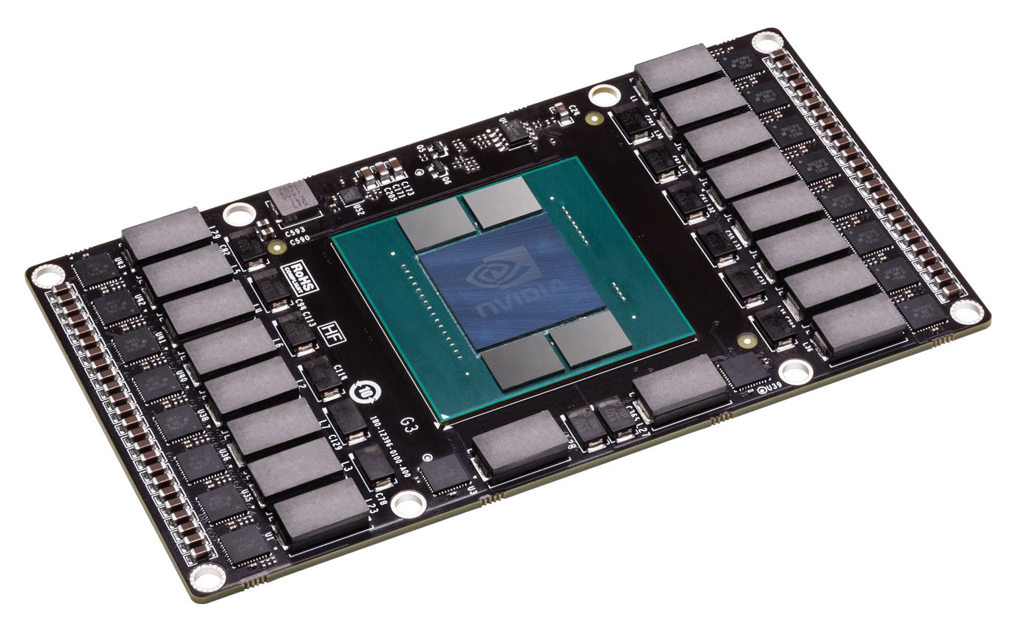
What is High-Bandwidth Memory (HBM)?
Enables systems with extremely high bandwidth requirements like future high-performance GPUs

Slide 35

HBM Overview
Channel 0
Channel 1
4 DRAM dies with 2 channels per die
Optional Base “Logic” Die
Each HBM stack provides 8 independent memory channels
  These are completely independent memory interfaces
    Independent clocks & timing
    Independent commands
    Independent memory arrays
    In short, nothing one channel does affects another channel

Slide 36
HBM Overview - Bandwidth
Each channel provides a 128-bit data interface
  Data rate of 1 Gbps per signal (500 MHz DDR)
  HBM2 bumps this to 2 Gbps per signal (1 GHz DDR)
  16-32 GB/sec of bandwidth per channel
8 Channels per stack
  128-256 GB/sec of bandwidth per stack
For comparison:
  Highest-end GDDR5-based today (NVIDIA GeForce GTX 980Ti)
    384b wide GDDR5 (12 x32 devices) @ 7 Gbps = 336 GB/s
  AMD Fury X with 4 stacks of HBM
    Four stacks of HBM @ 1 Gbps = 512 GB/s
  Future possible GPU with 4 stacks of HBM2
    Four stacks of HBM2 @ 2 Gbps = 1 TB/s

Slide 37
HBM Overview - Bandwidth
At lower overall DRAM system power –
~6 pJ/bit vs.
~18 pJ/bit for GDDR5
Each channel provides a 128-bit data interface
  Data rate of 1 Gbps per signal (500 MHz DDR)
  HBM2 bumps this to 2 Gbps per signal (1 GHz DDR)
  16-32 GB/sec of bandwidth per channel
8 Channels per stack
  128-256 GB/sec of bandwidth per stack
For comparison:
  Highest-end GDDR5-based today (NVIDIA GeForce GTX 980Ti)
    384b wide GDDR5 (12 x32 devices) @ 7 Gbps = 336 GB/s
  AMD Fury X with 4 stacks of HBM
    Four stacks of HBM @ 1 Gbps = 512 GB/s
  Future possible GPU with 4 stacks of HBM2
    Four stacks of HBM2 @ 2 Gbps = 1 TB/s

Slide 38
HBM Overview - Capacity
Per-channel capacities supported from 1-32 Gbit
  Stack capacity of 1 to 32GBytes
  Nearer-term, at lower-end of range
  HBM: 4 high stack of 2Gb dies = 1GBytes/stack
  HBM2: 4 high stack of 8Gb dies = 4GBytes/stack
8 or 16 banks per channel
  16 banks when > 4Gbit per channel (> 4GBytes/stack)
Not including optional additional ECC bits
  A stack providing ECC storage may have 12.5% more bits

Slide 39
HBM Channel Overview
Each channel is similar to a standard DDR interface
  Data interface is bi-directional
    Still requires delay to “turn the bus around” between RD and WR
    Burst-length of 2 (32B per access)
  Requires traditional command sequences
    Activates required to open rows before read/write
    Precharges required before another activate
    Traditional dram timings still exist (tRC, tRRD, tRP, tFAW, etc.) – but are entirely per-channel

Slide 40
HBM Channel Summary
Function | # of µBumps | Notes
Data | 128 | DDR, bi-directional
Column Command/Addr. | 8 | DDR
Row Command/Addr. | 6 | DDR
Data Bus Inversion | 16 | 1 for every 8 Data bits, bi-directional
Data Mask/Check Bits | 16 | 1 for every 8 Data bits, bi-directional
Strobes | 16 | Differential RD & WR strobes for every 32 Data bits
Clock | 2 | Differential Clock
Clock Enable | 1 | Enable low-power mode
Total | 193

Slide 41
New: Split Command Interfaces
2 semi-independent command interfaces per channel
  “Column Commands” – Read / Write
  “Row Commands” – ACT / PRE / etc.
Key reasons to provide separate row command i/f:
  100% column command bandwidth to saturate the data bus w/ BL=2
  Simplifies memory controller
  Better performance (issue ACT earlier or not delay RD/WR)
Still need to enforce usual ACT→RD/WR→PRE timings

Slide 42
New: Single-Bank Refresh
Current DRAMs require refresh operations
  Refresh commands require all banks to be closed
  ~ 1 refresh command every few µsec
  Can consume 5-10% of potential bandwidth
  Increasing overheads with larger devices
Sophisticated DRAM controllers work hard to overlap ACT/PRE in one bank with traffic to other banks
  Can manage the refresh similarly
  Added “Refresh Single Bank” command
    Like an ACT, but w/ internal per-bank row counter
    Can be issued to any banks in any order
    Memory controller responsible for ensuring all banks get enough refreshes each refresh period

Slide 43
New: RAS Support
HBM standard supports ECC
  Optional: Not all stacks required to support it
ECC and non-ECC stacks use same interface
  Key insight:
  Per-byte data mask signals and ECC not simultaneously useful
  Data Mask Signals can carry ECC data
  - makes them bi-directional on HBM stacks that support ECC
Parity check of all cmd/addr busses also supported

Slide 44
Other HBM Features
HBM supports Temperature Compensated Self Refresh
  Temperature dependent refresh rates with several temperature ranges (e.g. cool/standby, normal, extended, emergency)
  Temperature sensor can be read by memory controller to adjust its refresh rates as well
DBIac Data Bus Inversion coding
Reduce number of simultaneously switching signals
  No more than 4 of 9 (DQ[0..7], DBI) signals switch
  DBI computation maintained across consecutive commands

Slide 45


HBM2 – The next step
Evolution of HBM
Doubles bandwidth of I/O channel
Requires doubling burst-length and DRAM atom
Break up channel into two pseudo-independent half-wide channels
Pseudochannels add bank-level parallelism
Prevent DRAM atom size from increasing
Reduce DRAM row overfetch by cutting effective row in half

Slide 46
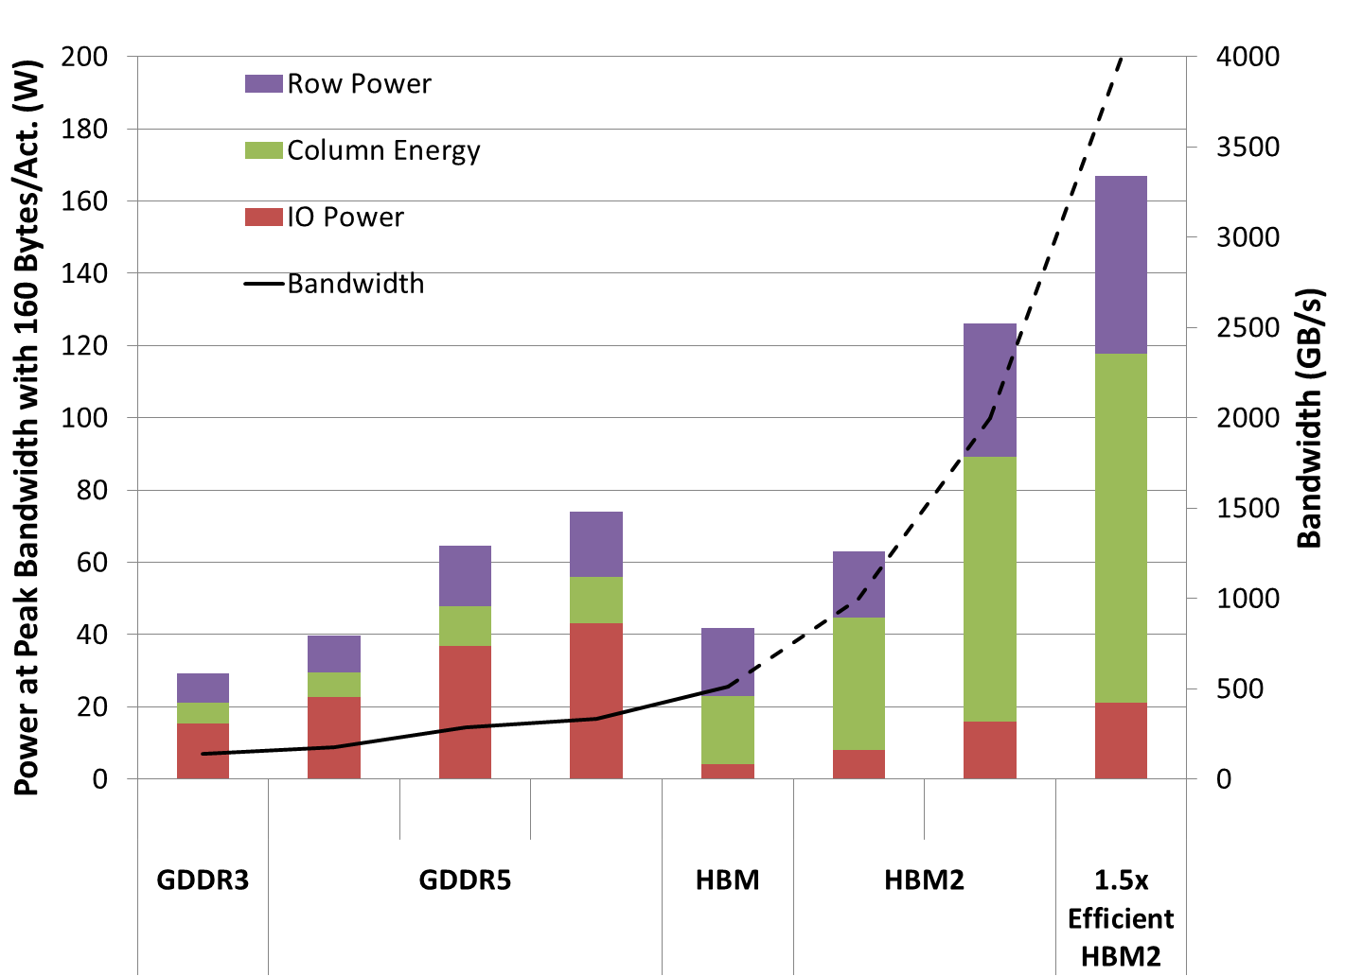
High Bandwidth DRAM Energy Trends

Slide 47
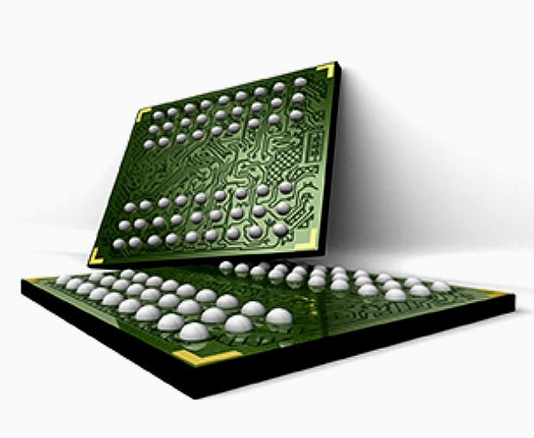
Conclusion
GPUs place significant requirements on the DRAM
Ideal GPU DRAM provides
energy efficient
high-bandwidth
to small quantities of data
Stacked memories like HBM2 are good,
but need new innovations to get to Exascale-class nodes

