Slide 1
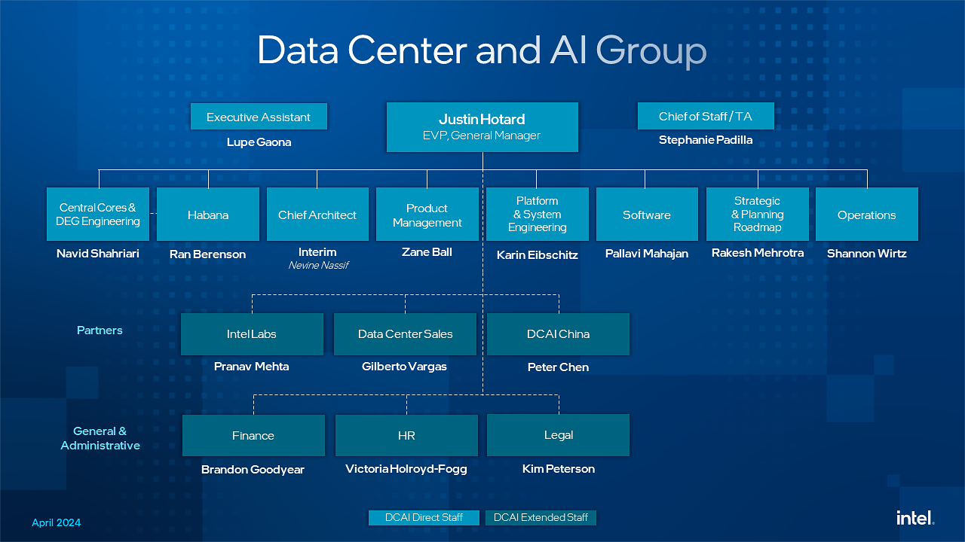
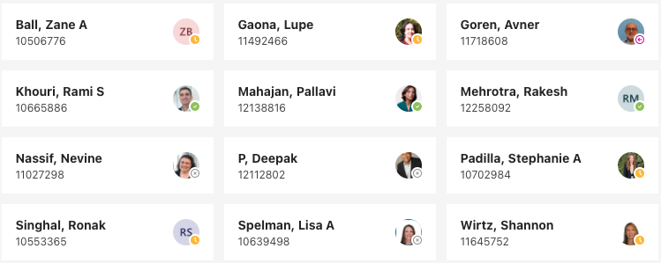
From 12 to 10
Remove 5
Add 3
Interim 1

Slide 2
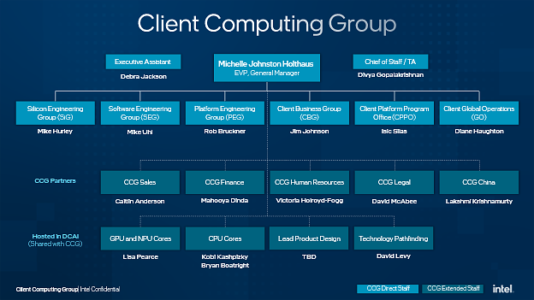
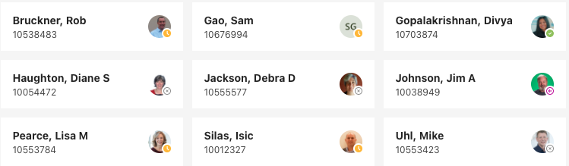
From 9 to 8
Remove 2
Add 1
Client Engineering Ran Berenson
IP Mike Hurley
Soc Arch. Jeff Wilcox
Validation Karin Eibschitz
MPE Ron Amit
PESG Manoj Selva
PQN David Pullen

Slide 3
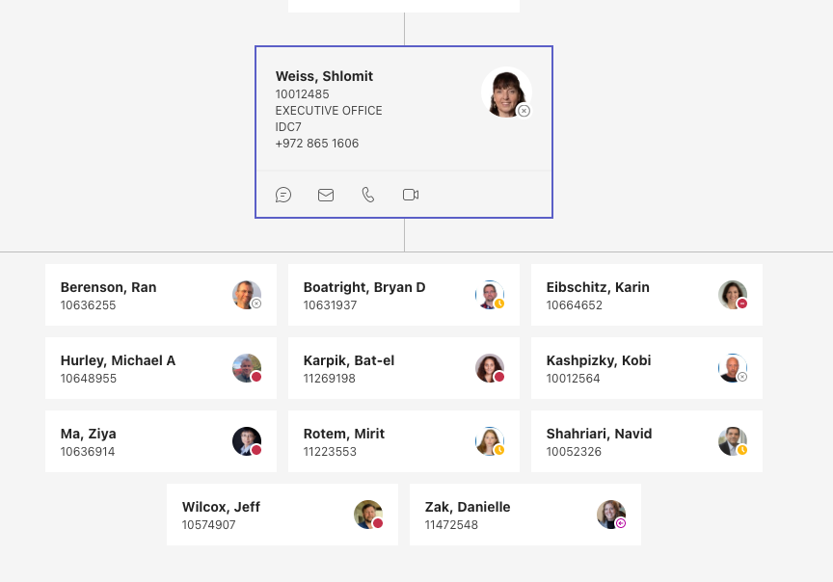
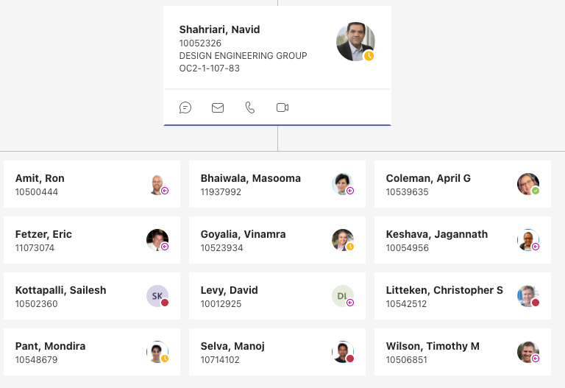
Mike Hurley
DCAI
CCG
CCG
CEG
DCAI
Core
CCG
Validation
CCG
MPE
DCAI
Design
DCAI
CCG
IP
CCG
Pgm, Ops
DCAI
Core
DCAI
Core
DCAI
Design
DCAI
Design
CCG
Software
DCAI
Design
DCAI
Post Si
CCG
PQN
David Pullen
DCAI
DCAI
Core
CCG
Arch
CCG
CCG
PESG
DCAI
Design
DCAI

