Slide 1
Samsung Summary
FTE
June 6th, 2024 (updated on June 28th with PPA using PBK)
Contains or Derived from Supplier Confidential Information

Slide 2
Samsung Test Vehicles for silicon & OSAT learning
Using S4LPP, FTE had done 4 TCs tape-out including 1st Creek, 2nd Creek, Muddy Creek and Tower Creek.
1st Creek and 2nd Creek had finished the tests and measurement
Muddy Creek single die tests finished. Stacked die test ww29
Testing our FTE eco system for scalability and modularity cross Fab/OSAT
Tower Creek just finished all layers TO in middle May
3DIC and ecosystem exploration for future system design and integration

Slide 3
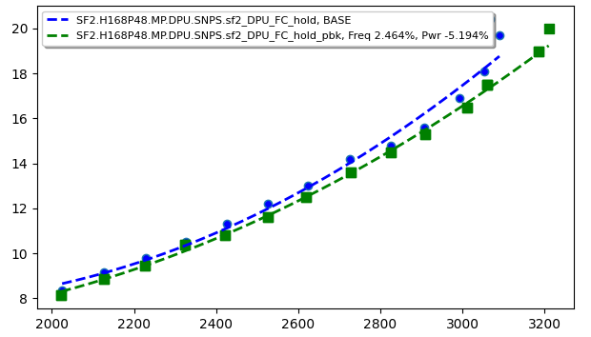
SF2 PBK PPA Update
PBK: Performance Boosting Kit
SF2 H168 PBK available for SS_0P63_M40C corner
S4LPP and N3E do not have PBK
Content: Additional 540 stdcells
Combinational cells with greater than 8 pins
ICG: Clock gating cells
SDF: Scan Flip Flops
With PBK
~2-3% performance improvement and ~5-7% power improvement
At low target speed, tool uses more PBK cell to reduce power
At high target speed, max clock frequency boosts ~90Mhz
 | Setup corner | Hold corner | Power corner
SF2 H168 w/i PBK | SS_0P630V_M40C.CMAX SS_0P630V_M40C.RCMAX | FF_0P77V_125C.CMIN | TT_0P700V_085C.RCTYP
SF2 H168 w/o PBK | SS_0P630V_M40C.CMAX SS_0P630V_M40C.RCMAX | FF_0P77V_125C.CMIN | TT_0P700V_085C.RCTYP
Node | Freq@iso_power | Pwr@iso_freq
S4LPP (v1.0.6) | 1.0 | 1.0
SF2 H168 (v0.9) | 1.07 | 0.80
SF2 with PBK H168 (v0.9) | 1.10 | 0.74
N3E H169 (v1.0) | 1.22 | 0.45
Node | Freq@iso_power | Pwr@iso_freq
Intel Expectation | 1.0 | 1.0
SF2 with PBK H168 (v0.9) | 0.88 | 1.29
Intel expectation = N3E H169 (v1.0) results

Slide 4
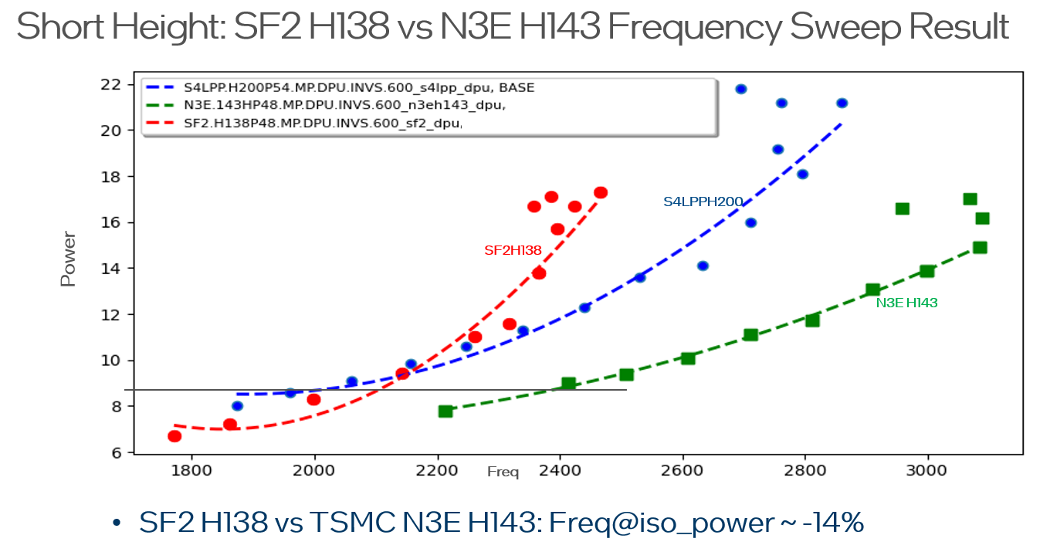
SF2 PPA vs N3E: Without SF2 PBK (performance boost kits) yet
SF2 short height library (H138) perf@iso-power is ~14% slower than N3E H143

Slide 5
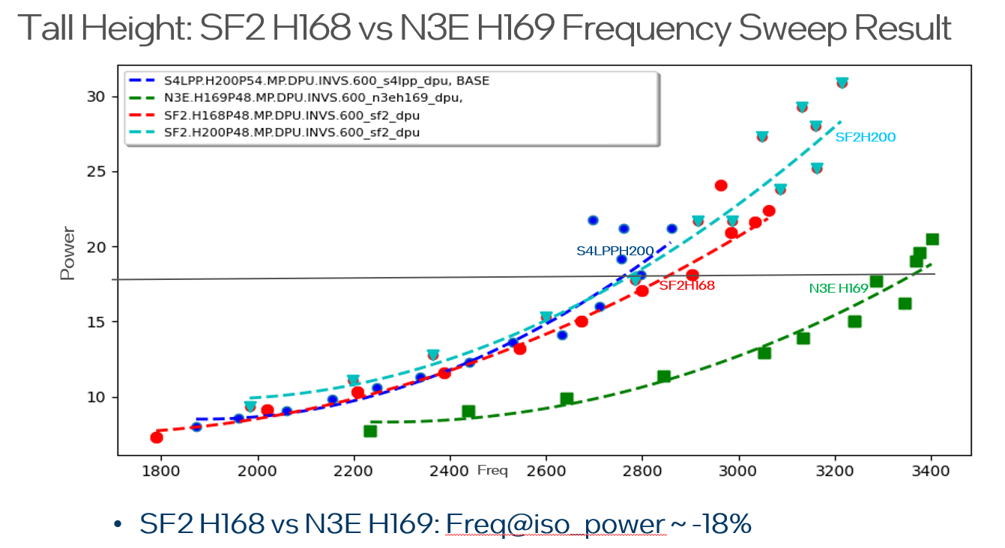
SF2 PPA vs N3E: Without SF2 PBK (performance boost kits) yet
SF2 tall height library (H168) perf@iso-powe is ~18% slower than N3E 169H

Slide 6
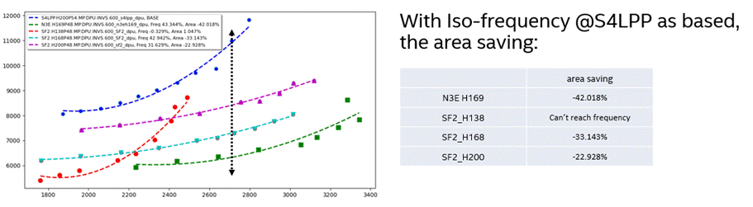
SF2 PPA vs N3E: Without SF2 PBK (performance boost kits) yet
SF2 H168 Area@iso-Freq is around 9% larger than N3E

Slide 7
Project Plans and Improvement Opportunities
Project Plans:.
Discontinued SF2 test chip effort; ~5 resources shifted to N2P or no hire
Periodical the SF2 paper studies when PDK updates become available
Continue existing test vehicle work for memory, 2.3D, and 3DIC learnings
Improvement Opportunities:
Improve alignment within GEMS/FTE on SF2 directions
Sharpen communication to Samsung on Intel expectations and roadmap-based engagements
Work with Samsung to improve their communication and PDK delivery for more effective engagements

