Slide 1

ArrowLake – Lead Foundry Node Experience
Fellows Connect – May 2024
Manoj Lal, Sr Director, CCG-SiG-DDG

Slide 2
Agenda
Introduction
  Arrow Lake
  Challenges
Experience
  N3B
  Intel20A
  Intel3
Path Forward
Summary
QnA

Slide 3

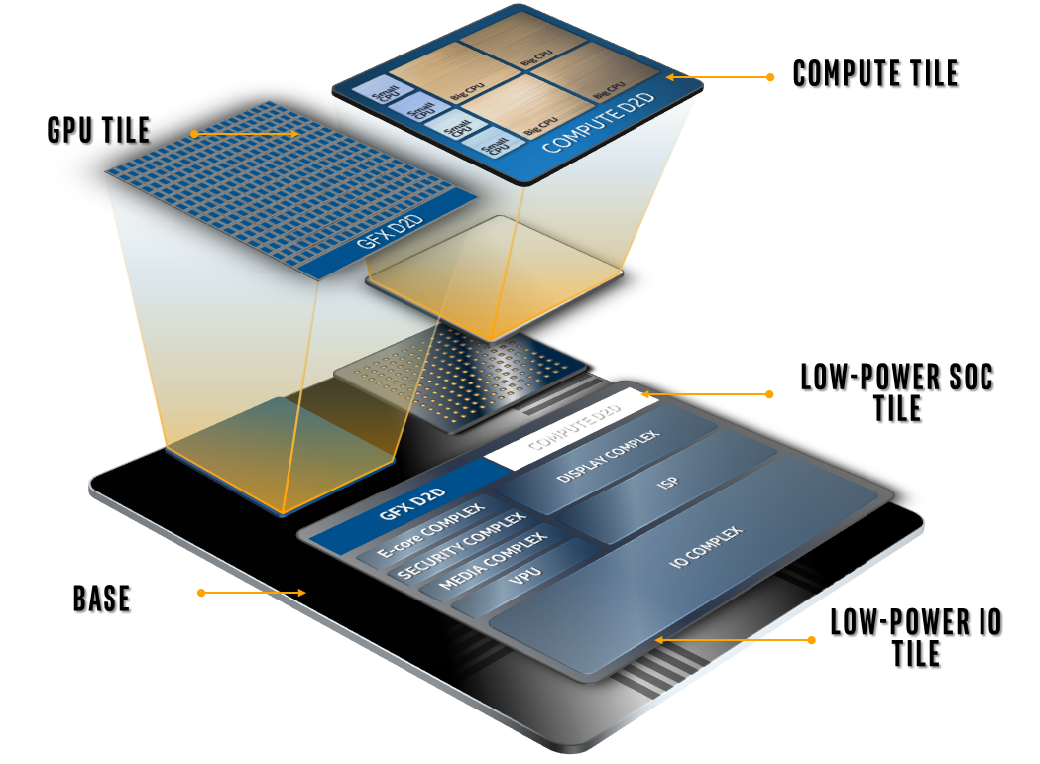
Arrow Lake (ARL)
Client SOC launching in 2024-2025
Built on Disaggregated Architecture, leveraging Meteor Lake construction.
Upgrades to SOC, Graphics, Compute Tiles
Compute Tile on Intel3, TsmcN3B, Intel20A
Experience of Designing on these Nodes
Take-Aways of designing ARL on Ext Foundry and IFS

Slide 4
Challenges
Intel Lead Process Nodes need to hit schedule/performance commits
  BU needs Schedule/Entitlement Predictability!
  MTL (1276) and ARL (1278) encountered delays from process maturity
Lead Process ramping on products.
  Design/Process interactions escape (20A) pre-product technology development process.
Product not meeting committed Landing Zones.
  Stable process enables focus on Functionality and PnP
  Need resilient product strategy for Lead node product intercept
We need co-optimize Lead Process ramp and Product requirements

Slide 5
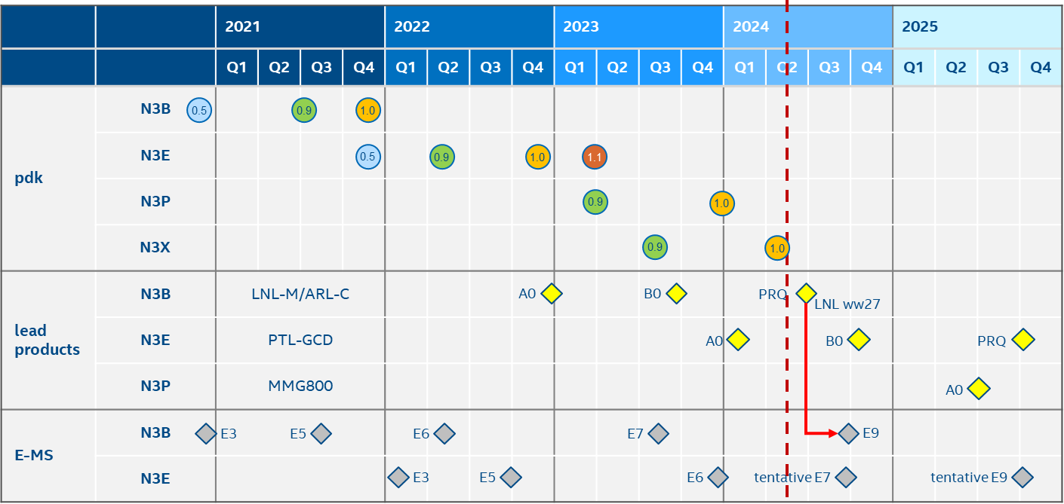
ARL N3B experience
PDK1.0 released 3 quarters before targeted TI
Post PDK0p5 no impact to circuit/memory design architecture;
  Testchip Ips (example Memory) only required tuning leading upto TI
  Many HPs were to intercept Intel asks
Strategic decision to transition from N3 → N3B (post 1p0) was largely transparent to Design
HP – Hot Patches
SOC – System on Chip
PDK – Process Design Kit
DP - Design Platform
ARL ww32
Stable Design Platform ~3 quarters before Planned TI
Source: Veit Klee
PESG

Slide 6
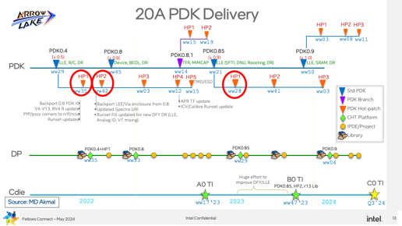
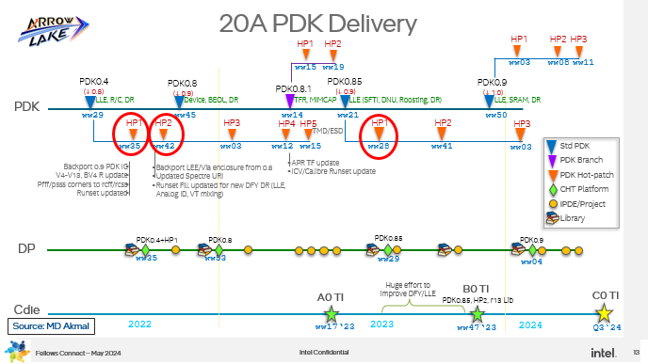
1278 20A - ARL Experience
13 Hot-patches to Process Design Kit (PDK)
3 Critical HP on path to TI; rest were minor, including few needed by SOC team
Major PDKs downgraded (↓) from planned quality
HP – Hot Patches
SOC – System on Chip
PDK – Process Design Kit
DP - Design Platform
UnStable PDK/DP will impact Quality/Schedule

Slide 7
Impact of Unplanned Hot Patches
What | Impact | Example
New certified Design Platform (DP) | Each Out-of-cycle DP release delays schedule by ~4 weeks. | On Astep, SOC hit with 1 quarter of schedule
Redesign of IP/Digital | IPs cannot get clean to late changes impacting Quality and Perf | Memory Design was impacted from LLEs. Not all LLEs intercepted – area growth
Missed entitlement de-commit | Late changes forces SOC to leave Performance on table | With late, new Library (FTI LLE) post Bstep release, SOC/IP could not absorb and consequently took 1-2% a hit in PnP
Unplanned effort from deferred work | IP/SOC resources have tight roll-off plans for cadence of Products. | IP teams missed Testchip commits for post-20A products
HP – Hot Patches
SOC – System on Chip
DP - Design Platform
DE – Design Enablement
FTI – Field Trench Isolation
LLE – Local Layout Effect
EC – Execution Commit
(PLC)
TFM – Tool Flows & Methods
Xchip – Test Chip
A maturing process needs new TFM & impacts Design construction

Slide 8
Ecore/Skymont - P1278.2 vs. TSMC N3B Cost of Adoption
Topic | SK3 (N3B) | Advantage | SK78 (1278.2)
PDK Maturity at VTI | 1.0.10 – very stable |  | PDK 0.4 + PDK 0.8. Complex hybrid env
Large Impact PDK releases 3 month before TI | NO |  | YES – Yield and perf major change (PDK 0.8 released to close to VTI – making it hard to absorb
Large PDK (process) changes after A0 | NO – mostly runsets and minor changes |  | Yes – Yield and Perf additional changes happening late (e.g. Stacked FTI) and more on PDK 0.9
Library | Stable over 3 month before A0 VTI and used for B0 as well |  | Larger changes close to VTI. 6 Library drops so far for B0.
Integration Testing | TSMC delivers DP – PDK+Lib+EDA tools – better tested Intel tools validation in house |  | TD delivers separately PDK, Lib (6 to 8wk) later, Most integration testing at project level. Separate release + desire to consume ASAP – creates serious churn
DA Effort (HAT based) | 1 X |  | 1.17 X (17% more effort). Despite being a derivative
TFM Enablement | RTL enablement mostly on SK3 Heavy Lift enabling Intel HS tools on N3B |  | Less RTL enablement effort (same RTL) More incremental effort in enabling BE tools (SD and Custom)
Source: Jim Defuria
PM SKT78
Stability of Library and PDK up to A0 TI and through B0 stepping was significantly
better on N3B yielding to less overall design effort and more time for optimization
Notes:
Break effort – before A0 and after A0
Clarify effort is for DA
HS tools – heavy lift on N3 . Less on 1278
RTL enablement mostly charged on SK3 (new uArch). Sk78 is a derivative

Slide 9
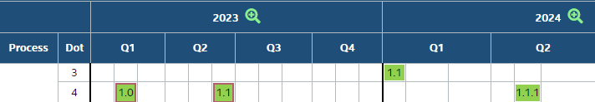
ARL 1276.4/Intel3 Experience
Stable PDKs and Design Platform achieved on Intel3
Stable TFM enabled smooth SOC execution
Process entitlements committed at EC were met and revised upwards post-TI with no impact to design.
Initial Silicon data aligned with Projections and on schedule!
TI
Stability of Process/DP is key predictable SOC execution
Intel7 (RPL) and Intel3 (ARL) were shining examples of this.

Slide 10
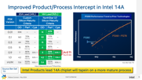
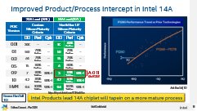
Path Forward
Product execution start when Process has met minimum criteria
  BU/TD have strengthened NorthStar; aligned to industry for 1280 ramp.
  Gladius process tracks Process maturity at SOC PLC checkpoints
Testchip and IP Shuttle Makeover
  Modern ARM Core on 1280 X-Chip; Improved FIP shuttle to meet industry standards
  Need Core on XChip. Build resiliency for Analog Ckt in early stages of Process.
Lead Node products have to factor high risk (schedule, performance)
  Customer Zero Product needs risk mitigations
  Resource Lead product to handle Design/Process discovery
IFS must WIN – Deliver predictably & meet Process entitlement

Slide 11
Summary
Make Lead Process intercept predictable to capture leadership
Redefine Xchip strategy for Lead process
Tighter NS compliance to ensure TTM. Path forward on 1280/RZL
Stable PDK & DP successful for on Intel7 and Intel3.
QnA

Slide 13

20A PDK Delivery
HP1
HP2
HP1
HP2
HP3
ww15
ww19
ww03
ww08
ww11
PDK0.4
(↓ 0.5)
PDK0.8
(↓ 0.9)
PDK0.8.1
PDK0.85
(↓ 0.9)
PDK0.9
(↓ 1.0)
PDK
LLE, R/C, DR
Device, BEOL, DR
TFR, MIMCAP
LLE (SFTI, DNU, Roosting, DR)
LLE, SRAM, DR
ww29
ww45
ww14
ww21
ww50
HP1
HP2
HP3
HP4
HP5
HP1
HP2
HP3
TMD/ESD
ww35
ww42
ww03
ww12
ww15
ww28
ww41
ww03
Std PDK
PDK Branch
PDK Hot-patch
CHT Platform
IPDE/Project
Library
Backport 0.9 PDK IC
V4-V13, BV4 R update
Pfff/psss corners to rcff/rcss
Runset updated
Backport LEE/Via enclosure from 0.8
Updated Spectre URI
Runset Fill updated for new DFY DR (LLE, Analog ID, VT mixing)
APR TF update
ICV/Calibre Runset update
DP
PDK0.4+HP1
PDK0.8
PDK0.85
PDK0.9
ww35
ww53
ww29
ww04
Huge effort to improve DFY/LLE
B0 TI
A0 TI
C0 TI
Cdie
PDK0.85, HP2, r13 Lib
Source: MD Akmal
2022
ww17‘23
2023
ww47‘23
2024
Q3`24

Slide 14
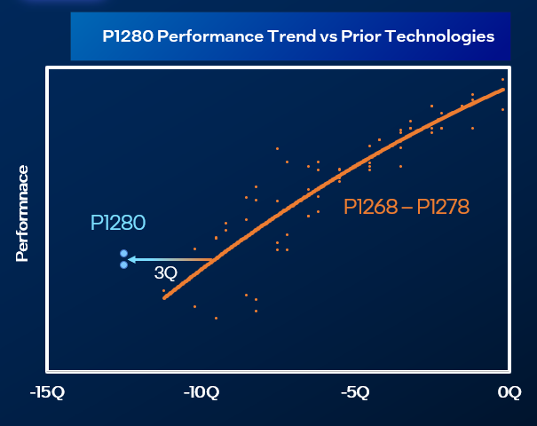
Improved Product/Process Intercept in Intel 14A
20A Lead (ARL)
14A Lead (RZL)
PDK Version | Custom Silicon Maturity Criteria |  |  | NorthStar 1.0’ Silicon Maturity Criteria
 | DD | Perf | Cpk | DD | Perf | Cpk
0.01 | 30K | -- | -- | 1K | 60% Perf Line | --
0.1 | 160 | 70% Perf Line | -- | 50 | 70% Perf Line | --
0.3 | 64 | 75% Perf Line | -- | 15 | 75% Perf Line | --
0.5 | 15 | 80% Perf Line | -- | 6 | 80% Perf Line | --
0.9 | 7 | 80% Yield Line | 30% > 1 | 3 | 83% Yield Line | 50% > 1
1.0 | 4.2 | 85% Yield Line | 50% > 1 | 4.2 | 87% Yield Line | 70% >1
HVM | 0.6 | 100% Yield Line | 90% > 1 | 0.6 | 100% Yield Line | 90% > 1
A-0 TI
Pre-PC RZL
Ack: Ben Sell, TD
https://deportal.intel.com/TDNorthStar
Source: Ben Sell
TD
Intel Products lead 14A chiplet will tapein on a more mature process

