Slide 1
How to use the pass-down slides
This pass-down provides an overview of messages and content from the Exec Sync on March 12, 2024.
Leadership Expectations
Use the information to have a discussion with your BU’s Grade 9+ leaders within two weeks of receiving the pass-down slides. Contextualize and translate the information to help them internalize and understand what’s relevant to their team and business.
Consider bringing it into staff meetings, scheduling 20:1s, intercepting existing forums, etc.
Encourage people managers in your organizations to create space and engage in the All Manager Forum on March 26.
Time estimate to go through this content is 20 minutes, and executives are expected to make this an ongoing dialogue.
Why engage?
Recent pulsing with grade 9-11 leaders indicate that the community wants to be trusted and engaged by their direct leaders in the organization and actively participate in solutions; discussions will build trust in your leadership, enrollment of leaders, and drive belief in Intel’s future.
As outlined in Exec Sync, the 8-K and earnings news will drive reaction with employees. Engagement and discussion will help next level leaders to process and be prepared.
What’s included
Building a stronger Intel: Pat
New financials and what to expect: Dave
Employee engagement and learning: Christy
Questions? Reach out to executive.communications@intel.com.
Starter Discussion Prompts
What do you need to see accomplished to believe in our future? What can we do to contribute?
What is your perspective on our transformation?
Let’s discuss our barriers and brainstorm how to overcome them.
What adjustments do we need to make?
How do we enroll our teams?
Where can I help?
What’s not included
The new organization structure and APB formula are not included; they are embargoed until announced to employees on April 3.

Slide 3
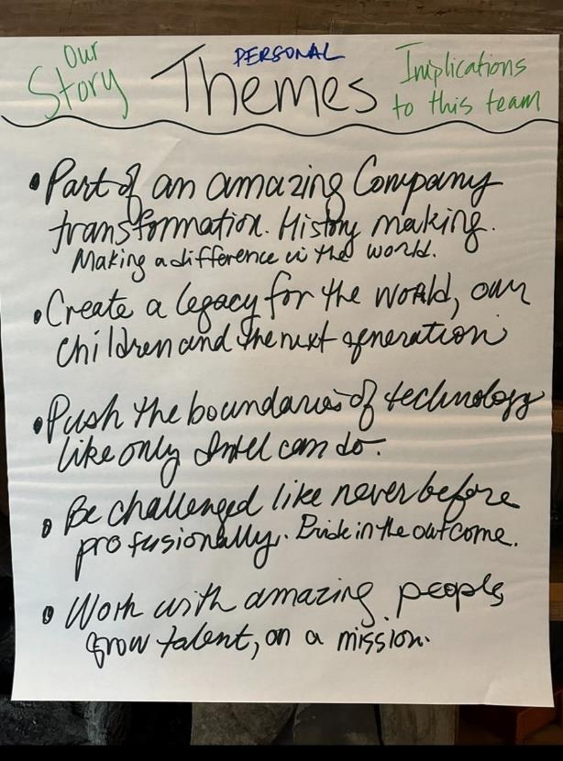
Themes
Part of an amazing company transformation. History making. Making a difference in the world.
Create a legacy for the world, our children and the next generation.
Push the boundaries of technology, like only Intel can do.
Be challenged like never before professionally. Pride in the outcome.
Work with amazing people, grow talent, on a mission.

Slide 4
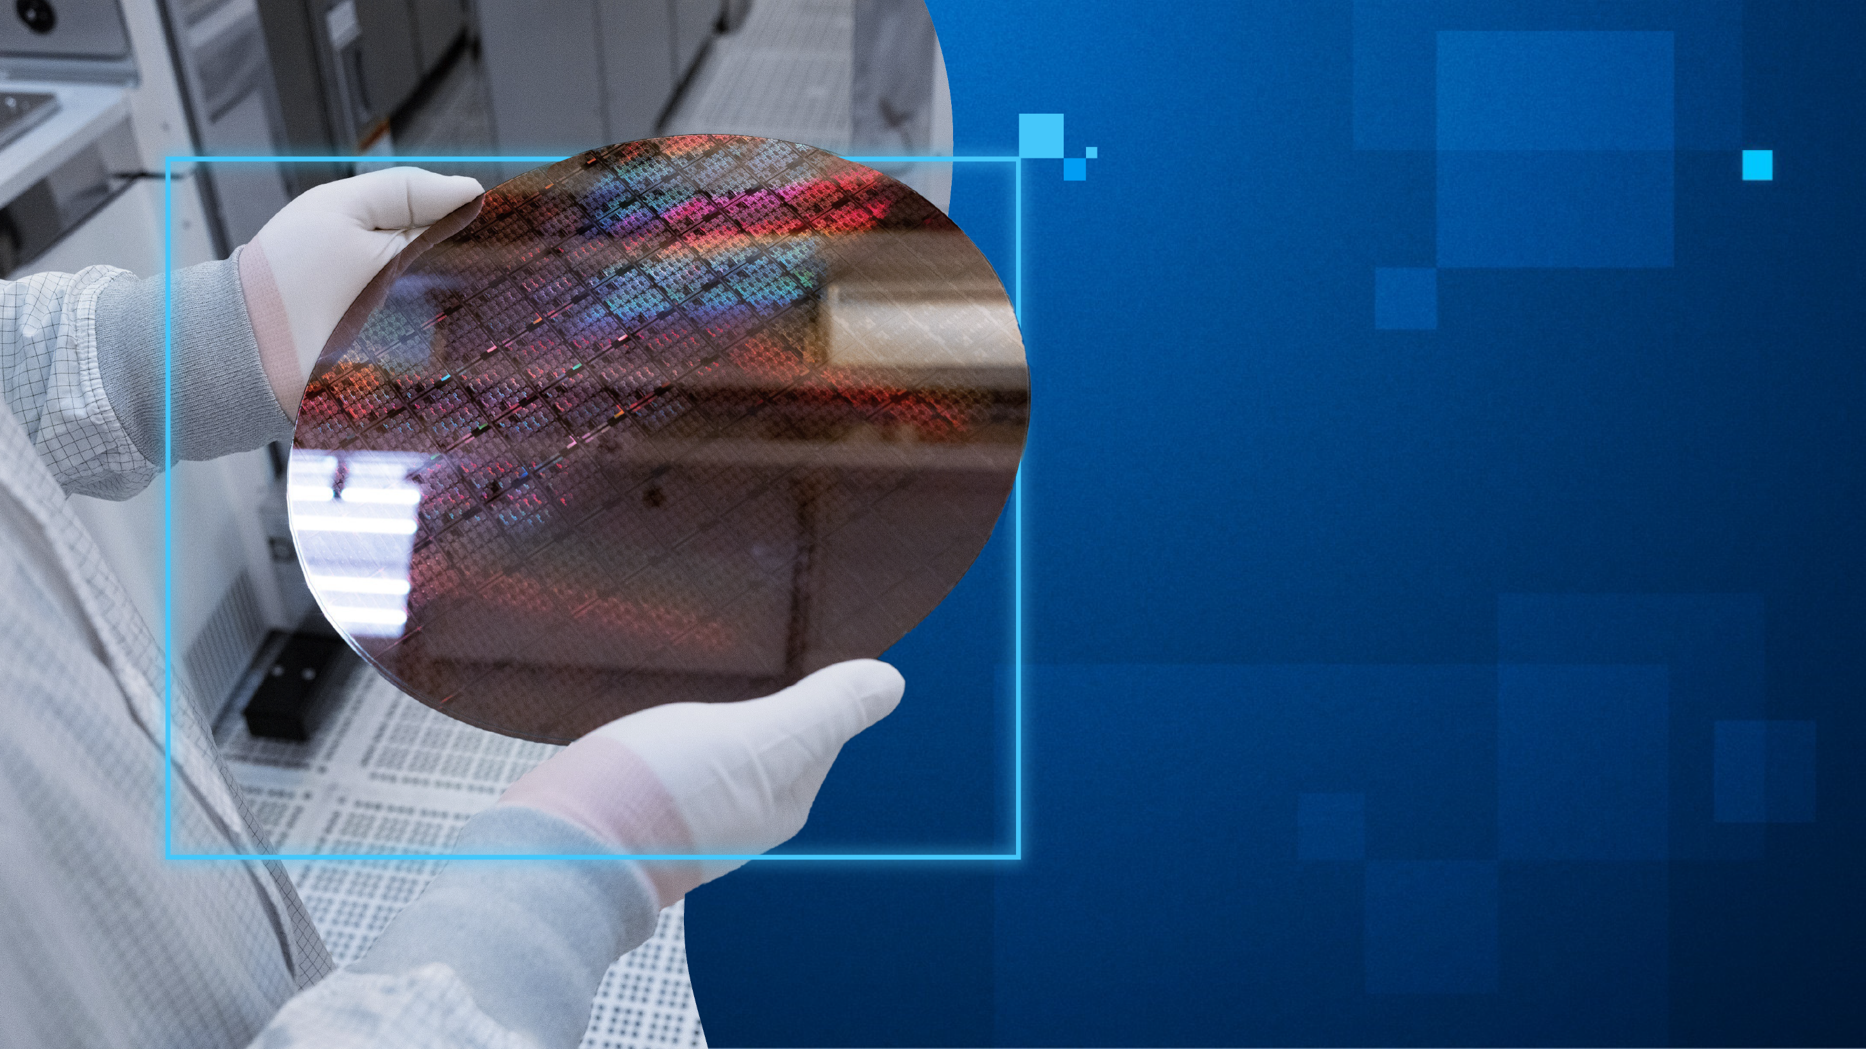

Building
a Stronger Intel.
March 12, 2024 Exec Sync | Intel Confidential

Slide 5

Driving Intel's Transformation
IDM 1.0
IDM 2.0
n+3
n+3
n+2
n+2
n+1
n+1
n
n
IDM 1.0 to IDM 2.0
IDM 1.0: Optimizing leadership capacity and speed
IDM 2.0: Optimizing leadership, cost and efficiency
Process Technology
Late to EUV, underinvested for a decade+
Drive forward Moore’s Law via process and package technology for age of AI
Financial Leadership
Lack scale, sub-optimized margins, overinvesting to catch up
Technology leadership, improved scale and extended life of assets
Mindset Shift
Focused on delivering only Intel products
Customer centric, ecosystem embrace, both external and internal customers
March 12, 2024 Exec Sync | Intel Confidential

Slide 6
Competing to Win
To IDM 2.0 Operating Model
From (IDM 1.0) Allocated Cost Model
Manufacturing (MSO)
Technology Development (TD)
Reportable P&L
Reportable P&L
Intel Foundry
PRICE
Intel Products
Foundry Services
CCG P&L
ALLOCATED COST
REPORTABLE P&L
Foundry Manufacturing & Supply Chain
DCAI P&L
Intel Product BUs
CCG, DCAI, NEX
Foundry Technology Development
NEX P&L

Slide 7
Operating Segment Reporting 8-K Historical Recast Provides Details Aligned To New Segmentation
Existing Operating Segments
Operating Segments Going Forward
 | 2023 ($B)
Operating Segment | Revenue | OP $ | OM %
Client Computing Group (CCG) | $29.3 | $6.5 | 22%
Datacenter & AI Group (DCAI) | $15.5 | ($0.5) | -3%
Networking & Edge Group (NEX) | $5.8 | ($0.5) | -8%
Mobileye (MBLY) | $2.1 | $0.7 | 32%
Intel Foundry Services (IFS) | $1.0 | ($0.5) | -51%
All Other | $0.6 | ($5.6) | -868%
Total Consolidated GAAP | $54.2 | $0.1 | 0.2%
Consolidated Non-GAAP | $54.2 | $4.7 | 8.6%
 | Year ($B)
Operating Segment | Revenue | OP $ | OM %
Client Computing Group (CCG) | $xx | $xx | xx%
Datacenter & AI Group (DCAI) | $xx | $xx | xx%
Networking & Edge Group (NEX) | $xx | $xx | xx%
Total Intel Products | $xx | $xx | xx%
Intel Foundry | $xx | ($xx) | xx%
Altera | $xx | $xx | xx%
Mobileye (Mobileye) | $xx | $xx | xx%
All Other | $xx | ($xx) | xx%
Intersegment eliminations | $xx | ($xx)
Corporate Unallocated |  | ($xx)
Total Consolidated GAAP | $xx | $xx | xx%
Consolidated Non-GAAP | $xx | $xx | xx%
Auto, Moonshot, CSF
Corp P&L

Slide 8
Our Profitability Journey
Significant operating profit improvement: expected as Intel Foundry returns to breakeven
Intel Foundry margin improvement drivers:
High confidence – return to leadership technology & pricing
High confidence – stabilize investment after completing 5N4Y
Our opportunity – deliver IAO operational efficiencies
Leadership call to action: accelerate Intel Foundry breakeven
Operating Profit Opportunity

Slide 9
IDM 2.0 Acceleration Why the Model Shift Matters
Expedites
Charge for mix changes or increased factory velocity, reducing requests
Financial savings:
>$1B per year
Ramp Rate
Charged standard market wafer price, flattening the cost curve during ramp
Financial savings:
$500M to $1B per year
Creates Transparency that exposes the economics of the business
Increases Accountability by creating the right incentives
Allows groups to Focus on what they can control and the work they do best
Embraces Standardization as a way to drive efficiency
Enables required Separation to attract Foundry Services customers
Product Architecture
Market-based pricing allows BUs to more easily identify feature ROI
Financial savings: >$1B per year
Samples
Charge for all samples the same way a foundry would
Financial savings:
$500M to $1B per year
Total Identified Savings Opportunity: $4B - $5B /year
Notes:
Why is this right?
Creates transparency that exposes the economics of the business
Increases accountability by creating the right incentives
Allows groups to focus on what they can control and the work they do best
Embraces standardization as a way to drive efficiency
Enables required separation to attract the Foundry Services customers
And we have been planning this already. We’ve been clear about changing how we manage our costs.
We’ve started this work to drive 60/40 margins. We have much more to do, but the payoff will be significant.
Our company’s ability to operate successfully and sustainably hinges on our ability to execute this.
Let me turn it over to Christy.

Slide 10


Bringing People Along on Our Transformation
March
April
May
June
July
Educating Leaders
Helping Employees Process Change
Transforming to Tomorrow’s One Intel
ELT + VPs + Fellows
Mar. 12 Exec Sync
Mar. 20 Exec Strategy Learning Series
Apr. 3 Exec Sync
Apr. 25 Exec Sync Express
May 21-22 Exec Sync F2F
Deepening Acumen and Understanding of Our Transformation | Leading Teams through Change
2H Next Wave
education and change adoption continues, emphasizing Catalyze One Intel culture/behaviors
Managers
Apr. 2
8-K Filing
Apr. 2 Investor Webinar
Mar. 26 All Manager Forum
May-June Execs lead manager cascade
Building Acumen and Understanding
Employees
Apr. 3 All Company Meeting
Apr. 25 Q1 Earnings
Apr. 26 Dave’s Take
Apr. 30 All Company Meeting
May 6-17 QGS window
Ongoing employee campaign: “Our next chapter starts with you” to create understanding our transformation and driving belief in our future.
Ongoing employee sensing to enable integration of feedback into messaging and approach.
Mar 4: EE Pulse
Apr 4 : EE Pulse
May (TBC) 2024 EES
Jun 4 EE Pulse

Slide 11

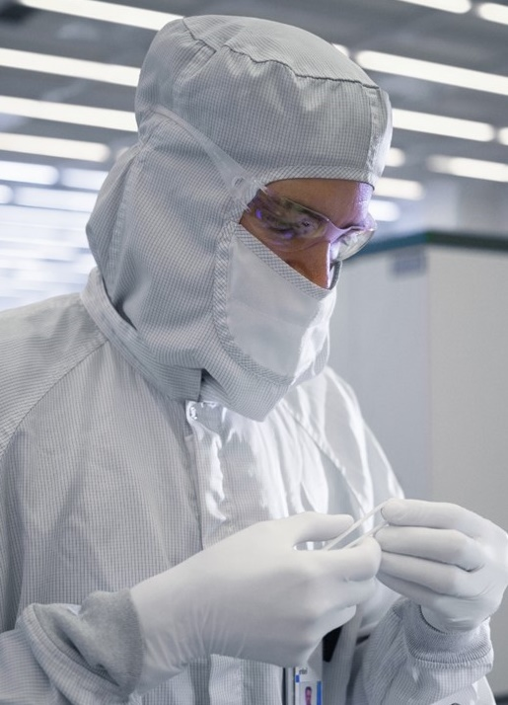
Embracing the Transformation Essential role for every employee
Put customer at center
Execute like an owner
Compete to win
March 12, 2024 Exec Sync | Intel Confidential

Slide 12



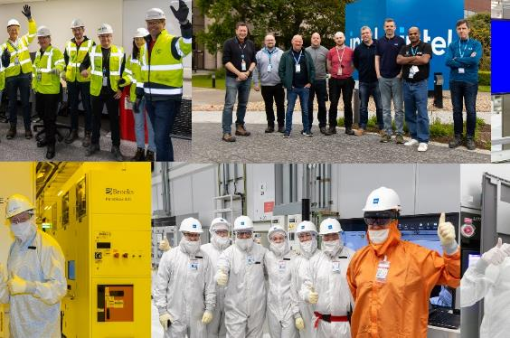

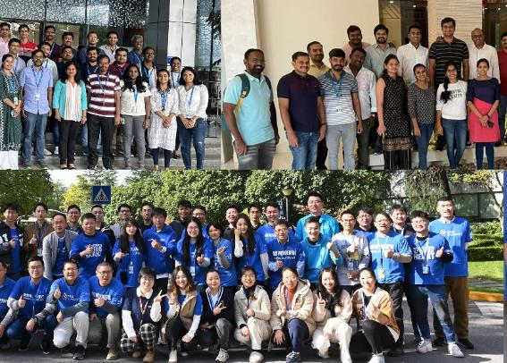
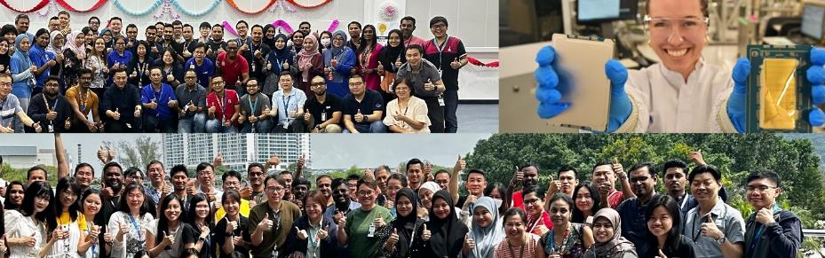


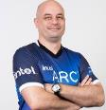

We were made for this.
Our next chapter starts with you.
March 12, 2024 Exec Sync | Intel Confidential

