Slide 1
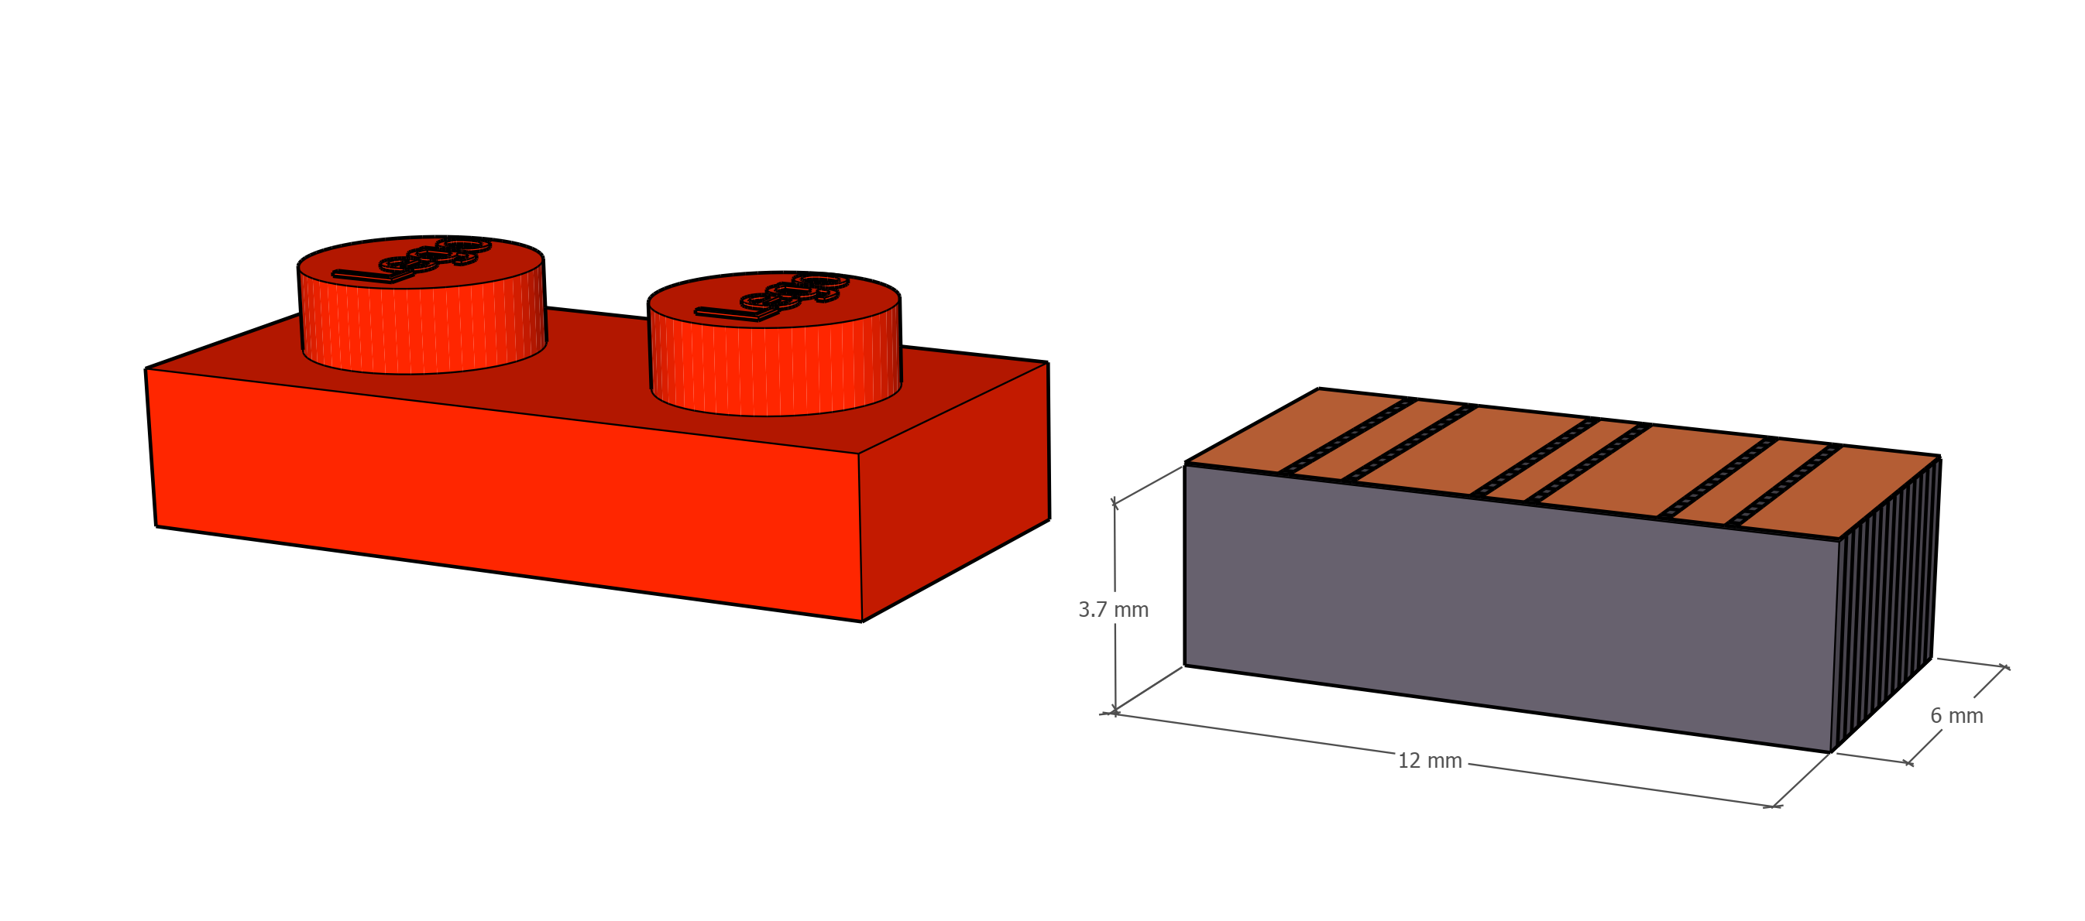
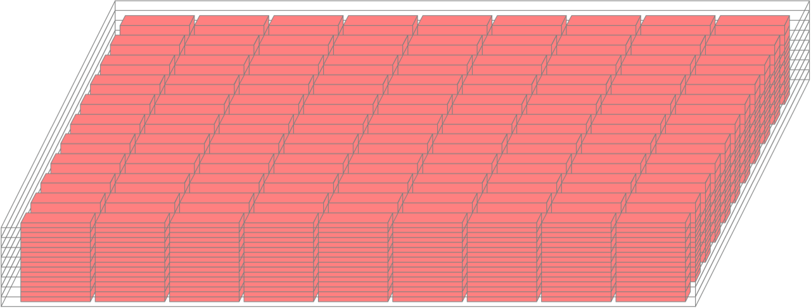
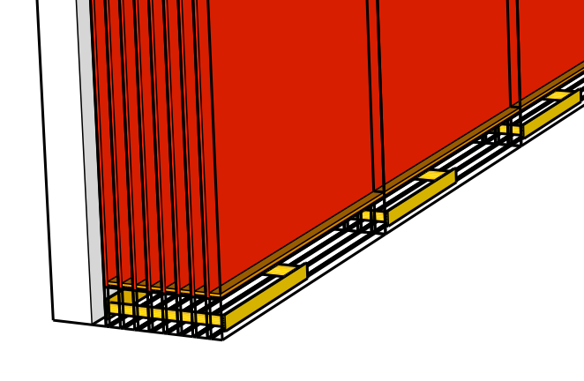
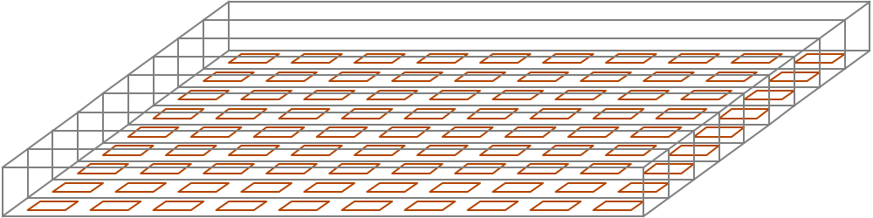
12mm
3.7 mm
12 mm
3
ZAM
5
6mm
4
0.1mm
3.7mm
Inductive attach with via-in-one
Revise 2009 U. Tokyo work

