Slide 1
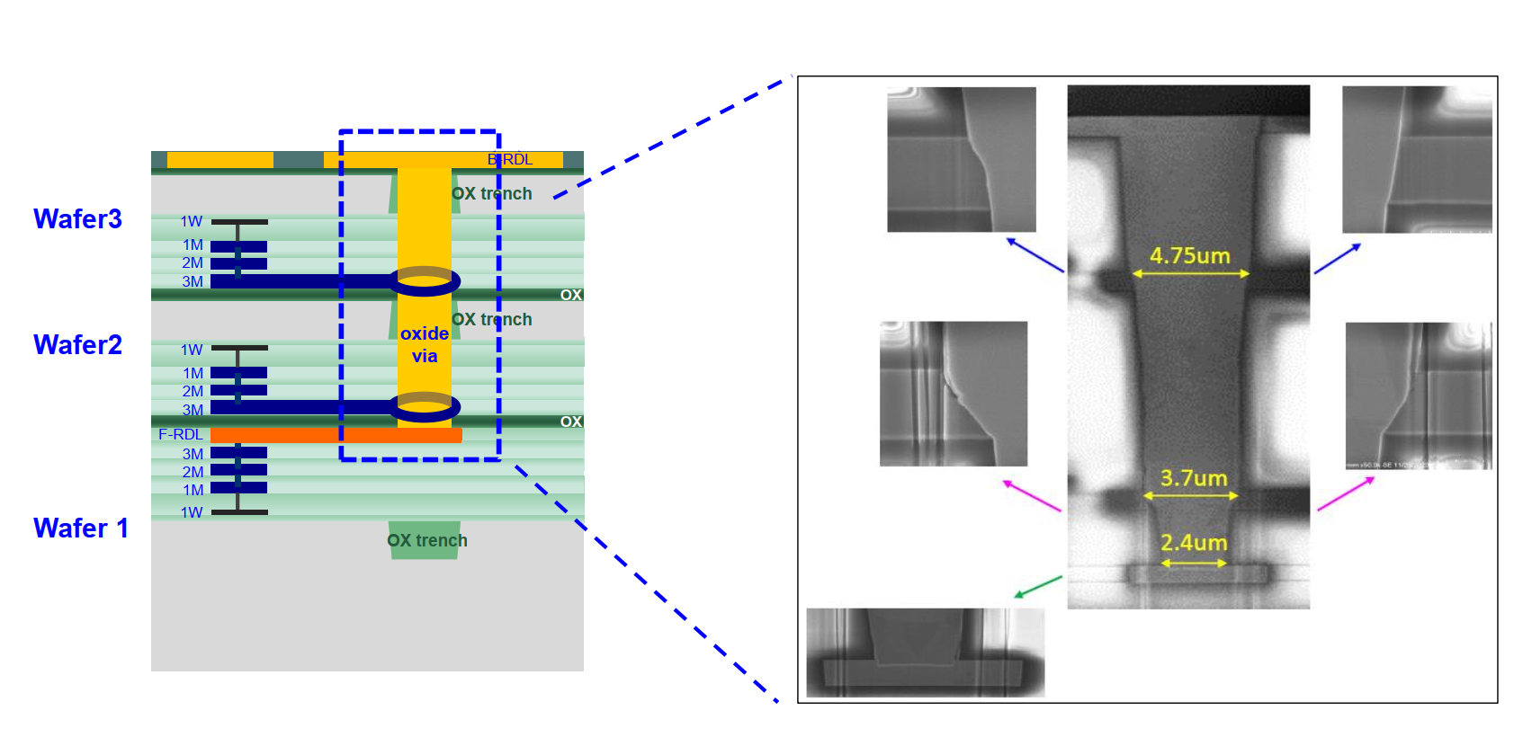
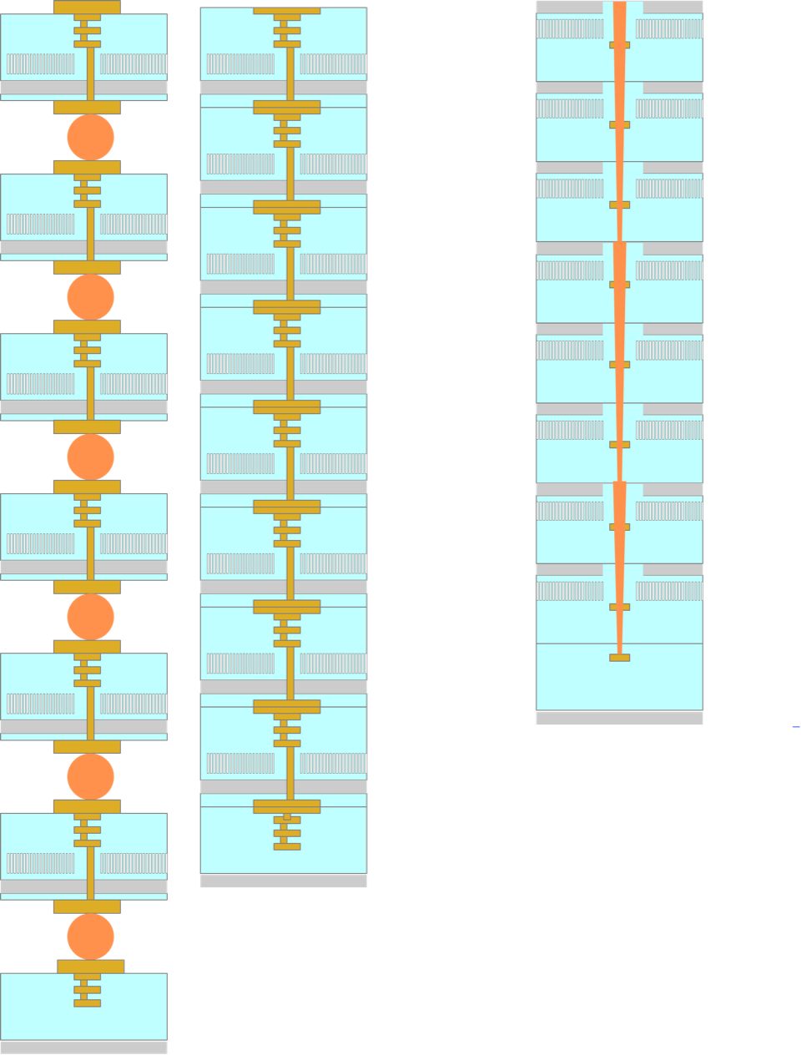
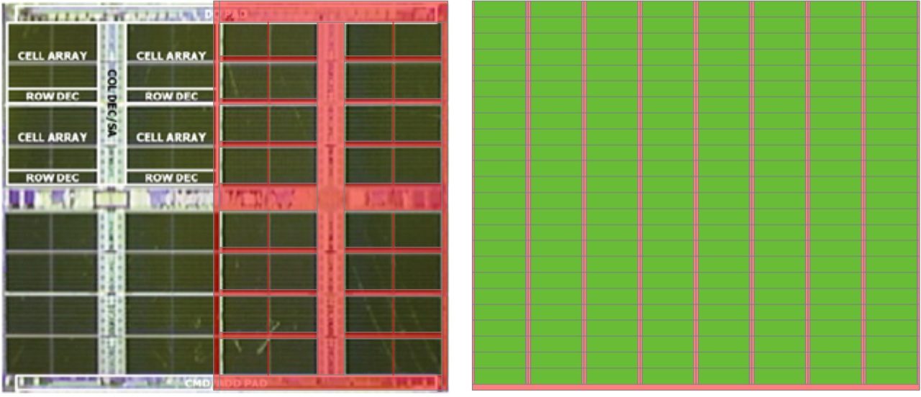
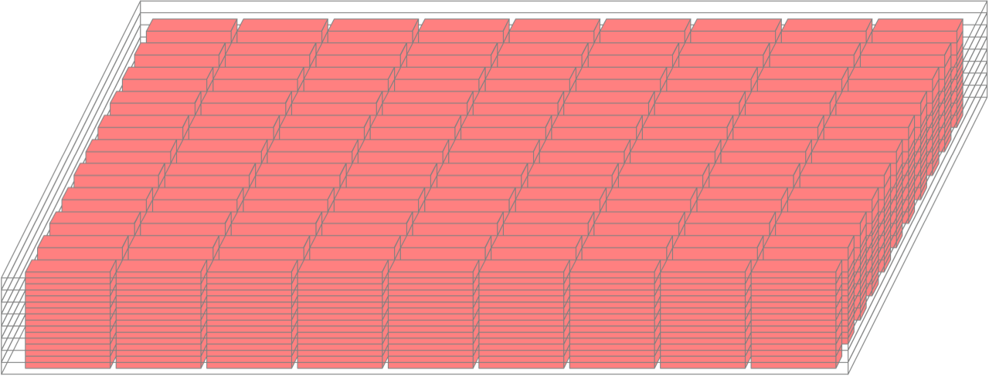
2
Via-in-one
re-floorplanning
Via-in-one
1
Via-in-one for low-cost high-yield stacking
Logic and wires moved to base die
Unmodified commodity DRAM process
HBI
12mm
uBump
3.7 mm
3
0.1mm
Tower repair for yielding 8+1 wafer
stacked memory per slice

