Slide 1
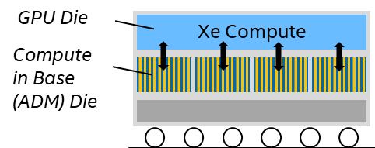
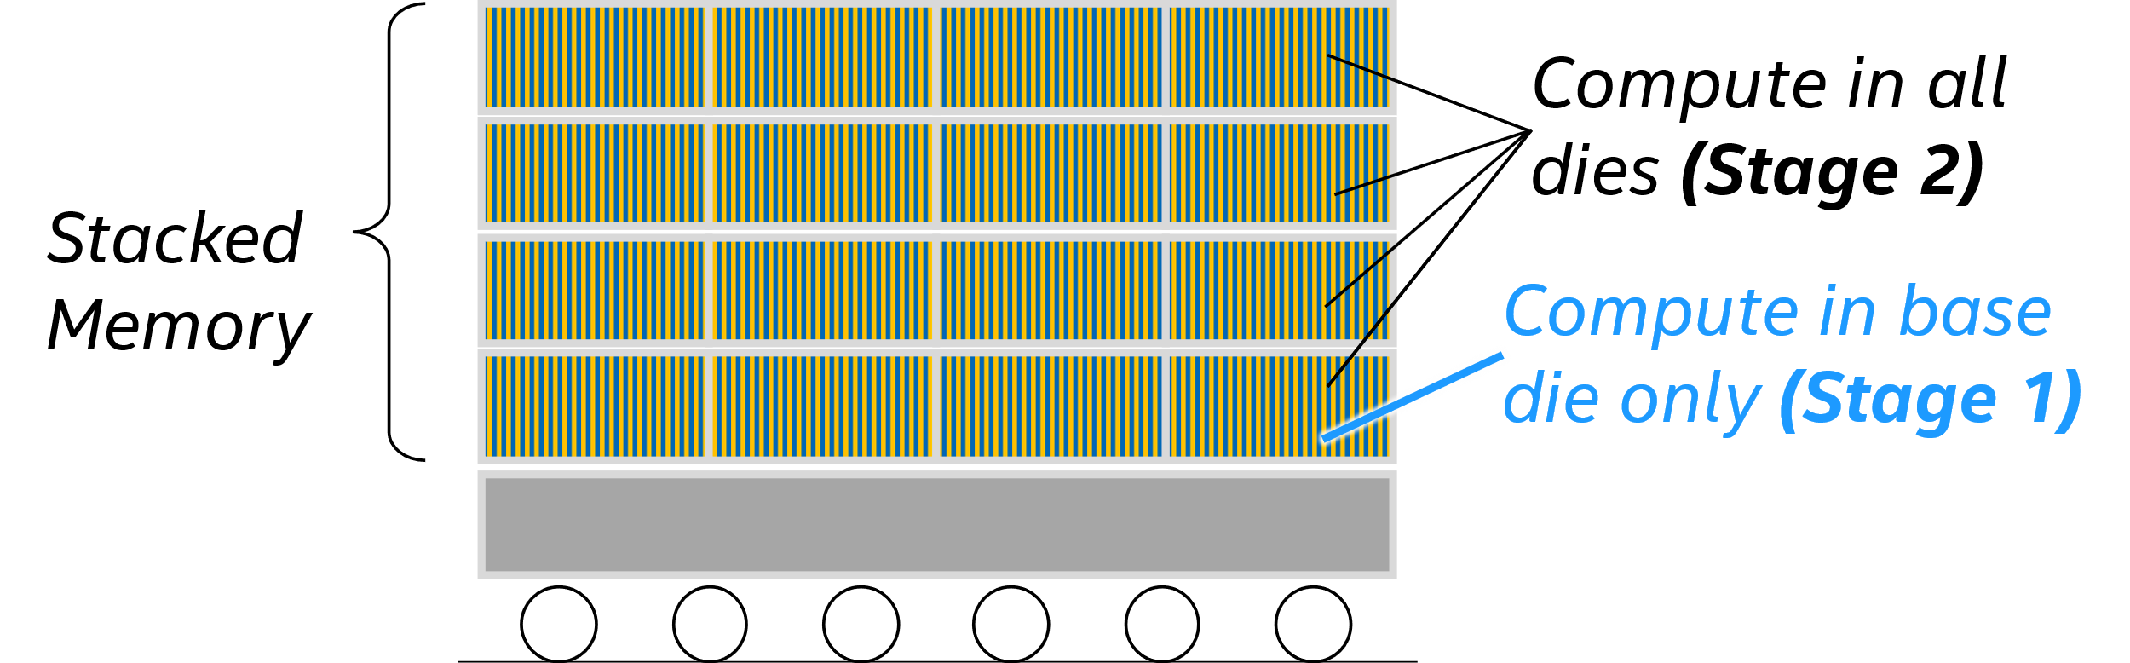
Memory-centric Compute Architectures (MCA) –Options
MCA – L3
MCA in HBM/XBM
Xe Cluster
Xe Cluster
EU/Systolic Array
(Tier-1 compute)
Xe Cluster
Xe Cluster
…
…
SoC Fabric
SoC Fabric
The Three Options:
1. Compute in HBM/XBM all stacked dies
2. Compute XBM/HBM Base Die
3. Compute in L3-ADM (cache/scatchpad)
…
HA
…
HA
HA
HA
MCA Tier-2 Compute
L3
(ADM)
L3
(ADM)
L3
(Optional)
L3
(Optional)
HBM
HBM
HBM/ XBM
HBM/ XBM
Channels

Slide 2
MCA – Options

Slide 3
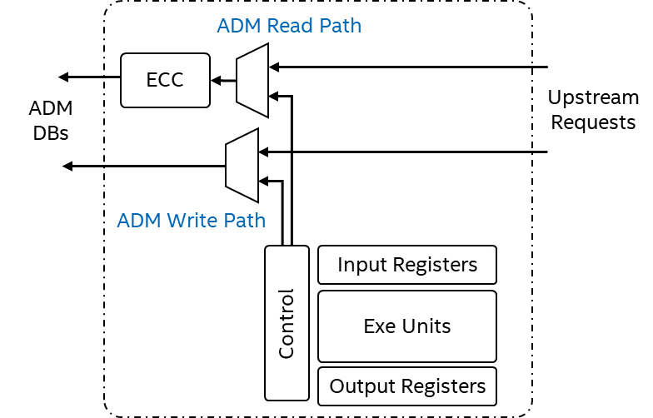
MCA – Indicative Channel Architecture
Channel Controller
Decoders with multi-cast support, a capability to route a data write request to one or more fan-outs
Memory Block
MCA Unit
Through shared physical bus
Routing tracks
ECC
Data-blocks
DBs
DB
DB
DB
DB
Upstream Control
Controller
DB
DB
DB
DB
E.g. : Reduction, Multicast
Aux. Compute
Compute Core + ECC
DB
DB
DB
DB
E.g. : GEMM/GEMV/DOTP, element-wise single/dual input operators
DB
DB
DB
DB
Compute Core + ECC
(MCA Unit)
Channel
Sub-Channel

