Slide 1
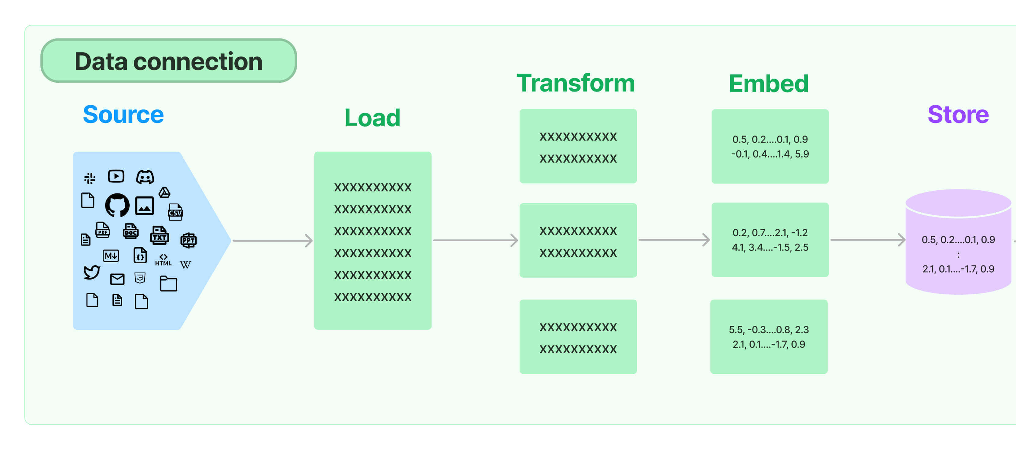
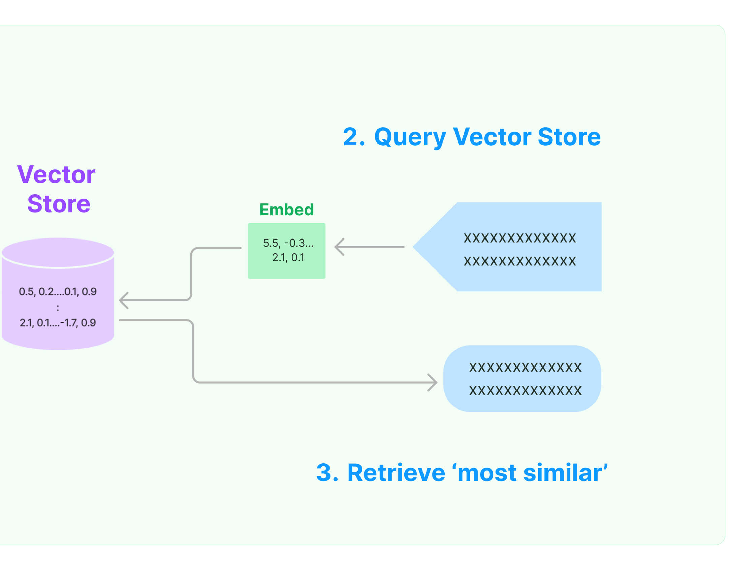
LLM - RAG: Preparation
One-time process, uses (part of) LLM
LLM - RAG: Retrieval
Vector Database
(index = vector)
Uses (part of) LLM
Think “minimal euclidean distance”
- but many retrieval strategies exist.
Intel Confidential

