Slide 1
Enhancing Memory Capacity and Bandwidth Utilization in AI Workloads though CXL expansion Memory – Key pictures as addendum
Karthik Tyamgondlu

Slide 2
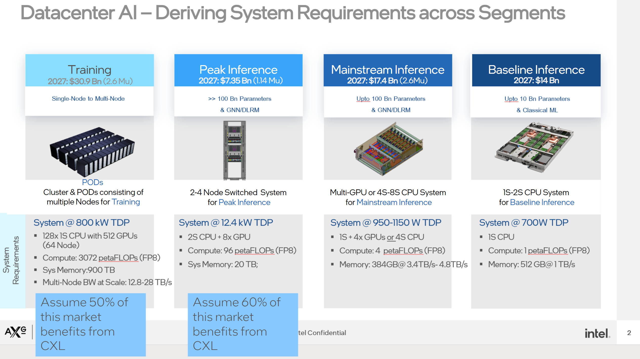
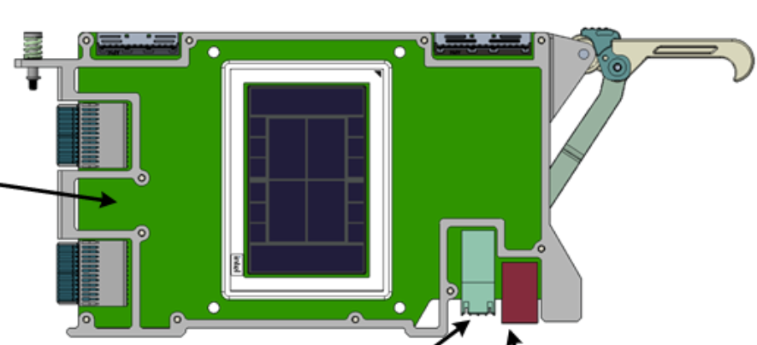
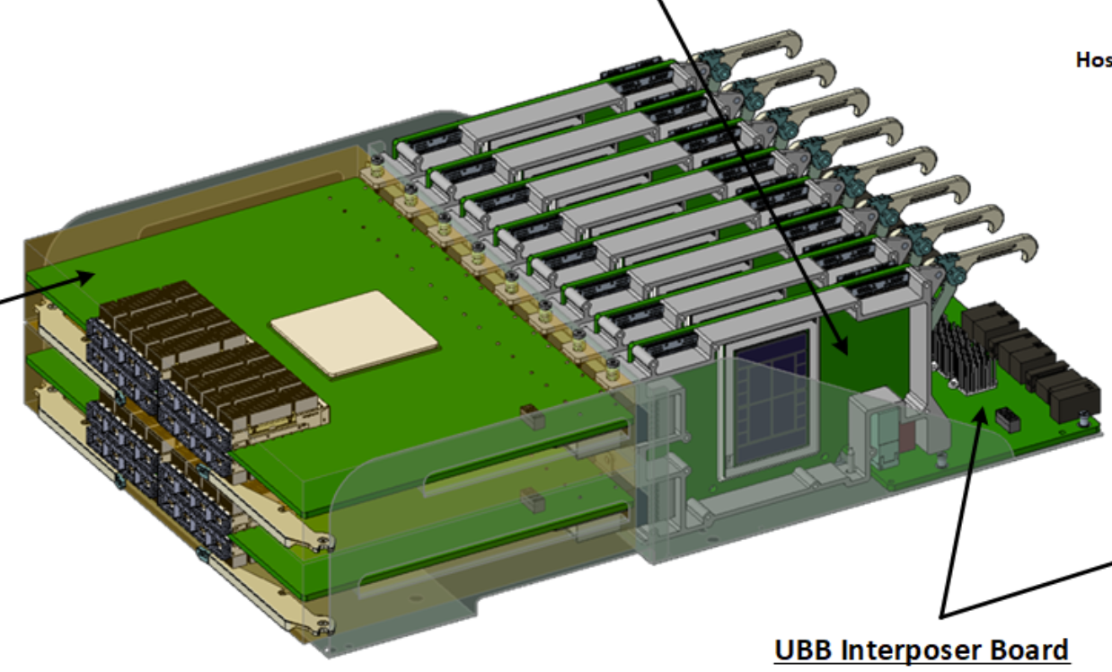
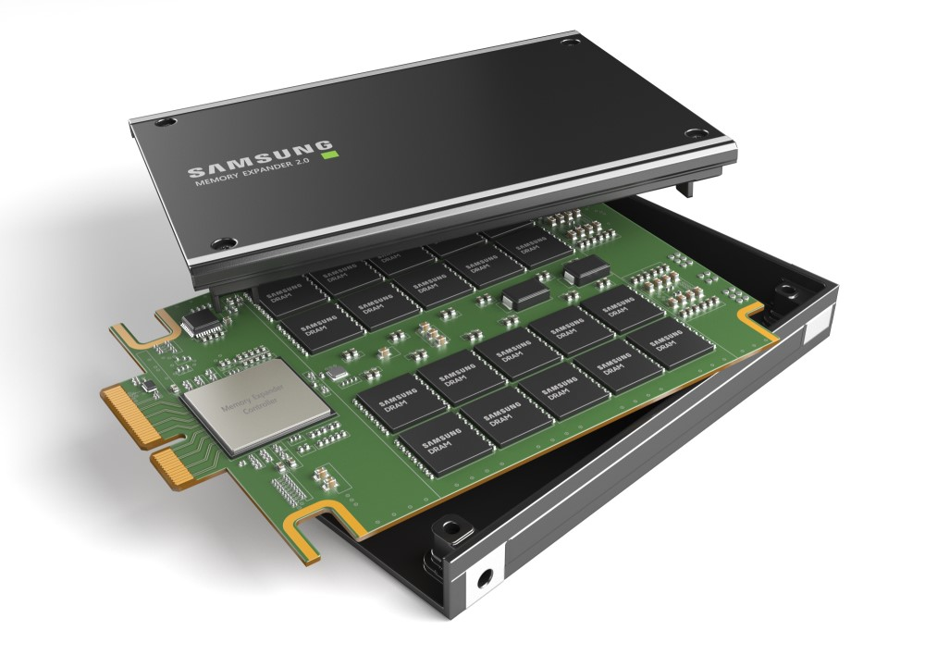
How accelerators addresses LLMs (inference)
Wayne Gretzky – “I skate to where the puck is going to be...”
1
2
3
1xModule
288GB Total
Limited to ~90-135B params [BF16]
~288B params [FP8]
Large part of peak inference market with BF8 and entire peak inference market with BF16
Cannot run larger models
Nx Modules
288GB x #GPU
~90-288B params x #GPU
TCO: Perf/$, Perf/w
1xModule w/8 x8 CXL DDR
Up to 4TB Memory
~1.2-1.9T to 4 Params
Up to 14x eff. Perf/w | Power
← 16xGPU | 24kW+
1xGPU+CXL DDR → | 1.7kW
# of Module | Capacity | Power
1 | 288GB | 1500w
2 | 576GB | 3000w
4 | 1152GB | 6000w
8 | 2304GB | 12000w
16 | 4608GB | 24000w + Node
DDR | Total Capacity | CXL DDR Power | Module+Mem Power
64GB | 512GB | 16w x8 = 128w | 1628w
128GB | 1TB | 18w x8 = 144w | 1644w
256GB | 2TB | 22w x8 = 176w | 1676w
512GB | 4TB | 27w x8 = 216w | 1716w

Slide 3
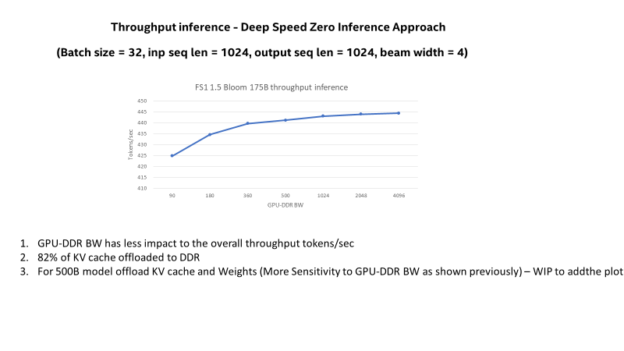
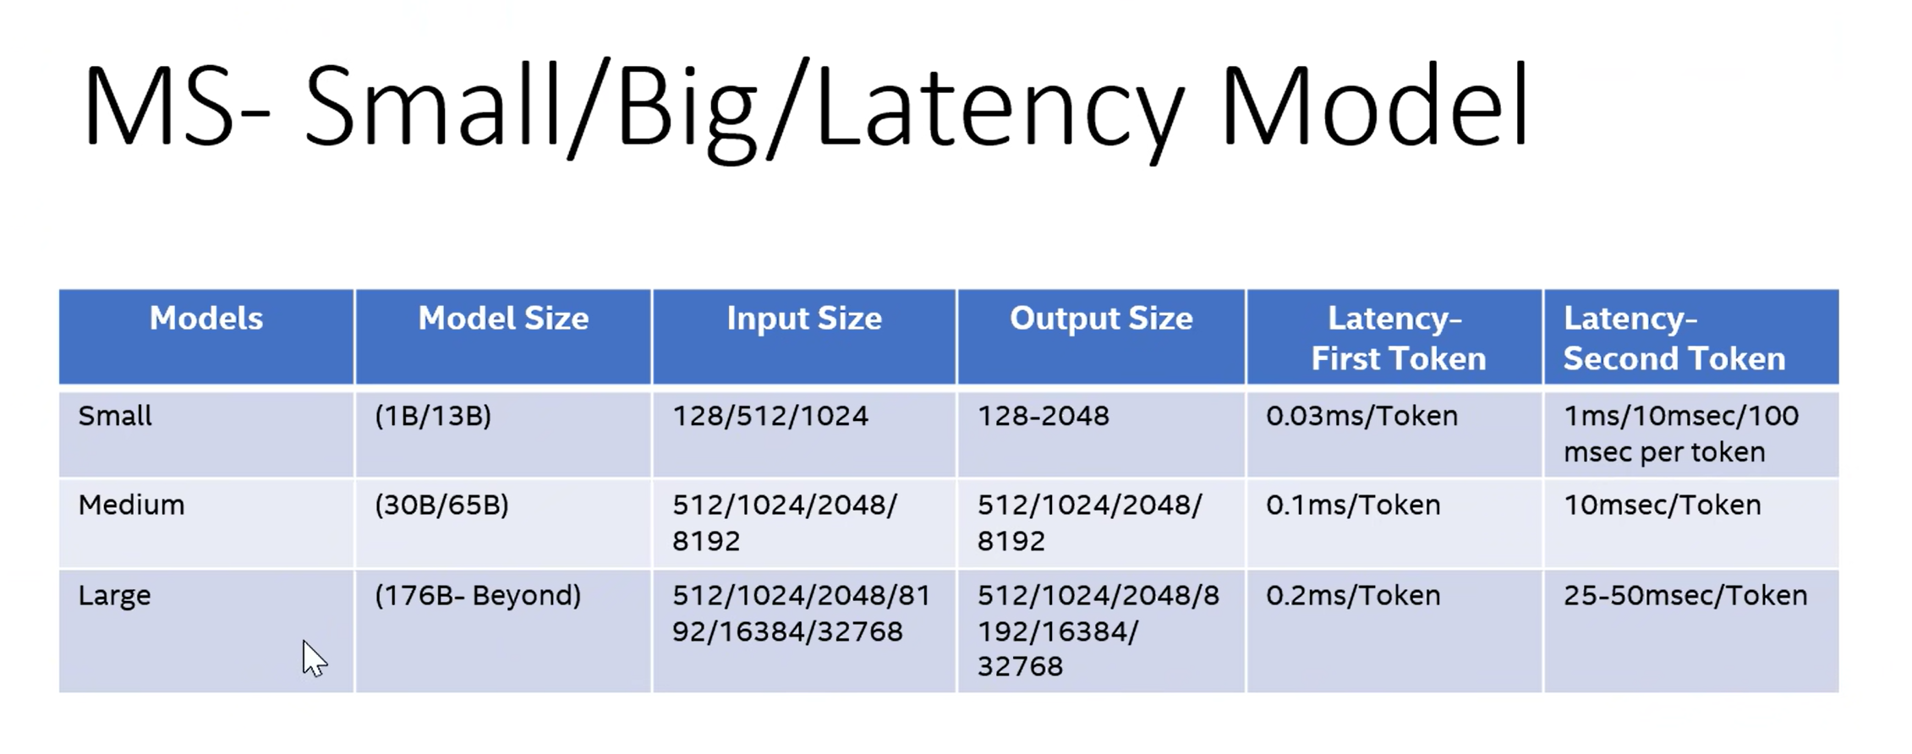
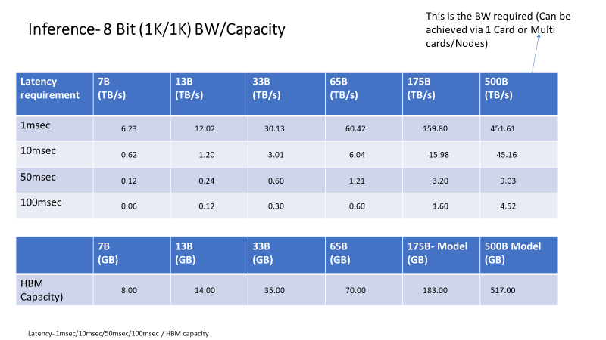
CXL DDR perf/$ and perf/w upsides
(*) Note: larger model param sizes could present higher TCO advantage
2LM Bandwidth saturates ~ 500 GB/s for Tput Inf WLs
CXL Expansion Memory – Throughput inference – BS=32
LLM – 175B Mem cap: ~.65G | Power | TCO | Notes
3 FS1 | 4.5kW | $65K
1 FS1 + 512GB CXL3.0 | 1.628kW | $30k | 2.16xTCO 2.7x Power
CXL Expansion Memory – Latency inference
LLM – 500B | Power | TCO | Latency | Notes
4 FS1 | 6kW | $81k | < 1sec
2 FS1 + 786 MB CXL3.0 | 3.2kW | $58k | 3 sec | 1.4x TCO 1.9x Power
LLM – 500B Mem cap: ~1.12G | Power | TCO | Notes
6 FS1 | 9.0KW | $119k
1 FS1 + 1TB CXL3.0 | 1.644kW | $31.5k | 3.77x TCO 5.5x Power
TCO and Power improvements seen even for latency Sensitive use cases ( Customer specific Latencies – 3s in this example)
Significant TCO and Power improvements for Tput inference Wklds

Slide 4
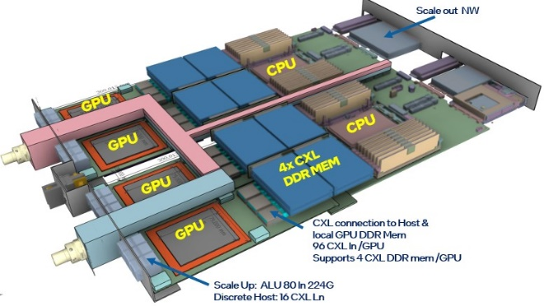
Future options with rackscale – where CXL modules can be integrated on a rack

