Slide 1
Computex ‘24 Highlights
FTE Ops 24ww23
Mike Goldsmith
ETPP

Slide 2
Outline
Summary / So What
Nvidia Keynote
AMD Keynote
Qualcomm Keynote

Slide 3
Summary / So What
AI Everywhere; Microsoft Copilot+ branding was the big sales item
  Nvidia and AMD also talked HPC roadmap
Nvidia Keynote: “How we got here, what’s new, what’s next”
  Highlighting the SW ecosystem and how AI Factories will service all markets in the future by “making tokens”
  Roadmap update through ‘26, entirely focused on HPC / Datacenter
  Some announcements of RTX mobile w/ AMD APUs, but these are Lovelace
  No Blackwell consumer announcements
AMD Keynote: Zen5
  Desktop (Granite Ridge), Server (Turin), APU (Strix Point) all announced
  MI300 roadmap through ‘26; no Consumer dGPU announcements
Qualcomm Keynote: Elite X / Windows on ARM is here (for real)
  20+ laptop design wins, coming in several waves

Slide 4
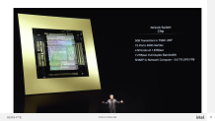
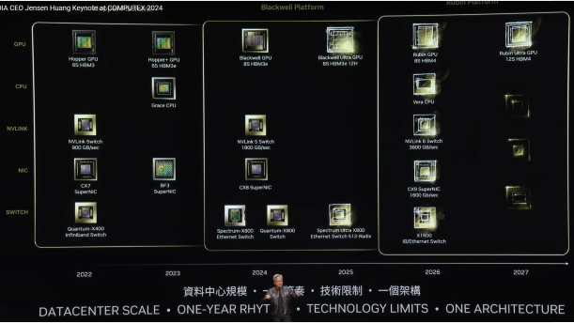
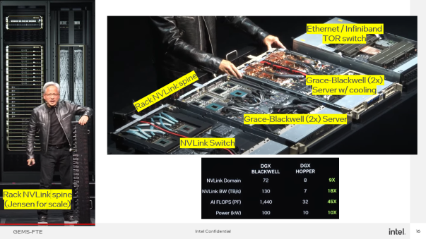
Nvidia Keynote
Showcased Blackwell production platform:
  Air Cooled DGX for “x86 based”, up to 8 OAM style cards per chassis
  Liquid cooled Grace-2xBW module board, 2x per 1U rack
  NVLink switch 1U rack with copper backplane for rack, total 72 GPUs per DGX cluster (which is a full rack coherent)
Gave roadmap update for HPC solution platforms; Annual update cycle
  Hopper Platform today, Blackwell soon™, Rubin later
  Grace CPU + Hopper, Blackwell GPUs; Vera CPU + Rubin (and likely nextgen)

Slide 5
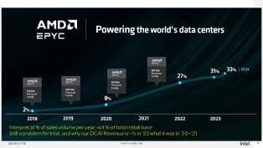
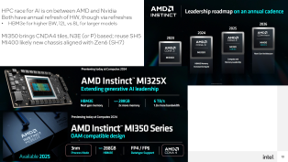
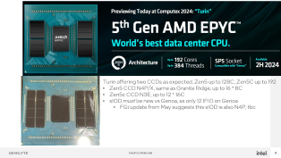
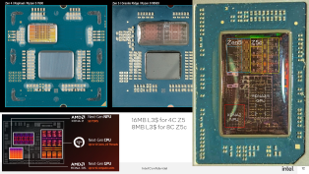
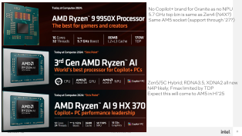
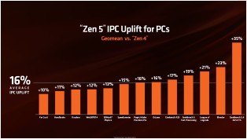
AMD Keynote
Zen5 full roadmap update for Desktop, Server and Mobile:
  Overall claim is Zen5 average IPC is +16% vs Zen4
  Desktop top SKU (so far) Fmax 5.7 GHz vs 5.8 GHz rumored; likely N4X
  APU SKU both Zen5 (Fmax 5.1 GHz) and Zen5c, two CCX; likely N4P
Server update for both Zen5 (128C) and Zen5c (192C) SP5 options
  Aligned with projections; Zen5 CCD same as Desktop (but N4P); Zen5c CCD N3E
  Bringing Zen5c to market on two nodes concurrently (dual drive)
  Highlighting growth in DC market share, which clearly comes at our expense
HPC roadmap for MI300X~MI400X – annual updates like NV
  MI325X is MI300X with faster HBM3e, more capacity (12L vs 8L)
  MI350X will be new with CNDA4 tiles on N3E(P) → assume SH5 still
  May also move to Zen5 in an MI350A, but not announced
  MI400 will likely be new platform / architecture more aligned to Zen6 products

Slide 6
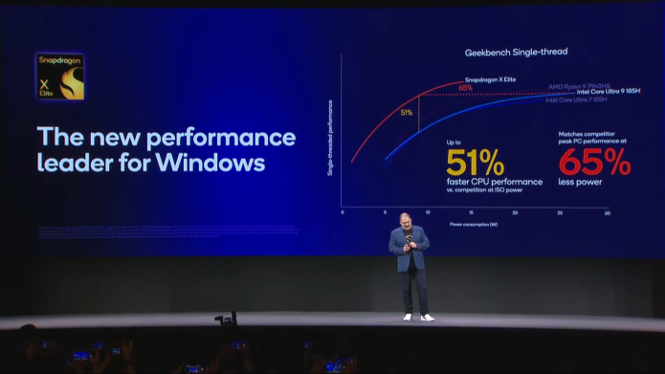
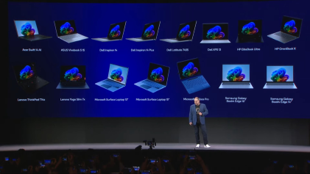
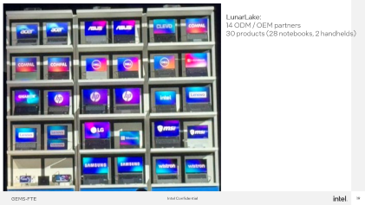
Qualcomm Keynote
Entirely focused on Elite X and design wins, competitive position:
  Highlighting the performance / W benefit of their solution (which is N4P based)
  Highlighting multiple design wins and Copilot+ integration across the board
    7 ODM / OEMs represented for 15 notebook designs
    Intel for LunarLake showcased twice as many ODM/OEM partners and products

Slide 7
Backup

Slide 8
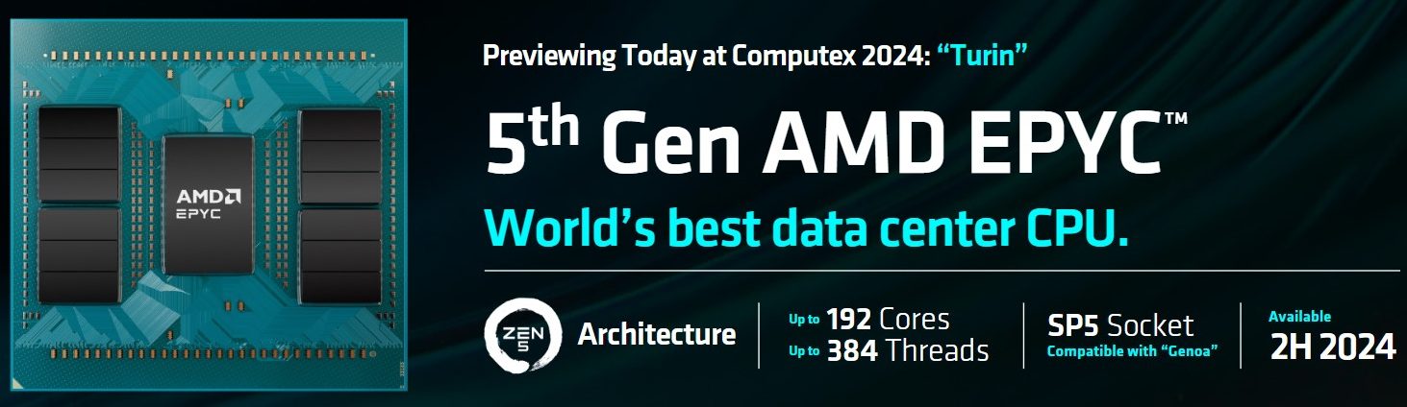
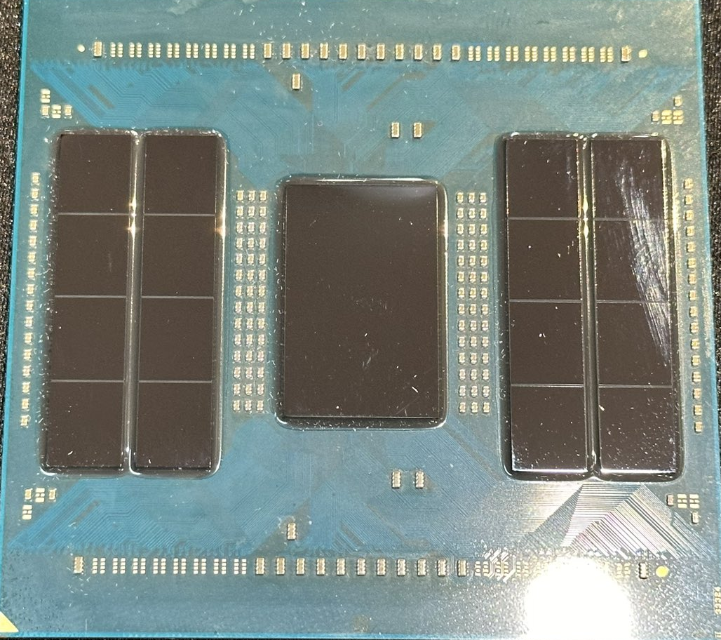
Turin offering two CCDs as expected. Zen5 up to 128C, Zen5C up to 192
Zen5 CCD N4P/X, same as Granite Ridge, up to 16 * 8C
Zen5c CCD N3E, up to 12 * 16C
sIOD must be new vs Genoa, as only 12 IFIO on Genoa
  FGi update from May suggests this sIOD is also N4P, tbc

Slide 9
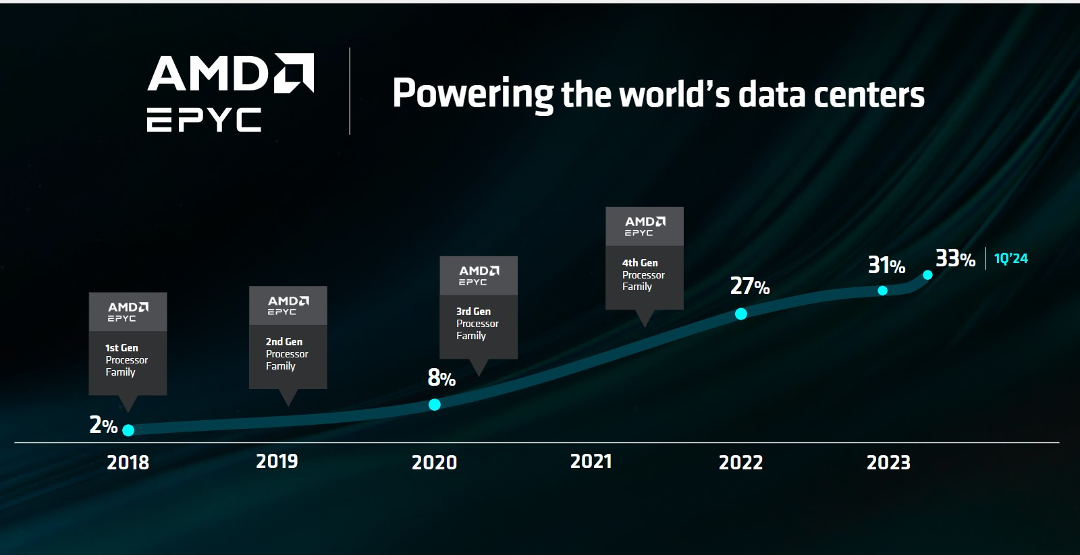
Interpret at % of sales volume per year, not % of total install base
Still a problem for Intel, and why our DCAI Revenue is ~½ in ‘23 what it was in ’20~’21

Slide 10
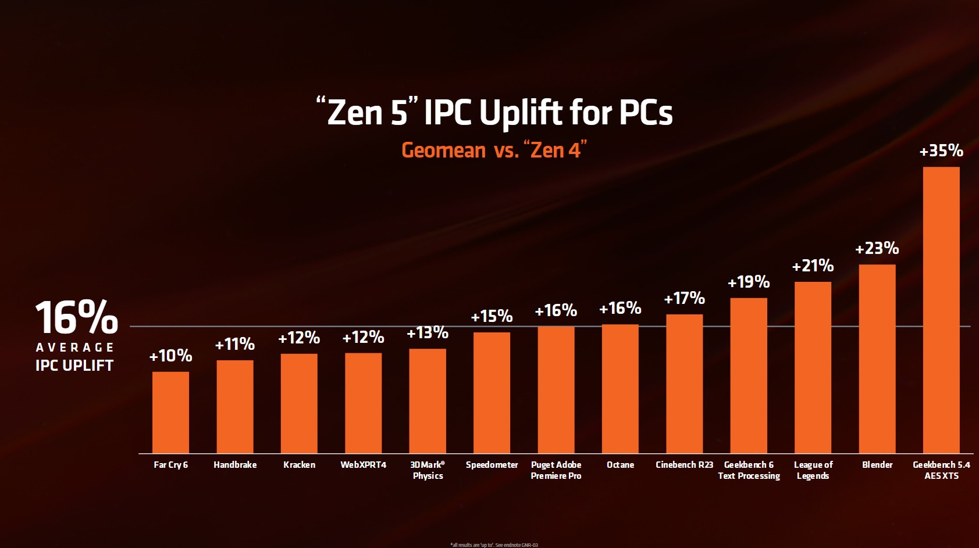

Slide 11
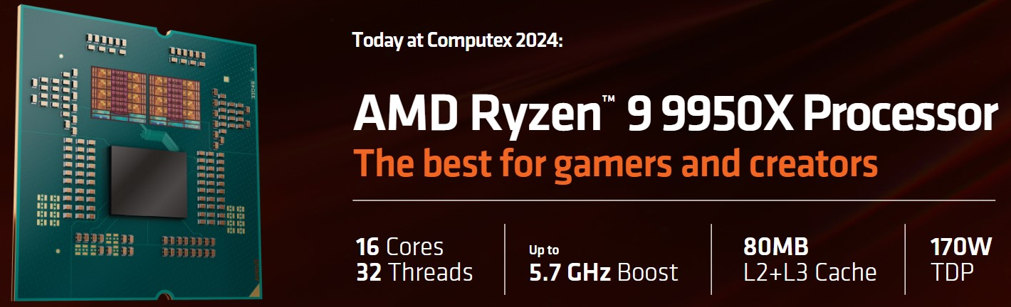
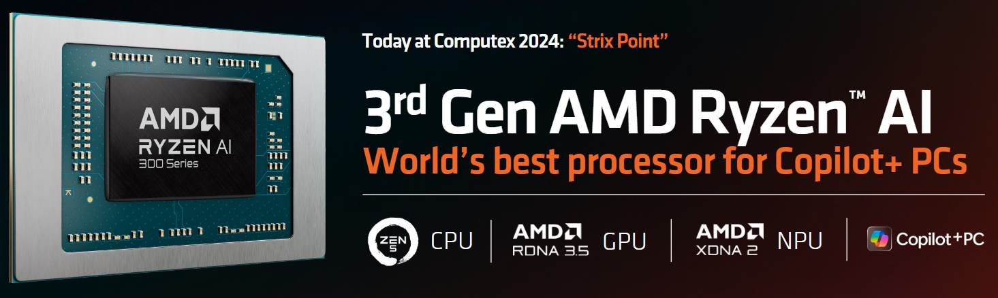
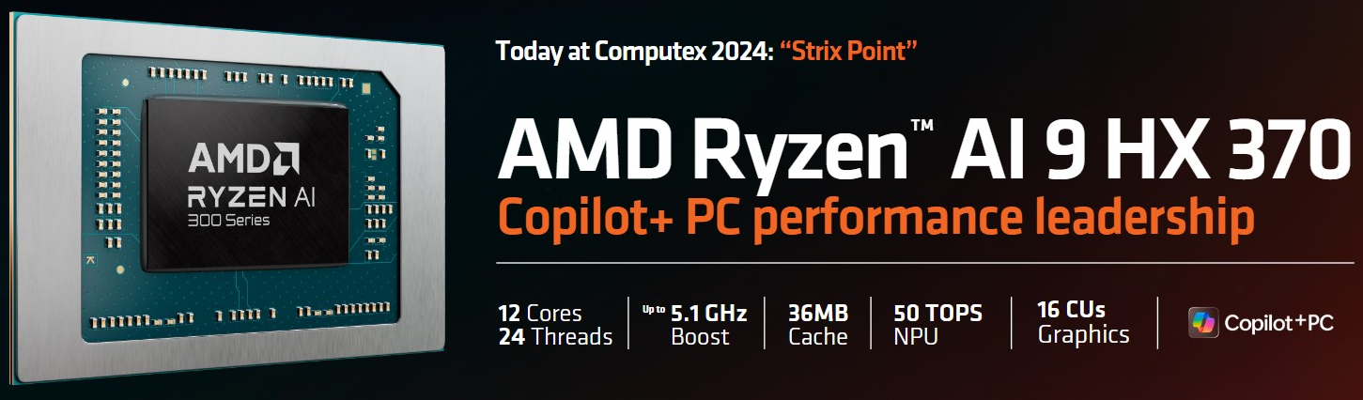
No Copilot+ brand for Granite as no NPU
5.7 GHz top bin is same as Zen4 (N4X?)
Same AM5 socket (support through ‘27?)
Zen5/5C Hybrid; RDNA3.5, XDNA2 all new
N4P likely; Fmax limited by TDP
Expect this will come to AM5 in H1’25

Slide 12
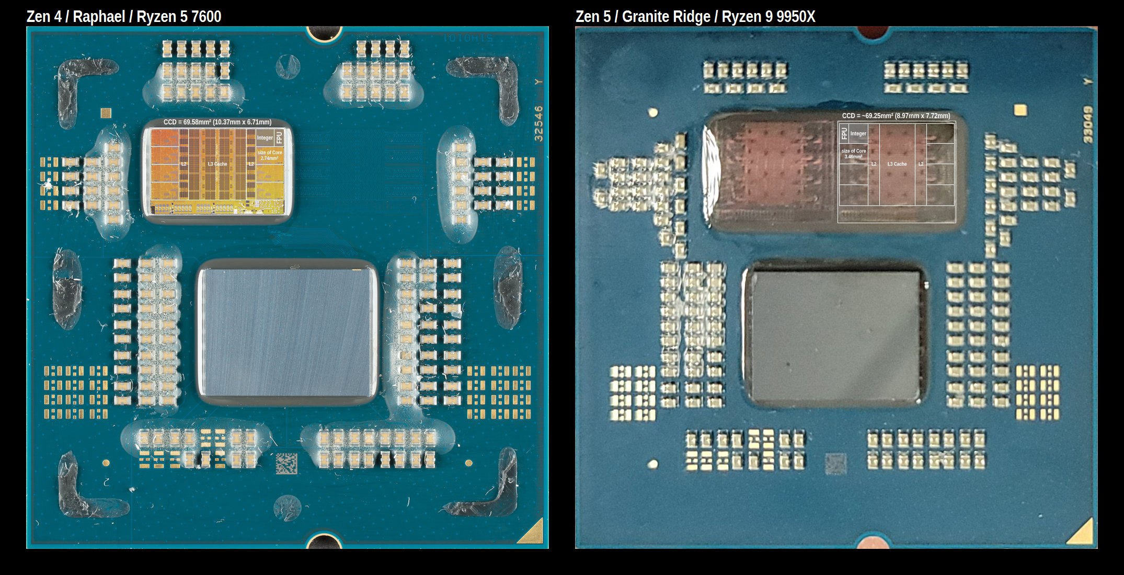
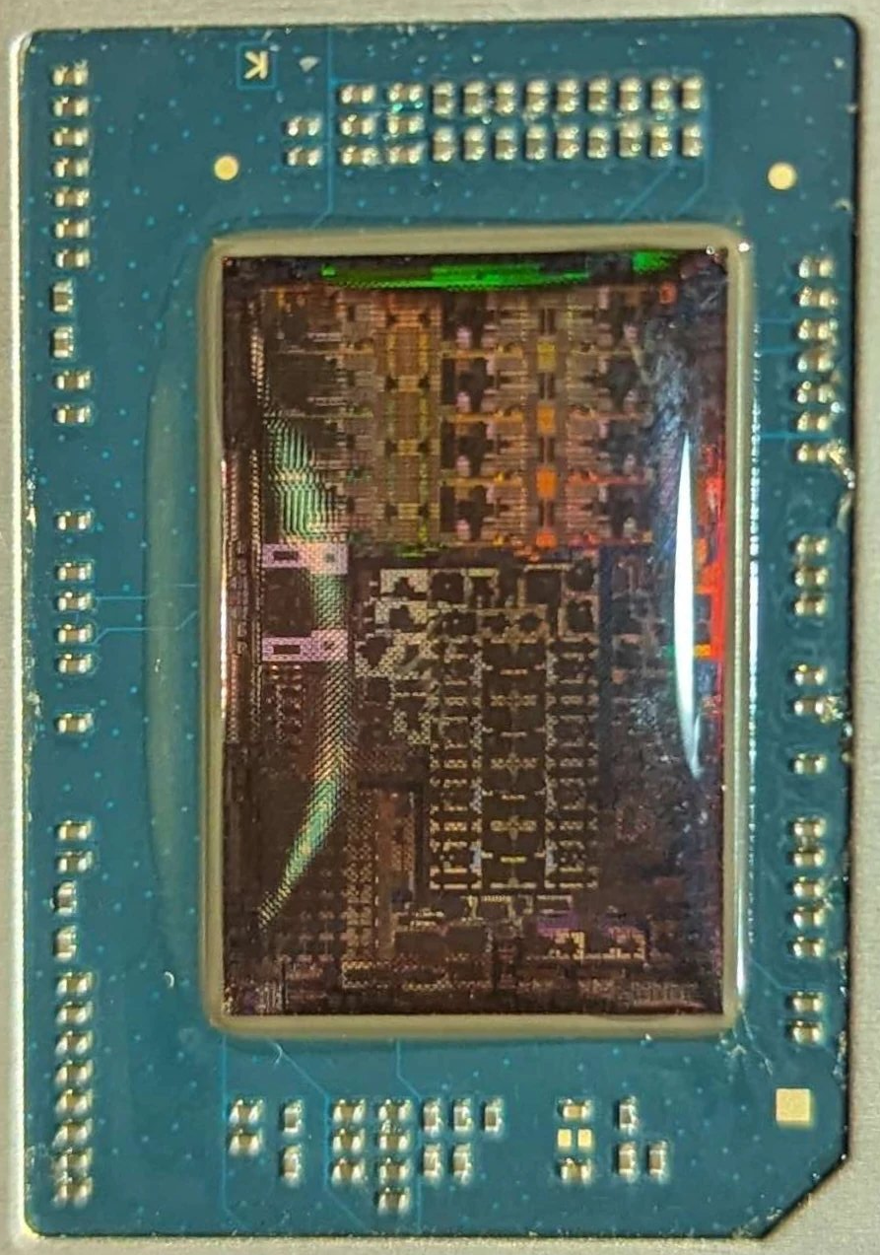
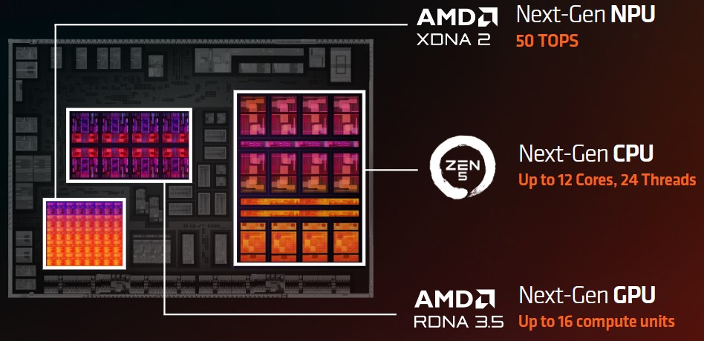
Zen5
Z5c
RDNA3.5
GPU
XDNA2
NPU
16MB L3$ for 4C Z5
8MB L3$ for 8C Z5c

Slide 13
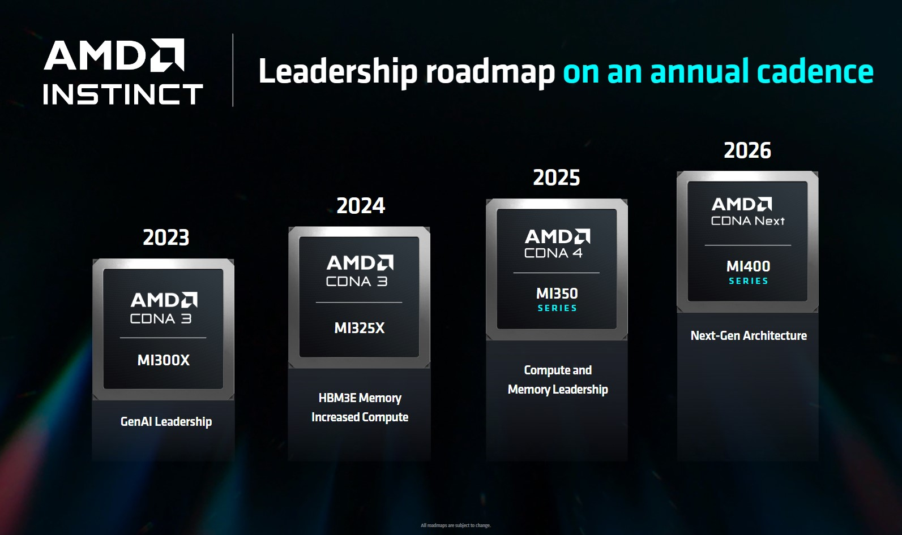
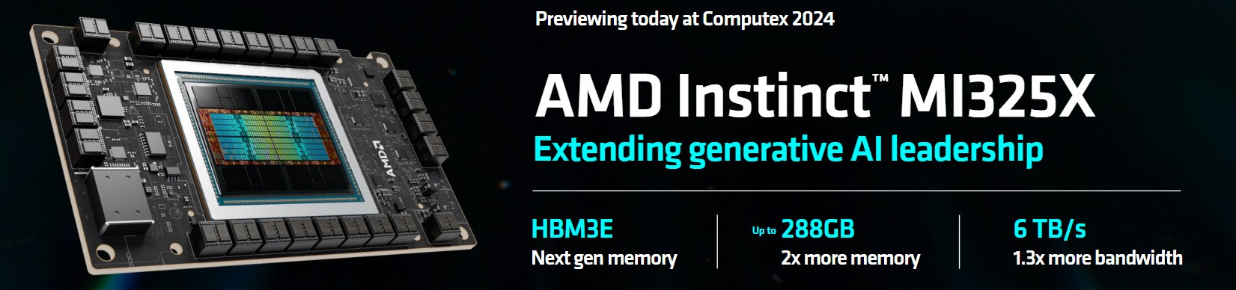
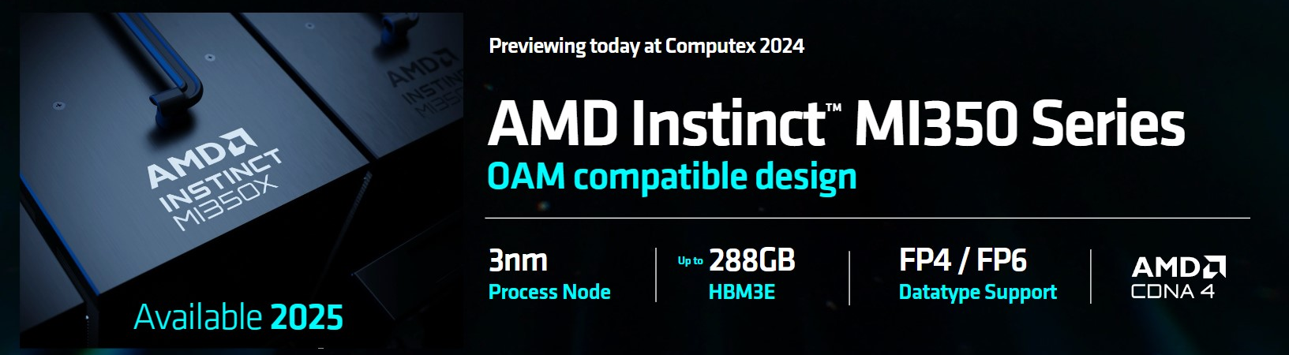
HPC race for AI is on between AMD and Nvidia
Both have annual refresh of HW, though via refreshes
HBM3e for higher BW, 12L vs 8L for larger models
MI350 brings CNDA4 tiles, N3E (or P) based; reuse SH5
MI400 likely new chassis aligned with Zen6 (SH7)

Slide 14


Slide 15
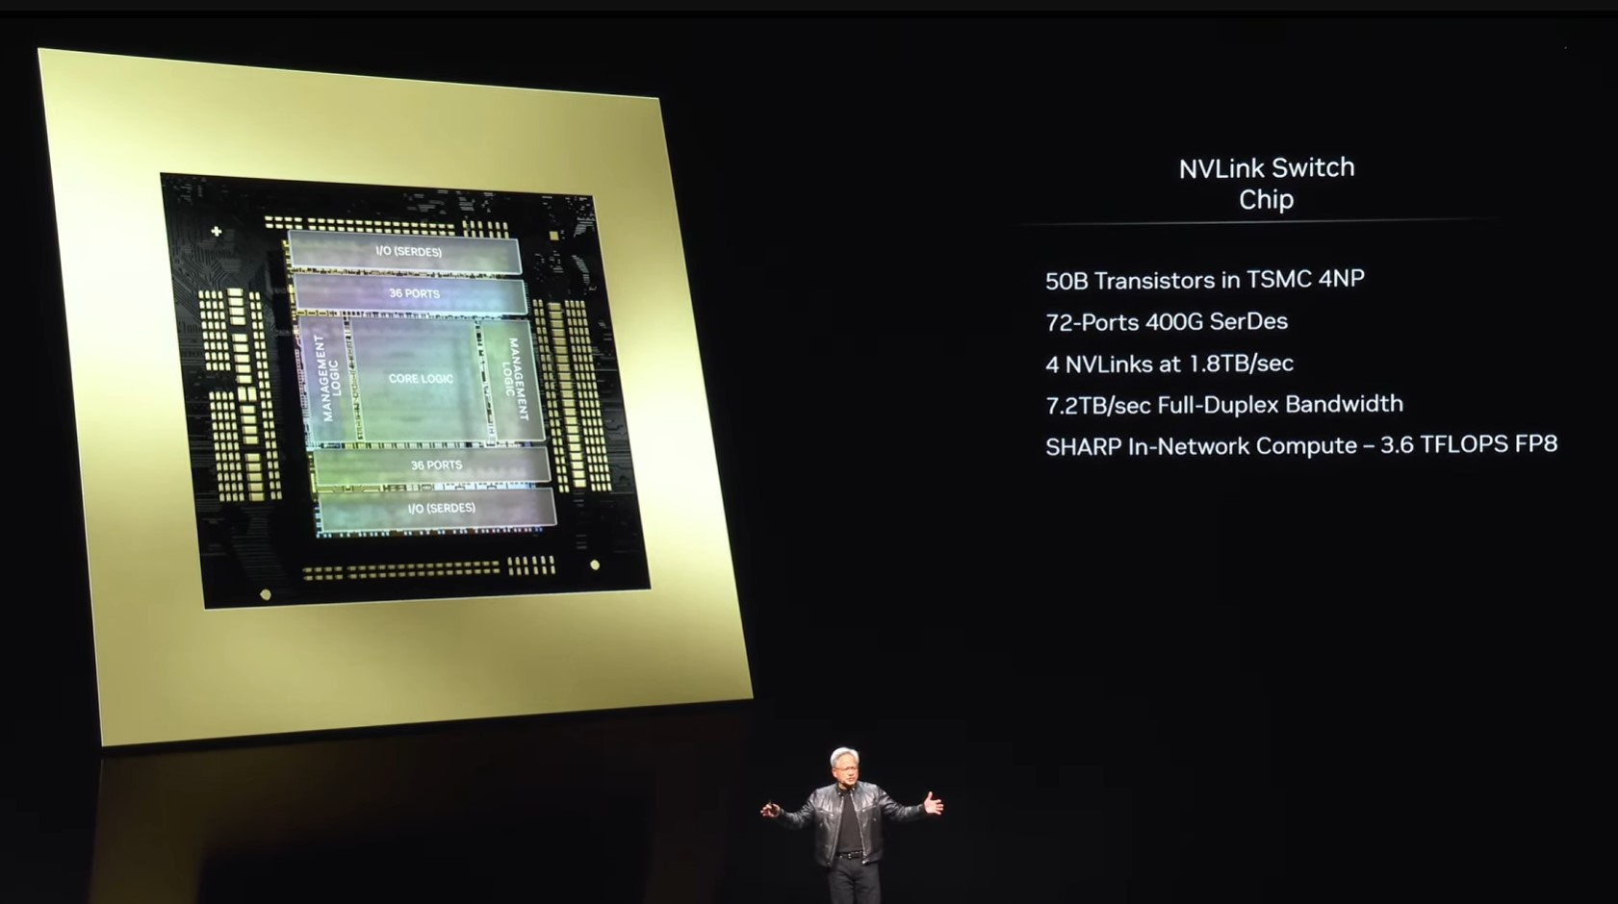

Slide 16
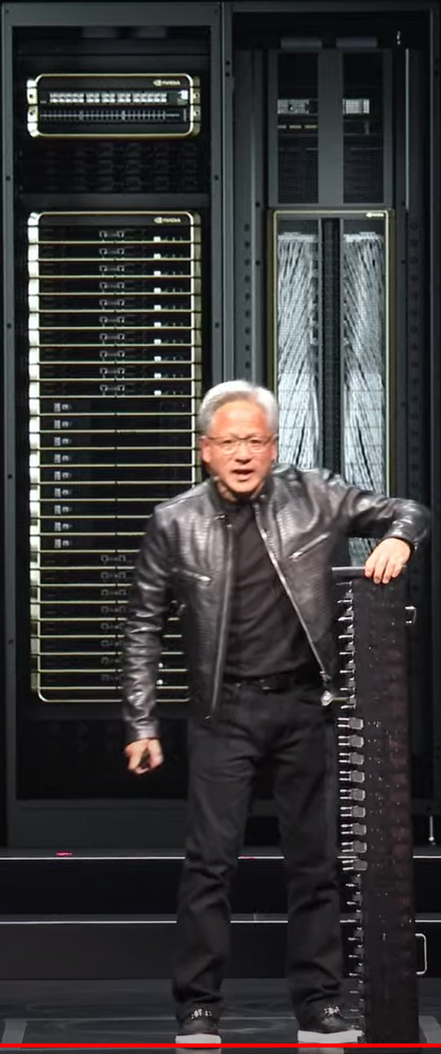
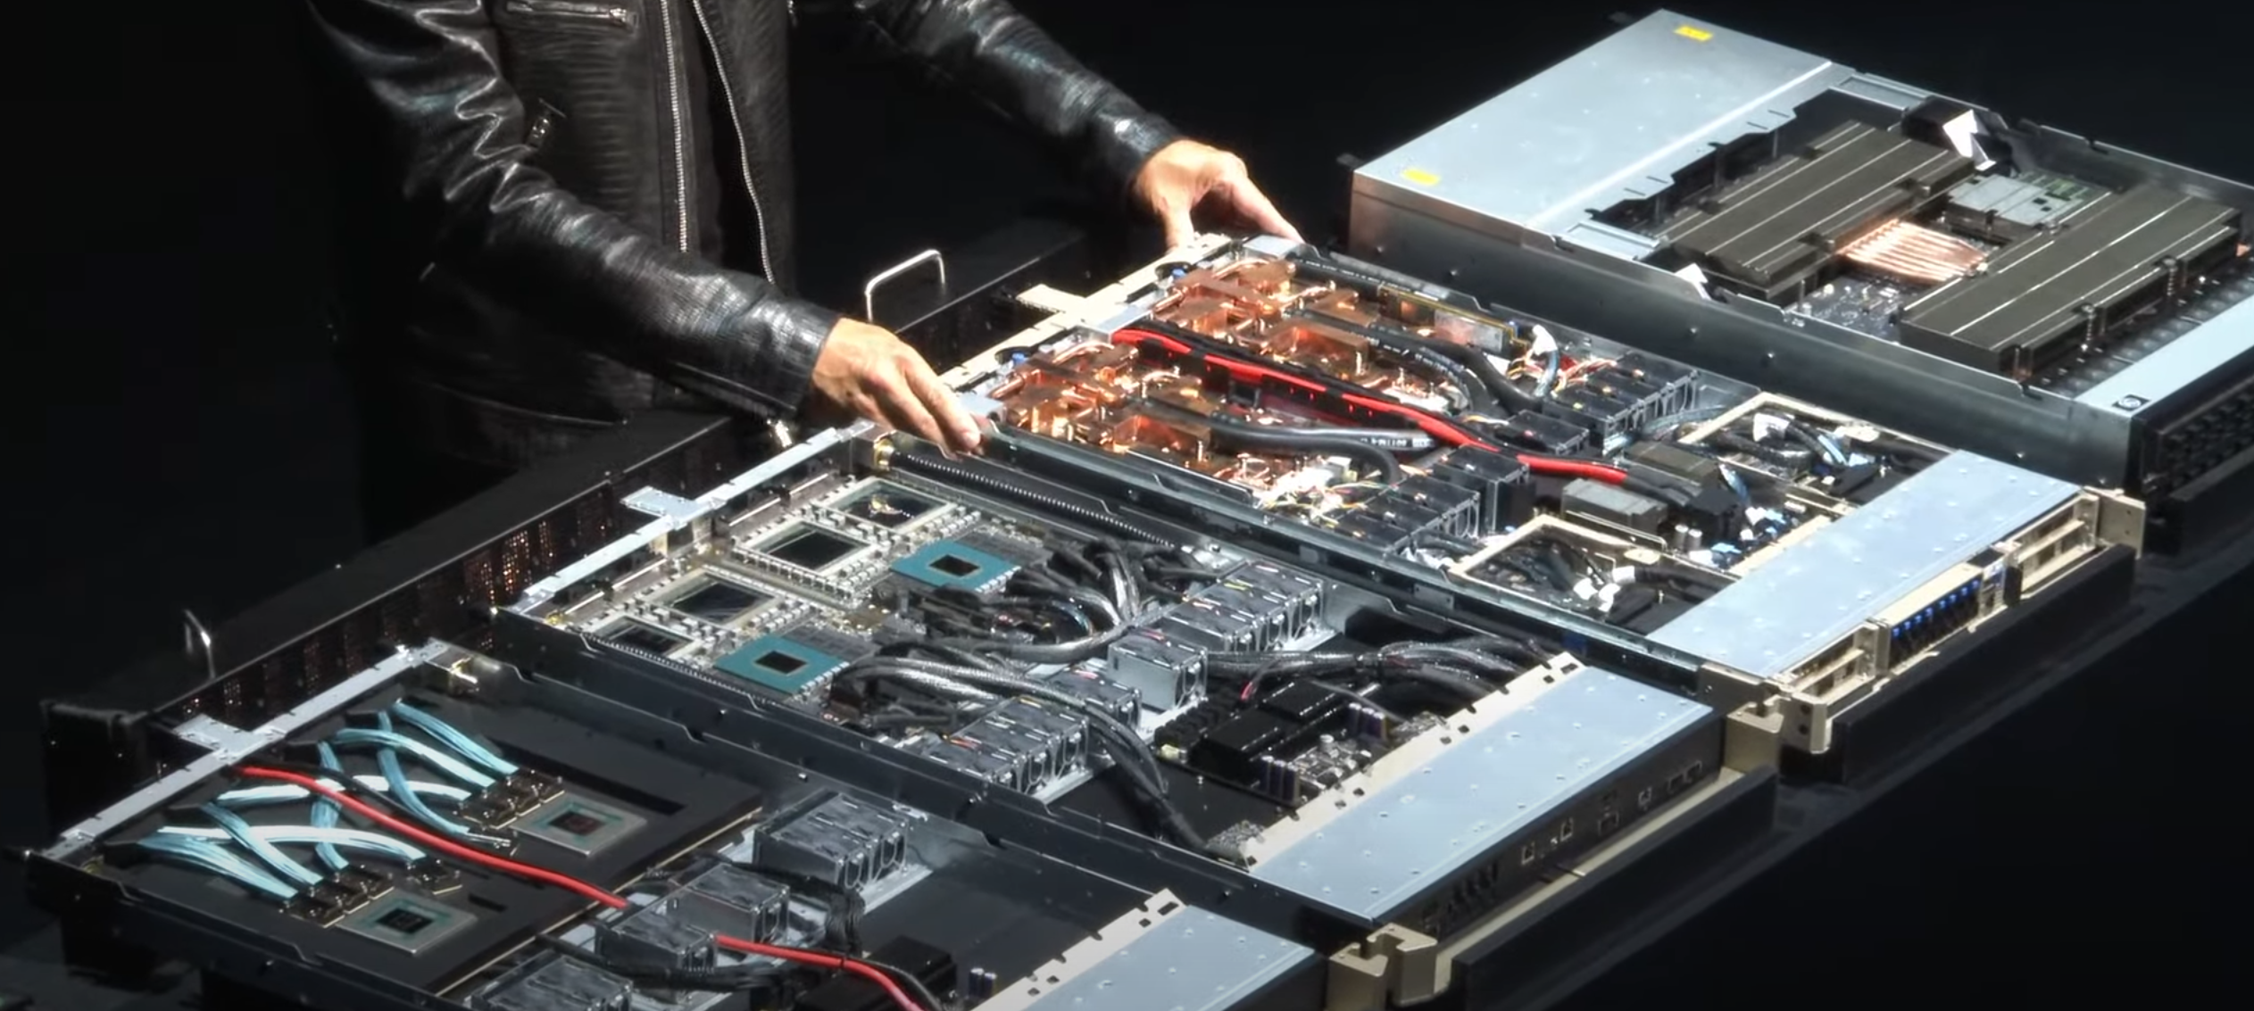
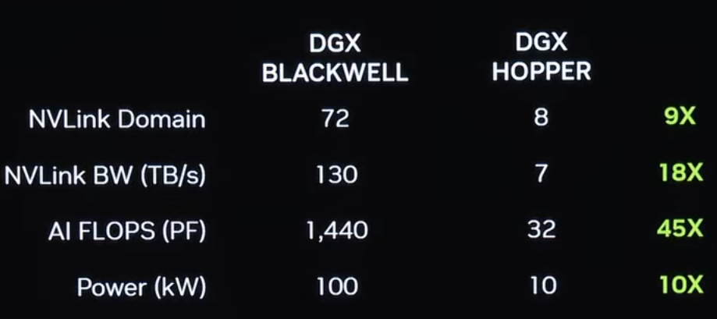
Ethernet / Infiniband TOR switch
Grace-Blackwell (2x) Server w/ cooling
Rack NVLink spine
Grace-Blackwell (2x) Server
NVLink Switch
Rack NVLink spine
(Jensen for scale)

Slide 17


Slide 18
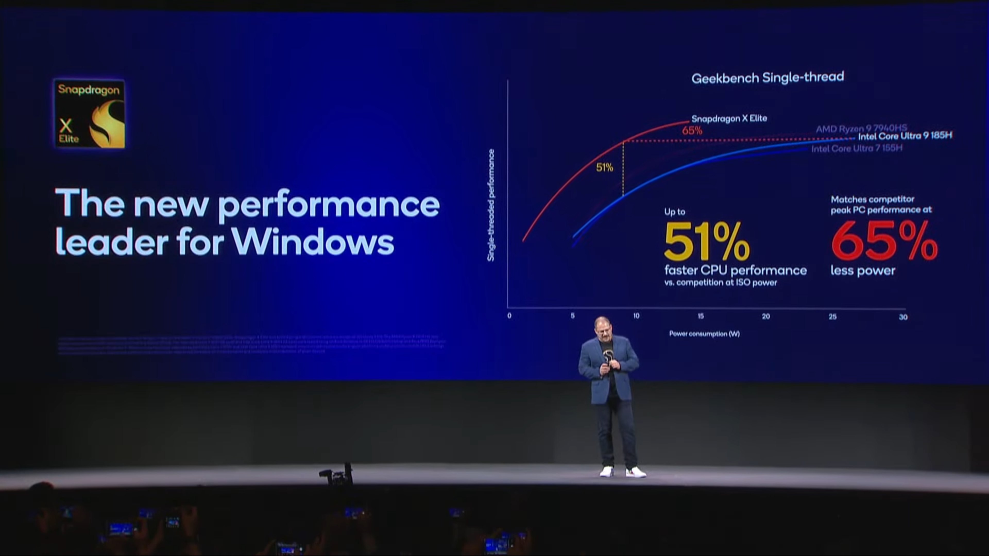

Slide 19
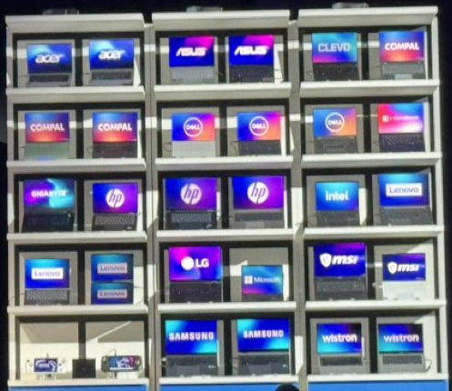
LunarLake:
14 ODM / OEM partners
30 products (28 notebooks, 2 handhelds)

