Slide 1
How to use this Passdown
This passdown provides an overview of messages and content from the Q1 2023 Exec Sync.
Leadership Expectations
Use the information included to have a passdown discussion with your BU’s Grade 10+ leaders within two weeks of receiving the Passdown.
Executives are expected to contextualize the information shared so that the required actions are relevant for their team and business.
Time estimate to go through this content is 25 minutes.
What’s included
Business update: CEO Pat Gelsinger & CPO Christy Pambianchi
IAO – goal, model, progress and next steps: SVP, GM and Chief Business Transformation Officer Stu Pann
DCAI update – roadmap, trends and strategic outcomes: DCAI EVP and GM Sandra Rivera & DCAI CVP and CTO Deepak Patil
Customer update – price feature value: EVP and Chief Commercial Officer Christoph Schell
Have questions or need assistance? Please reach out to executive.communications@intel.com.

Slide 2
Q1
Exec Sync
Passdown
Slides
March 14, 2023

Slide 3

Forward Focus
Meet or beat our quarterly financial targets
Ramp Sapphire Rapids
Pull in, ramp Meteor Lake and Intel 4
Pull in Granite Rapids and Intel 3; Deliver Sierra Forest
Leadership with 18A; win IFS 18A customer
Make our internal foundry model succeed
Notes:
We’ve made progress against our strategy to deliver leadership products, anchored on open, secure platforms and powered by at-scale manufacturing and supercharged by our people.
This year is one of the most important in our transformation journey and I need all of you to live our values and be laser-focused on executing with urgency and excellence.
Our top goals are clear this year – our strategy remains the same.
Put simply these are the things we must do in 2023:
Meet or beat or quarterly targets – this is especially true for Q1. I’ll come back to this.
Ramp Sapphire Rapids, key to stabilizing DC share
Pull in and ramp Meteor Lake and Intel 4
Pull in Granite Rapids and Sierra Forest and Intel 3
Technology leadership happens with 18A, must execute and must win IFS Whales
Make our internal foundry model succeed, foundry is not optional. We cannot make reasonable returns on leading edge nodes w/o it

Slide 4
IDM 2.0 Acceleration Office Update Stu Pann SVP, GM, Chief Business Transformation Officer

Slide 5
Superior Products
Superior
Manufacturing Processes
Intel Value Proposition
Intel
Value
Proposition
Highly Efficient
Business
Processes
Notes:
2023 is the year we really stabilize the business. We have revenue plans based on macroeconomic realities that realistically reflect where we are right now.
We have to do three essential things. First we have to have superior manufacturing processes. This is the heart of our company, what fuels future growth.
5 nodes in 4 years and getting back to process leadership is essential in this journey. From those superior manufacturing processes come superior products: Sierra Forest, Arrow Lake, Panther Lake etc: you can see emergence of much more competitive products.
The third element is new: how do we have highly responsive, adaptable business processes that efficiently allow us to run effectively and ramp our products faster. All three elements together are essential to give us our competitive advantage.

Slide 6
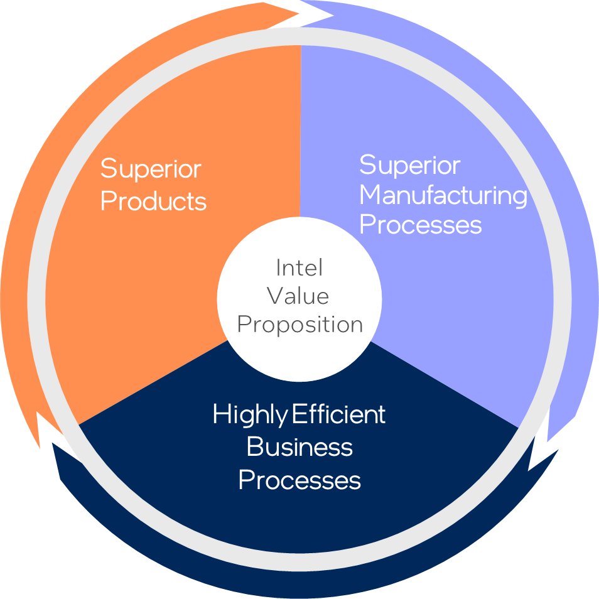
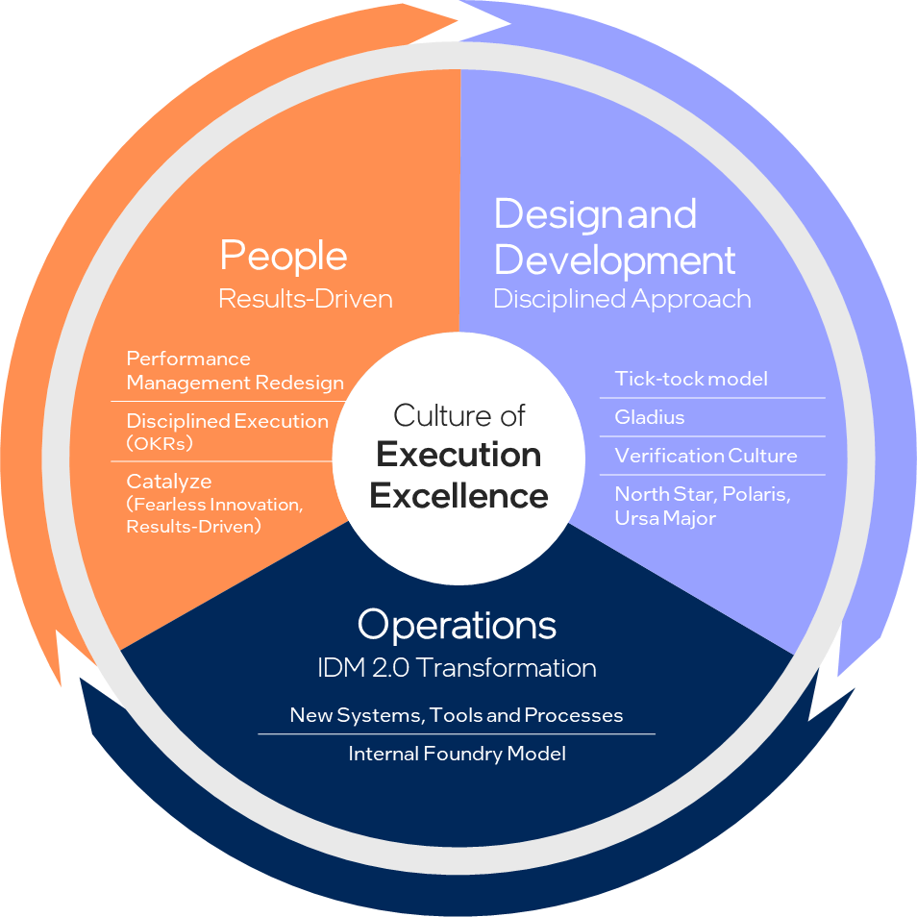
This
This
Needs
Notes:
To successfully execute to the three pillars of regaining leadership and competitive advantage, we need a culture of execution excellence.
To create this internally, we need a systematic transformation of our operations, results-driven growth of our people and a disciplined approach to design and development.
In our people system, how do we measure execution, performance, how we collaborate and bring out the best in each other. We have catalyze, which really focuses on fearless innovation and results-driven culture, and we have brought back OKRs for disciplined measurement and tracking of our achievements against Intel’s overall goals.
Programs like GLADIUS and the tick-tock model ensure we have a steady, predictable cadence of product execution with a committed schedule and optimized resource allocation.
And finally, our operational transformation with the IAO office will put new systems, tools and processes in place to drive transparent, incentivized accountability throughout the company.

Slide 7




The IAO goal: Create a foundry accounting model further enhancing transparency, efficiency, & accountability across all areas of the company.
Processes
DATA
What this means: Significant changes across our processes, systems and behaviors
Decision Rights
Tools
Notes:
Creating this internal foundry model means letting go of our past.
The IAO framework is data-driven, and we are working on the right tools, decision rights architecture and processes to reach our goal: report our financials through the new foundry accounting model externally in 2024, and drive transparency and accountability by associating costs and incentives to decisions and the way we run our factories.

Slide 8




Industry Leadership
TMGF
Orgs
Business Units
Strategic Partnership to Regain Leadership
Notes:
You have to study what competition does and what we can learn from it: what makes them successful and why?
TSMC has used Apple as their process development partner. Very early engagement through small, specialized Test chips maximize learning, faster ramp to yield etc.
We are figuring out what lessons we can learn and apply internally at Intel. Our product groups: DCAI,. CCG etc are essentially our Apple: our customer 0. We are one unified company, and we need to figure out how to leverage the benefits of this operating model internally.

Slide 9
The IAO Model
TMGF Board of Advisors
Mobileye
One Intel
Cash Flow Focused
Lead with Process / Systems
Embrace Standardization
One Price Product Specific Charges
This interface will be modeled after a 3rd party foundry relationship
IDM Fab
Wafers sold to BUs at Standard Price
DCAI
Package
CCG
TSMC Wafers OSAT Costs Other 3rd Party Costs
Package bought by TMGF, sold to BUs
NEX
A/T, Die Prep
Service charged to Product Co
AXG
TD
Product Design/Eng
IFS
Technical/Feature Requirements
Ecosystem Enablement
Tower
Software
Sales to 3rd Parties
Volume Order from BUs
Sales & Marketing
“External Foundry-like” SG&A
TMGF Orgs
BUs
Notes:
What we are creating is a way for BUs to buy from TMGF (left portion of the slide).
On the opposite side, you see different product groups, who will buy the same way AMD buys from TSMC and the same way we buy from TSMC today. We are already having to figure out how we buy and forecast from TSMC, and we are going to take this learning into creating this internal foundry model. This allows for BUs to have a predictable, market-competitive cost.
We will also focus on not losing the One Intel aspect: we want to retain the ability to respond to customers, internal and external alike, effectively. Standardizing our systems under S4 HANA saves customization time where relevant for standard transactions to lower our cost structure. Questions on how the product groups make those decisions are already surfacing and being addresses. Through this, the goal is to generate effectiveness and enable our foundry business to be successful while giving our business groups the same opportunities to buy as other business groups outside of Intel do.

Slide 10
Day 2 Readiness
Alignment on operating model and high-level requirements
Day 1 & Day 2 Requirements
Day 1
Jan 2023
Day 2
Jan 2024
Day 3
TBD
End State
Systems/processes in IAO configuration
Excel based TMGF/BUs PnLs
External/internal reporting
Pricing Update
Release 4 WW12
BUs leveraging release 3 pricing now
ERP
Phase 0 kickoff coming
SI selection underway
S4 transition & priorities
Business Process:
Retool of internal process for revenue, close, supply management, forecasting and TMGF P&L all in IAO format
Notes:
Significant rewiring from org changes to system S&OP changes to decision rights.
Day 1 is done, and we have wafer costs, packaging and assembly costs etc released in excel format. We are seeing a lot of great questions about decisions rights and why costs are a certain way, and we are now working on finetuning those through subsequent pricing releases.
For day 2, we have committed to reporting our financials externally in Jan 2024. Day 3: ERP transformation is a 3-4 year journey. Not overnight, but effective. The biggest factor here is the mindset shift: we need to be highly engaged across the company with small, dedicated teams to help us in this effort.

Slide 11
Next Steps/Call to Action
How
We
Win
Embrace the new model. TMGF orgs & Business Units working together to regain leadership.
Drive engagement and disciplined transparency. Actively engage with your teams in a transparent manner and ensure each person understands their role.
Ensure accountability and ownership to deliver and execute the Internal Foundry model. Link IAO/Internal Foundry success to group and individual OKRs.
Speak up. Help IAO define the ideal future state. Share observations and ideas on how we can best implement and achieve success with our new operating model.

Slide 12
DCAI Technology and Compete Update Sandra Rivera EVP and GM, DCAI Deepak Patil CVP and CTO, DCAI

Slide 13
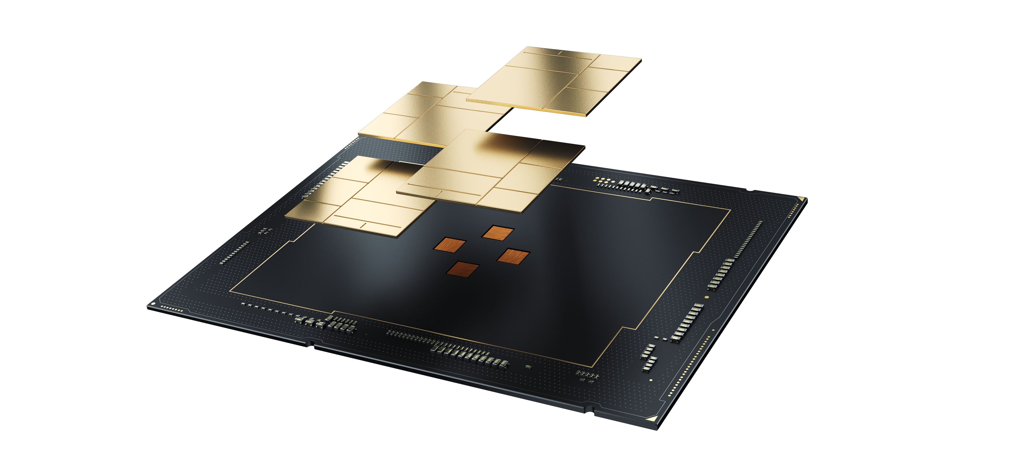
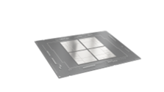
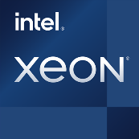
Xeon Roadmap Status
Launched high-quality product & ramping
P-Core
4th Gen Xeon
Volume validation well underway
P-Core
Emerald Rapids
Platform is healthy and hitting key milestones
P-Core
Granite Rapids
Entered power-on & running multiple OSs
E-Core
Sierra Forest
Leading Indicators are on Track & Customer Confidence Growing
Notes:
We continue to make excellent progress on our Xeon roadmap since our refactoring into P-core and E-core swim lanes at the start of 2022.
Silicon coming out of the factory is healthy, and we're hitting all major milestones with our upcoming Xeon programs. All our leading indicators are on track and in many areas, we’re ahead of our commits.
Earlier this year, we launched our 4th Gen Xeon at the highest quality we've seen in multiple generations. Today, there are over 200 OEM and ODM designs shipping and we have more that 500 design wins. The world's top global CSPs are deploying services using our latest Xeon.
Volume validation is underway for our Emerald Rapids program. We continue to meet, and in some cases even beat our engineering commitments for this program. We are sampling silicon to customers today, and we remain on target to execute this program in Q4 of this year.
Following Emerald Rapids, the next product in our P-core swim lane is Granite Rapids. This program is in excellent shape and we’re hitting all our key milestones. Granite Rapids will be our first P-Core-based Xeon on the Intel 3 process, and we’re on schedule to launch these products in 2024. Granite Rapids will deliver several process improvements, including increased core counts, improved performance-per-Watt and faster memory and I/O speeds. The first stepping of Granite Rapids coming out of our factories is incredibly healthy. We’re sampling this product to customers today and the feedback we’ve been getting has been highly encouraging.
Our first E-core-based Xeon will be Sierra Forest. The progress we're making with this program is exceeding our expectations. Sierra Forest will be the lead vehicle on our Intel 3 process technology. We started the power-on process earlier this quarter and the silicon is very healthy. We were able to boot multiple operating systems on the silicon in less than 18 hours. Just recently, we sampled early Sierra Forest parts to a customer, and we will be getting more samples into the hands of additional customers in the coming months.
The progress we're making with all these programs is highly encouraging, and is leading to greater confidence in Intel among our customers.

Slide 14





Industry Trends
Evolution of the Distributed Edge
Sustainability & Power Efficiency
Artificial
Intelligence
Disaggregated Compute
Trust
Role of Software Developers
Cloud Operating Model
Cloud Service Provider Evolution
Notes:
As we evaluate the industry landscape and the future of data center computing – there are 8 trends which will increasingly shape our product direction, priority decisions and strategies. The cloud operating model has been a game changer over last decade. Delivery of resources over the network; democratization of software engineering; and transformation of business commerce into on-demand and pay-as-you go models– has fundamentally changed computing. Cloud Service providers like Amazon, Microsoft, Google have driven this revolution and along the way have become significantly prominent for our future than they were before.
Software developers are evolving to be the most prominent persona that will define the future of the data center – just like what they did for the cloud. Software will continue to eliminate the boundaries between infrastructure and applications, while APIs, micro-services, open-source solutions, cloud, and developer communities will continue to expand the innovation potential of software developers.
Sustainability has evolved from a good consideration to a decision tie-breaker. The world is actually running out of power grids that can support new large data centers. From the largest cloud service providers to enterprise and government buyers – power consumption, performance per TCO, and efficiency are critical factors in technology decisions. AI is evolving to be one of the most important and specialized workloads – but in addition – Applied AI is transforming data centers from highly managed to autonomously managed. All key hyper-scalers expect that over next decade – majority of the data center design, planning, provisioning, config and management decisions will be driven by AI and ML. Lastly there is a strong movement towards disaggregated computing. At large scale – resource stranding is becoming a serious challenge and these data centers are turning into tightly coupled; commonly managed – but highly disaggregated and fungible pools of systems.
With significant advancements in infrastructure form factor, content distribution technologies, and connectivity – the distributed edge is evolving to be a very attractive and real destination for workloads. And lastly – with the speed at which businesses are moving forward – Trust is becoming more important than ever – with implications across cloud, software, services and infrastructure.

Slide 15
Strategic Outcomes
1
2
3
4
5
6
Continue to win with Xeon
at Scale
Design
for Sustainability
SW Defined & Silicon Enabled
Win
with Hyper-scalers
Win the Workloads of the Future
Enable New Use Cases
Leadership
across breadth of workloads
No Watt
Left Behind
Annual recurring
revenue
Tailored solutions across the portfolio
Composability & interop
AI and FPGA
Notes:
To capitalize on these trends, DCAI Staff has articulated six strategic outcomes – representing our “north star” goals for the data center business. These are articulated in the Data Center Technology Strategy – a project that has been kicked off in the fall last year – and now in a quarterly cadence of publication. The strategy document was borne out of the following priorities: (1) a consistent framework to synthesize market transitions, competitive headwinds and innovation opportunities into a singular technology vision for the data center (2) identify outcomes that drive investments, priorities and design tradeoffs and (3) Institute consistency in taxonomy, operational model and planning frameworks. Written by senior technical staff and business leaders across the company, Version 1 was published in January and V2 will be published April 17, 2023.
The six strategy outcomes are as follows:
Continue to win with Xeon at scale: Intel must continue to execute the Xeon roadmap at scale with quality, schedule productivity, power efficiency, breadth of workload supportability and performance.
Design for Sustainability and Power: Intel must reclaim its leadership in power efficiency and take a “Leave no Watt Behind” approach.
Software Defined & Silicon Enabled. Intel must embrace the power of software in eliminating the boundaries between data center infrastructure and the applications. Furthermore, it is imperative for Intel’s future to use software to embrace an as-a-service deliver model for key capabilities, where more of Intel’s product portfolio is delivered to customers in a self-serve, immersive and cloud-aware operating model
Win with the Hyperscalers. Winning with hyper-scalers is fundamental to Intel’s future success because of the scale, ubiquity, growth rate and competitive threads associated with the public clouds. While the hyper-scalers want to take advantage of the merchant volume economics of Xeon scale – they are also looking for unique competitive advantages through their partnership with Intel. Intel must solve this dichotomy for them and deliver on both fronts for each of the top hyper-scalers.
Win the Workloads of the Future. Intel must execute a compelling CPU + GPU roadmap for the AI workloads and process implications of applied AI on its customers and plan. Additionally, Intel must use FPGAs as the key incubator for a heterogenous Chiplet strategy and custom silicon development for key data center applications as well as cloud-to-edge workloads.
Enable New Use Cases. Composability and interop must become two key priorities for Intel’s future product decisions. A highly composable, disaggregated product platform that intelligently pools resources; can be dynamically assembled based on the workload needs; and can be optimized at “runtime” by customers is a future imperative. As the data center becomes a pool of independently programmed collection of fungible resources that are autonomously assembled and optimized through AI, the Intel Platform Architecture needs to evolve to meet the needs of that future. Furthermore, Intel’s products need to interop seamlessly to enable sales plays, use cases, and work-load focused solutions

Slide 16
Customer Update Christoph Schell EVP and Chief Commercial Officer

Slide 17
Price Feature Value
Primary PFV metrics include performance, power, and total cost of ownership (TCO).
Competition leads on most of these value metrics
Secondary PFV metrics include lifecycle support, software ecosystem, and brand value.
Intel leads on most of these value metrics
Primary PFV Metrics
Source: SMG Account Team Inputs, IPCA perf estimates, Internal TCO Model
Notes:
Data Center Price Feature Value
There are multiple value metrics data center customers evaluate Intel product value relative to alternative offerings. The spider chart to the right illustrates in yellow the importance of various important value metrics. Three primary metrics applied in nearly all data center decisions include Performance, or specifically Intel’s performance on a specific industry benchmark or workload application; Power Efficiency, the energy power consumption of the product; and Total Cost of Ownership, which incorporates the system acquisition price, performance of the system, and operational costs of the system – including electricity power costs.
In 2023, competition leads on most of these primary value metrics – dependent on the specific performance metric – as illustrated by the dashed red and blue spider chart positioning of competitive relative to Intel in solid dark blue. This represents the roadmap competitive PFV challenges facing the data center market in 2023.
Fortunately, most data center customers recognize there are additional value metrics that carry weight in decision making – we reference these as secondary PFV metrics and include Product Quality, as measured by metrics including defects per million (DPM), bug count, etc.; Security, including both Security features and firmware security maintenance; Brand Value as attributed to consumer/customer confidence and willingness to pay; Software Ecosystem Enablement of Intel’s vast enablement of operating system and software applications enablement; and Lifecycle Support including Engineering capabilities, Debug Support, and Supply Chain assurances. While these PFV metrics typically carry less weight in customer PFV decisions, Intel retains leadership in these capabilities today and does factor into how Intel will continue to win in the market.
Price, power, and performance are putting Intel at a significant disadvantage. Workload leadership is a partial advantage we have, to combat against these disadvantages. Intimate knowledge of customer workloads is critical to maintain an understanding of the continuously evolving emergent workloads. Our deep technical relationships with customers in this space will ensure customers leverage Intel silicon and allow Intel to continuously improve our future products.

